Slide 1
Dell WW NGCS Software Sales AIM Training
Welcome

Slide 2
Welcome
Welcome to Dell AIM Training
One Week Task Oriented Training
– We “Train the basic tasks of AIM and apply these to comprehensive solutions to customer problems”
Designed for success
– Experience and understand AIM concepts and tasks
Skill Building Labs
– Develop your “Core Strengths” by applying skill building labs into customer problem solving scenarios and demonstrations.

Slide 3
Welcome
Exciting times
Immerging Technologies
      Virtual Technologies
      Cloud technologies
      Network and Storage Advancements
Changing Environments
Heterogeneous environments
Physical and Virtual Systems converged together in the data center
Different Operating Systems, Hardware, Software, Technologies
Changing Requirements
Increased needs
Value
Redundancy
High Availability
Disaster Recovery

Slide 4
Static to Dynamic
Dell AIM Delivers:
  Scalability
    Manage large datacenters with a linearly scalable software
    Provides a single management console
  Manageability
    Streamline and standardize the process for adding new workloads and datacenter resources, expedites the migration of existing resources
  Usability
    Provides automated operations, real-time monitoring, and status reporting
    Automates error detection, analysis ,and remediation
  Extensibility
    Streamlines adding new hardware components and workload types
  Functionality
    Workload to edge network provisioning
    Network aware resource and virtual machine life-cycle management
  Security
    Allows datacenters to use their preferred security standards
    Support for multiple, secure administration domains, and isolation
    Eliminates vulnerabilities

Slide 5
Welcome to Dell
Exciting Time to be at Dell
Top Name
Top Products
New Enterprise Technologies – Dell AIM and VIS
Why you are here
      As a Dell employee working with AIM you need to understand how AIM can provide solutions to Dell customers for there everyday pain points.
      This class provides you with an outstanding opportunity to work with an exciting technology within your team environment.

Slide 6
Expectations
What we expect
      For you to
      Be here this week 8+ hours a day
      Take this opportunity serious
      Participate fully
What you can expect
To become experienced in
      Talking about and working with Dell AIM
      Applying AIM into your work and lab environments.
      Enhancing your hands on and presentation skills.
Take advantage of this opportunity

Slide 7
Know your Team
Each Person in this training has their own
Experience
Specialty
Abilities
Know your team and its members, network and rely on each other for help and to improve your experience.

Slide 8
Thank you
Please continue…

Slide 9
Dell AIM Training
Class Agenda

Slide 10
Topics and Tasks by Day

Slide 11
Thank you
Please continue to the first module

Slide 12
Dell AIM Training
Dell AIM Technical Overview

Slide 13
Dell Advanced Infrastructure Manager
Dell AIM lets you:
  Create a dynamic IT infrastructure that quickly adjusts to the changing needs of your business.
  Run your data center more simply and efficiently.
With Dell AIM you achieve:
  Increased IT productivity
  Reduced operational costs
  Higher responsiveness
  Lower capital expenditure
Customers use Dell AIM to :
  Rapidly rollout servers & services
  Improve availability of servers & services
  Create an enterprise cloud or shared IT infrastructure
Notes:
Dell’s Advanced Infrastructure Manager (AIM) creates a dynamic IT infrastructure that automates real time changes in alignment with the needs of the customers business.
Through preset automation AIM manages the data center simply and efficiently, increasing IT productivity and reducing operational costs while providing higher responsiveness and lowering costs.
Examples of these cost savings can be hardware, IT man hours, and facilities.
Hardware: the average physical server is utilized only 15%, Virtual Systems 75%. AIM can effectively increase use to above 90%
Facilities: Floor and cage space costs plus utilities is another expense that is cut through improved utilization.
Our customers use Dell AIM to Rapidly rollout servers & services, Improve availability of servers & services, and Create an enterprise cloud or shared IT infrastructure

Slide 14













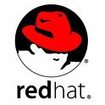

Dynamic IT Infrastructure & Dell AIM
Typical data center infrastructure is divided into 3 technology silos – servers, network, storage
Each silo is managed by specific set of tools supplied by multiple vendors
Servers are immovably tied to specific server images. Change is complicated and requires manual cross-silo coordination
In a dynamic IT infrastructure, server images are disassociated from servers – making images mobile, and the servers re-purposable
Dell AIM automates cross-silo coordination and simplifies infrastructure moves, adds, and changes
Dell
AIM
Network
Mgmt
Server &
Virtualization
Mgmt
Storage
Mgmt
Server
Image
Mgmt
VM
VM
VM
Server
Images
Network
Servers
Storage
Notes:
Lets look at dynamic IT infrastructure and how Dell AIM fits within this dynamic environment.
The typical data center is divided into three technology silos Servers, Network and Storage. Each of these are operated by specific teams and possible venders using specific, if not multiple, management tools. This can and often does complicate the administration and growth of the datacenter environment.
Past strategies have included static data centers where server images (and the application workloads they support) are tied to the server that it has been installed , this is not true in a dynamic infrastructure enabled environment.
Data centers employing a dynamic strategy can apply and disassociate the images form servers that they have been pared providing scalability, failover, and maintenance opportunities not available to static environments. Server images are store on centralized storage Fiber Channel, iSCSI, or NFS and booted onto servers dynamically selected to optimally run the image by either automation software or by an operator. Network and storage resources must be appropriately provisioned for the selected host server before an image and applications can be associated and run. Coordination across each technology silo affecting the deployment must be automated to ensure efficiency within a dynamic datacenter environment.
Dell Infrastructure Manager (AIM) software coordinates the actions used to roll out servers and applications within the dynamic infrastructure on existing environment silos and hardware. Dell AIM operates within the “control plane” of your network, it does not affect the data path, existing server images and applications are not affected and will continue to provided unaffected service.

Slide 15
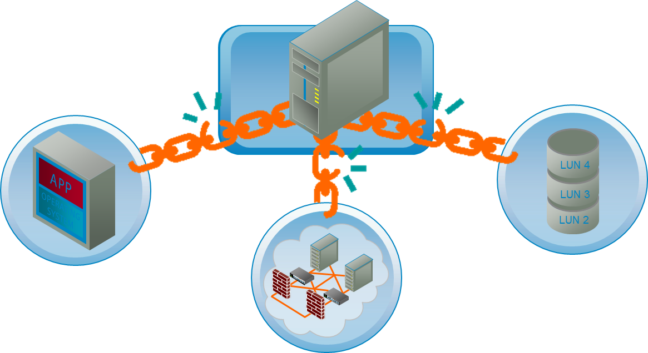
Unshackle Resources, Gain Agility
Dell AIM Technology
Rack Once, Cable Once; Reconfigure Repeatedly, Effortlessly, As Needed
Boot any software stack to any server
• Store images on central storage (iSCSI, NAS, SAN)
• Place on suitable virtual or physical machines, when needed
Provide any Storage (SAN, NAS) access
• Virtual WWN: Frees HBAs from physical identity
Power on & Provide any LAN Connectivity
• Virtual NICs free OS from NICs
• Virtual LANs free NICs from LANs
• IP address portability
Notes:
Server utilization directly affects cost of ownership, physical and virtual servers in a non dynamic environment are tied to, shackled so to speak to a single use scenario. The fundamental technical challenge that Dell AIM solves is this shackled scenario.
These servers are hard to repurpose, as they’re shackled by three aspects:
Software Stack: (operating system and application.)
Generally if a server is configured as a Windows 2003 / Exchange server, it stays that way. Virtualization hypervisors like Xen and VMware solve this… but add their own lock (the hypervisor itself, you can’t power off the machine and you do take a performance hit.
Dell AIM boots raw images from SAN, and runs them on bare metal, so we can power off and on machines, and take no performance hit. We work with physical or virtual machines.
2. LAN connectivity:
The server’s OS and applications have an IP address, and are configured to see and be seen by other servers and network resources. Reconfiguring these when you move the software stack to a new machine is resource intensive and can lead to missed configuration changes (yes, virtual machines suffer this problem)
Dell AIM moves the LAN context with the server.
3. Storage Access:
The HBA (or virtual HBA) is hard-bound to certain LUN segments on the storage network. The manual reconfiguration of possibly hundreds of storage access permissions every time you move a server or virtual machine (or, alternatively, configure every physical machine to have access to every storage resource can result in security and management implications and repercussions.
Dell AIM moves the storage context with the server.

Slide 16



Dell AIM in the Management Ecosystem
Dell AIM operates in the “control plane” of the data center
Dell AIM interfaces with infrastructure components using vendor supplied and supported APIs
Dell AIM offers an abstraction that unifies the management of multi-vendor infrastructure
Dell AIM offers scriptable CLI and convenient Web services for use by other management software
Dell AIM provides a browser-based graphical console with “drag-and-drop”, “point-and-click” simplicity
Dell AIM
Console
ORCHESTRATION
MONITORING
DELL INFRASTRUCTURE ABSTRACTION
DELL ADVANCED INFRASTRUCTURE MANAGER
Mgmt API
Mgmt API
Mgmt API
Mgmt API
Mgmt API
Blades & Servers
Hypervisors
Network Devices
Storage Devices
Operating Systems
Notes:
Dell AIM operates on the ‘Control Plane of the date center environment allowing the ability to route data correctly
Dell AIM interfaces with a wide range of infrastructure hardware and software using vendor supplied and supported APIs enabling live time configuration changes within the infrastructure.
Most types of equipment and software used within todays data centers are manufactured by one or more venders each with its own management API, the Dell AIM provides an abstraction that unifies the provisioning and management of the datacenter, simplifying management and lessoning the cost of administration.
Dell AIM comes with two forms of convenient access to the abstraction – a CLI for scripting, and Web services APIs. The use of these interfaces when running other management software in the data center, like orchestration or monitoring software, can increase their efficiency as well.
Personas are assigned to identified servers using the point and click capability of the Dell AIM browser based console , this interface also provides a unified management and configuration platform for datacenter network, storage, server equipment.

Slide 17
Technology
Automated Server Discovery & Inventory
Rapid Server Migration & Boot from FC or IP SAN
Dynamic Server Identity Management
AIM Technology Deployment

Slide 18
Automated Server Discovery & Inventory
Dell AIM facilitates manual discovery and inventory of existing servers and VMs
Dell AIM automatically discovers bare metal servers configured for network booting
Dell AIM creates a catalog of servers and their physical identities, hardware configuration, and network connectivity
Dell AIM displays the resource catalog via the Console, and makes it available through the APIs.
The operator may power off or on discovered servers and VMs using the Dell AIM Console or APIs.
4
Dell AIM
Console
Dell AIM
Controller
3
Router
2
L2 Switch
L2 Switch
Windows
VM
Linux
VM
Windows
Server
Bare
Metal
Server
Bare
Metal
Server
1
2
3
Storage
1
5
Notes:
Dell AIM automates discovery and inventory of infrastructure equipment. This includes server equipment such as blade chassis, blade servers, rack mount servers, virtualization hosts (hypervisors), virtual machines, and network equipment such as Ethernet switches integrated in blade chassis, and stand-alone top-of-the-rack ones. The details collected about these devices are automatically cataloged in the configuration repository (XML) and become instantly available for viewing.
Dell AIM provides two mechanisms for server discovery.
The first is manually initiated, and is intended for servers that are already operational in the infrastructure. This is also applicable for virtualization hosts that already exist and virtual machines that are already provisioned and running. In this case, discovery is initiated by running a tool, that Dell AIM supplies, on each of these systems. This tool, that can be run directly from a CD or a USB key, finds the Controller, inventories the server for all the information it needs, and passes it on to the Controller.
The second mechanism is initiated automatically by the Controller, and is used for bare-metal servers or virtual machines that are set to network boot. The Controller automatically boots these systems into a discovery image that inventories the server for all the information it needs, and passes it on to the Controller. Each time such a server boots, it is booted using the discovery image first. This way any changes to the server’s hardware (such as the addition of a NIC or the replacement of an HBA) are automatically captured and cataloged.
The Controller automatically saves the discovered information into a configuration database. The Controller also automatically locates the physical switch port to which a discovered is connected and saves that information as well.
The Controller uses the server’s serial number to uniquely identify it. It uses that information to tell the difference when a new server is being discovered versus when an existing one is being rediscovered.
The operator can view the catalog using the Console or the CLI. 3rd party applications can get access to it through the APIs.
The operator can now remotely power on or off the discovered servers using the Console or CLI. 3rd party applications can do the same using the APIs. Dell AIM uses remote management protocols, such as iLO, IPMI, and vendor-specific chassis management protocols, to remotely manage the power state of a server. After initial discovery, a server is powered off automatically until it is needed to run a server image.

Slide 19
Rapid Server Migration & Boot from FC or IP SAN
Migrate boot image and data from a server’s local disks to LUNs on IP or FC SAN
Boot a physical server directly from the image migrated to SAN
Boot a virtual machine directly from the image migrated to SAN
Copy the migrated image from SAN to a virtual disk, and boot a virtual machine from it
2
Target
Server
1
BOOT
3
Source
Server
Target
VM
MIGRATE
BOOT
Local Disks
COPY
Target
VM
4
BOOT
Virtual Disks
Notes:
The Dell AIM Migration Utility (SMU) rapidly migrates boot and data volumes from local disks on a source server to LUNs on a central storage device like iSCSI target or Fibre-Channel SAN. For volumes containing boot images, the migration utility automatically prepares them for SAN booting on any suitable physical server or virtual machine. Migrated images can also optionally be copied to hypervisor specific file system formats like VMware VMFS or Microsoft VHD. The key attributes of the migration utility are:
No change to your source image. There is no need to install any agent software in order to carry out the migration. Images are modified after the migration to central storage. Offline injection of necessary drivers is a very unique feature.
High speed copy – Block devices are copied using a file copy method leveraging multiple threads and eliminating unnecessary files/folders like recycle folder, swap file, internet downloads, etc…
No dependency on any additional infrastructure element and no conversion to any proprietary image formats.

Slide 20
Dynamic Server Identity Management
Dell AIM
Console
A logical server identity (virtual MAC, virtual WWN, IP) is assigned to a server image, instead of a server, and all required network connectivity is configured
Before booting the image, Dell AIM assigns the virtual WWN to selected server
Server uses the assigned virtual WWN to boot the server image
Dell AIM automatically configures the required VLANs on the switch port the server connects to
Dell AIM dynamically creates virtual network interfaces in the server image with assigned virtual MACs and IP addresses
Dell AIM
Controller
4
Router
L2 Switch
L2 Switch
Bare
Metal
Server
Windows
Server
Bare
Metal
Server
2
3
Storage
1
1
2
3
Windows
Server Image
Notes:
This is a high level overview on the steps taken to identify the server image in a dynamic environment.
In a Dell AIM environment, as servers identity is determined dynamically depending on the server image (Persona) that is booted on it. When a server image is assigned to a server, the Dell AIM controller assigns Virtual WWNs to the server’s HBAs if there is need to have FC SAN access. This virtual WWN is non-persistent, meaning that if the server image gets disassociated from the server, the server loses this identity. The Virtual WWN will enable the server to log into the SAN and get access to the appropriate boot LUN. After the server boots up, virtual network interfaces are configured with associated Virtual MACs and IP addresses. . Also, if needed, the network switch ports that are connected to the server are automatically configured for their VLAN membership.
A logical server identity (virtual MAC, virtual WWN, IP) is assigned to a server image, instead of a server, and all required network connectivity is configured.
Each physical and virtual machine are assigned an IP address during the PXE request and discovery, this I is used during this phase only. Once identified this IP is discarded unlike the IP assigned to the Persona which exists until the Persona is destroyed.
Before booting the image, Dell AIM assigns the virtual WWN to selected server
Server uses the assigned virtual WWN to boot the server image
Dell AIM automatically configures the required VLANs on the switch port the server connects to
Dell AIM dynamically creates virtual network interfaces in the server image with assigned virtual MACs and IP addresses

Slide 21
Deploying a Dell AIM Environment
Install Dell AIM Controller on a physical server or virtual machine
Optionally, install a redundant Controller
Identify existing servers, VMs, hypervisors to add to the Dell AIM environment
Identify network switches to add to the Dell AIM environment
Identify new bare-metal servers and configure them to network boot
Cable the new servers to networks and storage
Dell AIM
Console
2
Linux
Server
Dell AIM
Controller
Dell AIM
Controller
1
4
Router
5
L2 Switch
L2 Switch
Windows
VM
Linux
VM
Windows
Server
Bare
Metal
Server
Bare
Metal
Server
1
2
3
HYPERVISOR
Storage
6
3
Notes:
The Dell AIM deployment begins by installing the Controller.
Dell AIM Controller is software that is installed on a physical server or a virtual machine.
The Controller runs under Red Hat Linux operating system (RHEL 5.4) and requires Layer 3 connectivity to the servers and infrastructure equipment it manages.
The server on which the Controller is installed may be secured from unauthorized access using prevailing best practices.
(The Controller installation lab covers the configurations and steps needed when deploying your AIM Controller).
A second Controller can optionally be installed to provide redundancy (Best practice).
Shared access to the Dell AIM configuration repository must be made available to both Controllers.
The configuration repository is a set of XML files, and may be stored locally (in the case of a single Controller) or on a shared volume on the SAN. (These XML files are created after first PXE request and discovery, then applied to systems that have been identified and associated to a particular Persona)
Next steps require the operator to log in to the Controller through the Dell AIM Console. (http://localhost:80)
The Console provides a graphical view of the infrastructure and delivers “drag-and-drop” and “point-and-click” access to all of Dell AIM’s functions.
After being identified by Dell AIM existing physical servers, virtual machines, and virtual machine hosts (hypervisors) can be included as part of the dynamic infrastructure. There are two main considerations: (Ideally these should have been verified prior installation)
Ensure that the network permits the Controller to reach the physical servers and the virtualization hosts (SCN and system identification (IP).
Ensure the proper credentials are made available for the Controller to manage these servers remotely. (Accounts providing privileges needed to run specified tasks)
Next, identify the network switches that are to be included in the dynamic infrastructure.
Note that this is not a mandatory step. Dell AIM can manage servers without having to necessarily manage the switches they connect to. However, if you wish to include switches, it is important that the Dell AIM Controller can reach the management ports of the switches over the network, and the credentials for remotely managing these switches are made available.
Add the bare-metal servers that are to be included as part of the dynamic infrastructure.
Bare-metal servers have no operating system installed on them. In a dynamic infrastructure, these servers will operate disk-less, using disks on the SAN instead.
Rack the servers and set the on-board firmware (FW) to network boot.
Cable the bare-metal servers to the LAN and SAN, and power them on.

Slide 22
Gradual Rollout to Minimize Impact
Network
OS
Server Image Configuration Management
4
Server
Storage
Network
OS
Network Topology Management
3
Server
Storage
Network
OS
Server Identity Management & Centralized Booting
2
Server
Storage
Network
OS
Server Discovery & Remote Power Control
1
Server
Storage
Notes:
Dell AIM recognizes that any transformation of a data center must be done in a planned and careful manner. The responsibility for data center management, at least in large organizations, is distributed among multiple groups, typically along the lines of the 4 silos – server, storage, networks, and operating systems/applications.
Dell AIM provides a methodology for gradual transformation of a data center from static to dynamic. This method is designed to make the transformation more manageable, particularly in so-called “brown-field” environments, where existing operational policies must be respected – IP address administration, network access restrictions, storage security, service level requirements etc.
This methodology begins with the server silo. Ultimately, the requirements for a dynamic IT infrastructure is driven by this silo. Dell AIM provides mechanisms for deploying a Dell AIM environment and cataloging servers that is completely non-intrusive.
Centralized booting is mandatory for creating a dynamic infrastructure. Dell AIM again provides tools and methodologies for migrating existing workloads to central storage and gradually transitioning from local booting to centralized booting.
The next step in this process, is cross silo coordination, particularly between the server and network silos. Dell AIM supports multiple modes of network management (read-only, fully managed, shared vs dedicated control etc.) that allow the network administrators more control over the pace of and the extent to which network changes are automated as a result of dynamic server repurposing.
The final step, automating server image configuration and integration with other management software in the eco system through Dell AIM provided abstraction and APIs, completes the transformation.

Slide 23
Features & Functions
Centralizes end-to-end provisioning
Integrates virtualization management
Unifies management of infrastructure resources
Automates high availability
Enables gradual transformation to a dynamic infrastructure
Notes:
The features and functions offered by Dell AIM are as follows:
Dell AIM centralizes the provisioning of servers, and their connectivity to LAN and SAN. Provisioning includes server discovery, server identity management, server booting, network and storage access configuration, and server image configuration. The end goal is a fully operational application or workload with access to the right network and storage elements, no matter which server it runs on or where that server is located in the physical topology of the data center.
Dell AIM integrates virtualization management. Virtualization is deployed in almost all data centers today, but it exists typically in isolated islands. The management of virtualized infrastructure is often handled differently than the physical infrastructure. Dell AIM integrates these environments, from a management and operations point of view. The abstraction it provides applies to virtualized infrastructures in the same way as it does to the physical infrastructure.
Dell AIM unifies the management of infrastructure equipment. As mentioned before, data centers have a variety of makes and models of equipment, even in the same category. Managing them using existing tools can be burdensome and inefficient. By unifying all manners of equipment under a single abstraction and data model, Dell AIM delivers a dramatic boost to the efficiency of your data center operations.
Dell AIM automates high availability for all servers in the data center. Servers that fit the requirements of specific Personas are available to these personas as needed. If a server that is assigned to a Persona requires maintenance or fails the Persona is dynamically brought back on line by the administrator performing the maintenance cycle or through AIM automation.
Finally, any infrastructure transformation project is a daunting one, to say the least. Anticipating this, Dell AIM facilitates gradual transformation – literally one silo at a time. It is designed for “brown field” environments in addition to the so-called “green field” ones. (Discussed in a later slide.)

Slide 24
Centralized End-to-End Provisioning
Automate server discovery and inventory
Migrate server image from local disks to central storage
Boot server from central storage
Dynamically change a server’s identity
  MAC address
  IP address
  WWN
Automate the provisioning of network connectivity
Automate server image configuration
  Operating system
  Applications/workload
Notes:
The goal of automated discovery and inventory is to eliminate the labor and tedium associated with adding new resources to the infrastructure, keeping track of upgrades to existing resources, and keeping track of movement of resources from one part of the infrastructure to another.
Dell AIM automates server discovery and inventory
All critical physical attributes of a server, such as CPU, NICs, and HBAs, and critical identities of the server, such as MAC addresses of NICs, WWNs of HBAs are automatically discovered and cataloged by Dell AIM. (These can be viewed through the AIM console)
Dell AIM also discovers the physical connections a server has to the network
In other words, it automatically figures out which physical port on which physical switch each NIC on a server is connected to. This critical piece of information allows Dell AIM to correctly co-ordinate changes to the network configuration when servers are repurposed to run different server images requiring access to different networks. (Managed switches coordinated with the AIM Persona)
The main goal of centralized provisioning is to instantly repurpose a server. In other words, a server can be dynamically reassigned to a different task – one that requires a different operating system, different set of applications, different network connectivity and different storage access. Another way to look at the repurposing is from the server image or application point of view. The goal is to allow the same server image to be instantly retargeted to a different server, possibly even a virtual machine, located in a different rack, and connected to a different network switch.
In both cases, the key requirements for server repurposing are:
A server’s identity, as far as network and storage go, can be changed dynamically, and is determined based on the server image targeted to run on it. The physical identity of the server is ignored, for all practical purposes. This allows the server image to move from server to server, and still use the same IP address, MAC address, and WWN.
A server’s network connectivity and storage access needs to be changed dynamically, so any server image targeted to run it can operate correctly. This may require changes to the network infrastructure that need to match the connectivity needs of the server image.

Slide 25
Centralized End-to-End Provisioning
Dell AIM
Console
Dell AIM copies server images from local disk and prepares them for booting from central storage (SMU utility)
Dell AIM dynamically assigns each server the LAN and SAN identity associated with the image assigned to boot on it
Dell AIM dynamically boots a server or VM from images on central storage
Dell AIM automatically configures network, storage and other devices to meet the requirements of the image
Dell AIM automates server image configuration after it is booted
Dell AIM
Controller
Router
4
L2 Switch
L2 Switch
2
Windows
VM
Linux
VM
Windows
Server
Bare
Metal
Server
Bare
Metal
Server
1
2
3
5
3
Dell AIM
Migration
Tool
Storage
1
2
3
3
1
Notes:
The first task in setting up centralized provisioning is to create server images on central storage, such as a FC-SAN array, an iSCSI target, or a NAS device. There are two critical steps:
One, to copy the server image from a local disk attached to a server to a volume on a storage device attached to a network.
Two, to enable the server to boot the copied image directly from central storage.
The second step invariably requires installing additional software (drivers) in the server image and configuring the server image appropriately. Dell AIM provides server migration tools that achieve both these steps easily and efficiently. The Server Migration Utility prepares a designated volume on central storage, copies the contents of the local disk to that volume, automatically injects/installs the drivers necessary for a physical server or a virtual machine to boot from that volume, and configures the image for booting from central storage. All of this is done without modifying the contents of the local disk in any manner.
Another critical requirement is dynamically managing server identity. This is required at each of the three stages of booting a server: pre-boot, during boot, and after OS booting is completed. In the pre-boot stage, Dell AIM dynamically assigns the correct identity to the server so it can have visibility and access to the boot LUN associated with the server image on the SAN. During booting, the server uses the dynamically assigned identity on the SAN, ignoring any physical identity that may already be present. Once the booting is complete, and before any applications can start, Dell AIM configured the OS with the correct number of interfaces on the appropriate physical NICs, virtual MAC addresses on those interfaces, and IP addresses that match the requirements of the server image. Dell AIM automates this entire sequence, using configuration data that is stored in the configuration data base corresponding to each server image. Server’s identity, as assigned by Dell AIM, is non-persistent: when the server image is no longer running on a server, the server reverts back to its physical identities.
Further, in order to complete the LAN connectivity for the server image, the physical switch ports to which the server is connected must be configured to allow the VLANs corresponding to those LANs. Using the previously discovered information about the physical connectivity of a server, Dell AIM automatically configures switch ports to match the LAN connectivity requirements of the server image.
Finally, there may be requirements to configure other devices in the infrastructure or even applications in the server image in specific ways to complete the provisioning process. Dell AIM provides convenient extensions that an administrator can take advantage of to program these additional provisioning steps through customized scripts or applications.

Slide 26
Integrated Virtualization Management
Instantly provision a server for use as a hypervisor or virtualization host
Automatically discover and inventory virtual machines
Use the same server image to boot a physical server or a virtual machine
Integrate/interoperate with virtualization management systems
Notes:
In addition to supporting the centralized booting of bare-metal servers into operating systems such as Windows and Linux, Dell AIM also boots hypervisor stacks or virtualization host operating systems from central storage. For example, VMware ESX, Microsoft Hyper-V, or Red Hat Xen. This provides great flexibility to the operator who can now dynamically dial-up or down the number servers that are part of virtualized environments. He can also use a common pool of server resources to share between different clusters within virtualized environments, or environments using different virtualization technologies.
A strategic goal for all data centers is to extend the same management paradigm they currently use for bare-metal servers to also include virtual resources. Also important is the requirement to blur the line between these two environments, bringing not only flexible resource sharing among them, but also workload mobility.
By integrating management of virtualized resources and enabling the same server image to move between physical and virtual resources, Dell AIM brings data centers much closer to achieving their strategic goals than they have ever been.

Slide 27
Integrated Virtualization Management
Dell AIM
Console
Dell AIM automatically discovers existing hypervisors and any VMs already configured on them
Dell AIM repurposes any bare metal server into a virtualization host by booting a hypervisor image from central storage
Dell AIM dynamically boots a VM from an image on central storage
Dell AIM dynamically boots the same image on a bare metal server
Dell AIM interfaces directly with the hypervisor to manage VMs
Dell AIM adapts automatically to changes made by virtualization management software
Dell AIM
Controller
Virt
Mgmt
SW
6
Router
L2 Switch
L2 Switch
5
VM
Bare
Metal
Server
VM
Bare
Metal
Server
VM
HYPERVISOR
HYPERVISOR
1
4
1
Storage
3
4
5
6
2
Notes:
Dell AIM automatically discovers a virtualization host, and all the virtual machines that are configured on that host. The discovery process used is exactly the same as the one used for physical servers. Dell AIM boots a virtualization host operating system on to a bare-metal server, again using the same techniques for identity management and centralized booting described before.
Virtual machines may be configured to network boot or boot from virtual disks natively supported by the host hypervisor.
Dell AIM repurposes virtual machines and boots them directly using images stored on standard central storage devices, such as NFS or iSCSI, or using images that are stored on centralized storage or formats that is proprietary to virtualization technology vendors, such as VMware VMDK or Raw Devices, and Microsoft Hyper-V VHDs or Pass-through disks.
An operator may use the same server image for booting either a physical server or a virtual machine. This provides additional flexibility for optimal resource management. Dell AIM makes this so-called P2V or V2P migration of server images instantaneous i.e. no conversion required between each transition. Dell AIM provides migration tools to prepare images, either at the time they are created for the first time, or even at a later stage, for this type of migration. Once an image is prepared this way, no additional conversion is required between transitions.
Dell AIM automatically adjusts to changes made to virtualization hosts (such as addition of a VM, deletion of a VM, migration of a VM from one to another) by other management systems, including those supplied by virtualization vendors themselves. Likewise, any change initiated to virtualized environments through Dell AIM can be tracked on those management systems.

Slide 28
Unified Management of Resources
Unify provisioning of blades, servers, network switches, storage devices, and hypervisors from multiple vendors
Unify provisioning of virtual machines and physical servers
Unify provisioning of Linux and Windows based server images
Provide a common abstraction for simpler management of data center resources
Provide APIs for convenient access to the abstraction
Notes:
The data center abstraction delivered by Dell AIM effectively unifies the management of a data center infrastructure that is potentially heterogeneous in each and every silo. It dramatically reduces the inherent cost and complexity associated with training IT personnel to become proficient in managing such an environment. Invariably, there will be changes to the infrastructure – major ones as new vendors may be chosen to supply certain components, or minor ones as current vendors introduce newer wares. The abstraction insulates higher order management software from these perturbations.

Slide 29
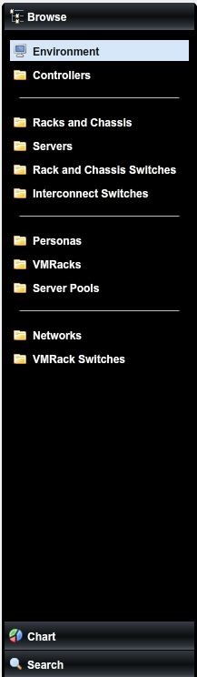
Unified Management of Resources
Integrated
Switches
Rack and Cassis Servers
Dell
Cisco
Nortel
Dell
HP
IBM
Unisys
Top of rack
Switches
Blade Servers
Dell
Cisco
Foundry
HP
Disk-booted
NFS booted
FC-SAN booted
iSCSI booted
Hypervisor
Virtual Machines
VMware
Microsoft
Red Hat
vDisk-booted
NFS booted
FC-SAN booted
iSCSI booted
Notes:
Resources shown within the physical view or Dell AIM
Interconnect switches: used to connect switches to switches. (generally to other parts of the customers environment)
Blade chassis: depicts the physical blade chassis
Blade servers: depicts physical blade server resources
Rack switches: depicts physical switch resources
Virtual rack: depicts virtual rack
Rack servers: depicts physical rack mount server resources
Hypervisor: Depicts a hypervisor managed ‘bare metal’ server and hosted virtual machines
Virtual machines: virtual machines hosted by a Hypervisor managed server
Interconnect switches

Slide 30
Automated High Availability
Protect all servers against failures
Typical distribution of servers by class of service:
  Mission critical: 20%
  Business critical: 70%
  Non-critical: 10%
Use common pools of servers for spares
Quarantine servers that fail repeatedly for maintenance
Notes:
High availability of a server or service comes at a price. That’s why, today, most data centers group their services into 3 classes based on their criticality to the business operations.
The highest tier is reserved for mission critical services that need to operate 24x7 and be continuously available. This class of services typically represents 5 -15% of the servers in the infrastructure.
The next tier is reserved for services that are business critical – which means that service levels may degrade only for short periods of times, usually minutes. This class of service typically represents 70-80% of the servers in the infrastructure.
The last tier is comprised of services that can sustain considerable downtimes – hours and sometimes even days. Dell AIM delivers cost effective high availability for the middle tier.
By allowing the use of common pool of spares to service the high availability needs of multiple servers, and by enabling the fail-over of server images from physical servers to virtual machines without extended downtime, Dell AIM:
Dramatically reduces the cost and complexity of maintaining service levels for business critical applications.
Improves IT productivity
Improves time-to-repair and recovery

Slide 31
Automated High Availability
Dell AIM
Console
Dell AIM creates pools of servers (ex. based on capability, hardware compatibility, type of virtual machine)
Dell AIM creates assignment rules for a server image targeting one or more server pools, in order of preference
Dell AIM automatically monitors health of server
Upon failure of server, Dell AIM automatically re-assigns server image to alternative server. The new server is assigned the logical server identity – virtual MAC, virtual WWN and IP – of the server image. Network configuration is changed automatically.
Dell AIM automatically takes servers that fail repeatedly out of use
Linux
Server
Dell AIM
Controller
3
Router
5
L2 Switch
4
L2 Switch
Spare
VM
Windows
VM
Spare
Server
Windows
Server
Linux
Server
Windows
Server
Windows
Server
X
Server
Pool A
Server
Pool B
1
Storage
2
1
2
3
Notes:
Dell AIM’s automatic high availability operates in the following manner:
The operator constrains the selection of alternative servers by creating pools of resources and creating assignment rules for each server image.
Dell AIM automatically detects when a server or server image has failed and automatically identifies an alternative server (physical server or virtual server) for booting the same server image, based on the rules created by the operator.
Dell AIM automatically assigns the server identity required for the server image to the newly assigned server and restores all network connectivity required for the server image.
If a server or server image repeatedly fail to boot, Dell AIM automatically places the server or server image into maintenance mode, effectively taking them out of service until an operator restores their operational state.

Slide 32
Summary
Dell AIM is management software for a dynamic IT infrastructure
Dell AIM works within the existing infrastructure and cabling
Dell AIM operates in the control plane without affecting workload performance
Dell AIM makes the data center easier to provision and simpler to change by:
  Centralizing end-to-end provisioning
  Integrating virtualization management
  Unifying management of infrastructure resources
  Automating high availability
  Enabling gradual transformation of infrastructure

Slide 33
Thank you
Continue to the next module

Slide 34
Dell AIM Training
Dell AIM 3.4 Refresher

Slide 35
Objective
Dell AIM 3.4 is a major release in the AIM product line, this module introduces you to the changes and new features of this release.

Slide 36
Topics
What’s new in AIM 3.4
Network changes
AIM Controller OVF for VMware
Software licensing changes
User Interface Changes (Console)
The major parts of the AIM Console
CLI command changes

Slide 37
What’s new in AIM version 3.4
Some of the changes in AIM 3.4 are:
Web Services API Changes
Support for Juniper Networks Switches
Support for Edge Network Devices
Automatic Configuration of Physical NIC Parameters
Automatic Management of VMware Standard Switch Configuration
Red Hat Linux Enterprise 5 Booting with Broadcom Extreme II
VMware ESX Booting with Broadcom Extreme II
Virtual World-Wide Port Name Support for Brocade HBAs and CNAs
Controller Software Installation Directory Changes
Notes:
Web Services API Changes
Networking Changes
The way you work with virtual networks has changed in this release of Dell AIM:
•Virtual switches (vSwitches) are replaced by networks.
•Virtual NICs (vNICs) are replaced by network connections.
Support for Juniper Networks Switches – Juniper Switched have been certified and are now supported
Support for Edge Network Devices – Edge Network Devices are now supported
Automatic Configuration of Physical NIC Parameters
Automatic Management of VMware Standard Switch Configuration
Red Hat Linux Enterprise 5 Booting with Broadcom Extreme II
VMware ESX Booting with Broadcom Extreme II
Virtual World-Wide Port Name Support for Brocade HBAs and CNAs
Controller Software Installation Directory Changes

Slide 38
Networking Changes
Virtual network changes in the 3.4 release of Dell AIM are:
  Virtual switches (vSwitches) are replaced by networks
  Virtual NICs (vNICs) are replaced by network connections
These changes are not only how we see these objects within AIM but the terminology towards what we call these objects
Notes:
Virtual network changes in the 3.4 release of Dell AIM are:
Virtual switches (vSwitches) are replaced by networks
Virtual NICs (vNICs) are replaced by network connections
Virtual switches and virtual NICs are also added into the AIM network environment through the command line.

Slide 39
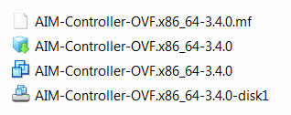
AIM Controller OVF for VMware
The AIM Controller is available as a VMware Virtual (OVF) Appliance can not be deployed as a replication set
AIM 3.4 media ships with a Centos OS based OVF appliance AIM controller. This appliance can not be deployed as a replication set and it is recommended to limit the use of this appliance to small or lab deployments only.
The .ovf consists of:
Notes:
AIM Controller OVF for VMware
The AIM Controller is available as a VMware Virtual (OVF) Appliance can not be deployed as a replication set
AIM 3.4 media ships with a Centos OS based OVF appliance AIM controller. This appliance can not be deployed as a replication set and it is recommended to limit the use of this appliance to small or lab deployments only.

Slide 40
Software Licensing Changes
Dell AIM 3.4 uses an activation code that allows for more granular control over aspects of the product license, such as:
  The number of sockets licensed
  Specific product feature enablement
An activation code can increase, decrease, activate, or deactivate one or more of the license’s aspects
Licenses are installed and updated in the same way as in the prior AIM releases
File path change from previous version:
  /opt/dell/aim/var/license
Notes:
Dell AIM 3.4 uses an activation code that allows for more granular control over aspects of the product license, such as:
The number of sockets licensed
Specific product feature enablement
An activation code can increase, decrease, activate, or deactivate one or more of the license’s aspects.
Software Licensing Changes
Licenses are installed and updated in the same way as in the prior AIM releases,
Begin installing a new or updated license file on a USB key, CD, or other location that you can reach from the Controller.
Log into the active Controller as the root user.
Change to the /opt/dell/aim/var/license directory.
If you have an existing license file, make a copy of it with a different name.
For example, you could create a copy with the current date in place of date:|
# mv license.dat license.date.bak
Copy the new or updated license file into the /opt/dell/aim/var/license directory.|
If you have a pair of resilient Controllers, this directory is on their shared file system, so copying the license file to this location on the active Controller makes it available to both Controllers.
If necessary, change the name of the new license file to license.dat
The Dell AIM Controller periodically checks the time stamp on the file and reloads the license if it has been updated, so no additional actions are required.

Slide 41
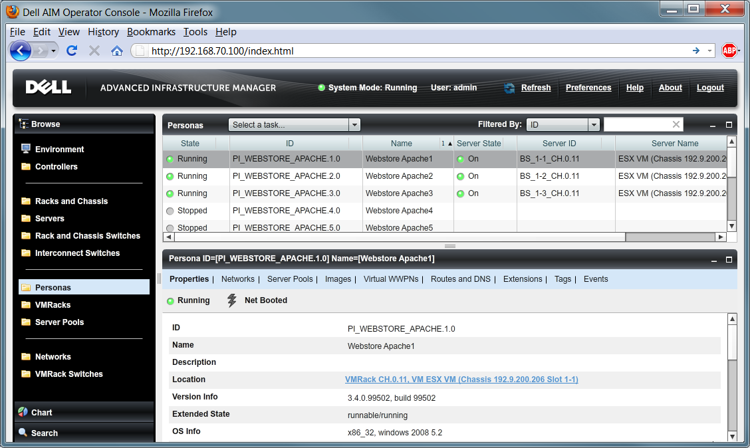
User Interface Changes
The Console (formerly the Operator Console) has been enhanced to provide key functionality for both administrators and operators that was formerly available in the Administrator Console.

Slide 42
Major parts of the AIM 3.4 Console
Current User
Display Refresh
Auto-Refresh
Documentation
System Status
Tasks
Navigation Pane
Element Types
Catalog
Element details
Workspace
Column Headings
Dropdown filter

Slide 43
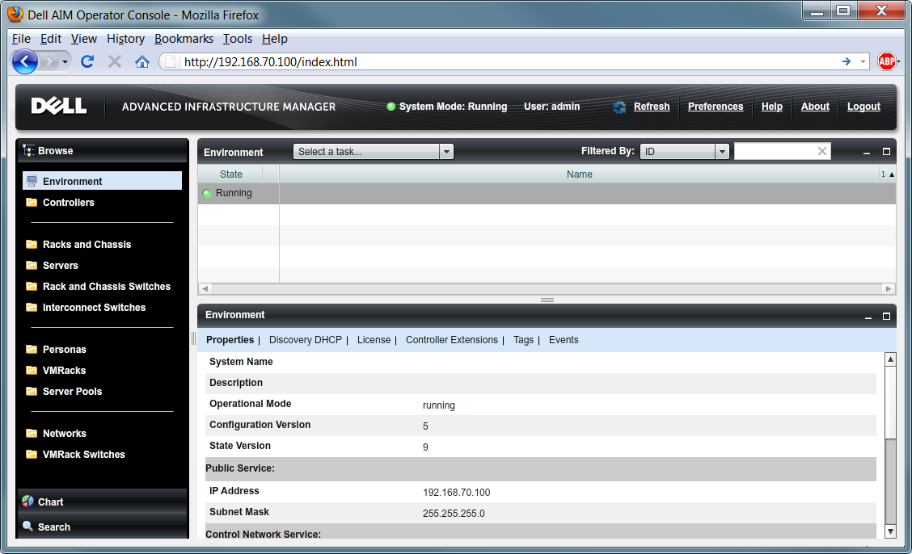
AIM 3.4 Console – Controller Properties
This screenshot depicts the status and properties of the AIM Controller.
  State -Operational Mode -Configuration Version -State Version
  Public Service information – Control Network Service information
Navigation Panel > Environment > Properties tab

Slide 44
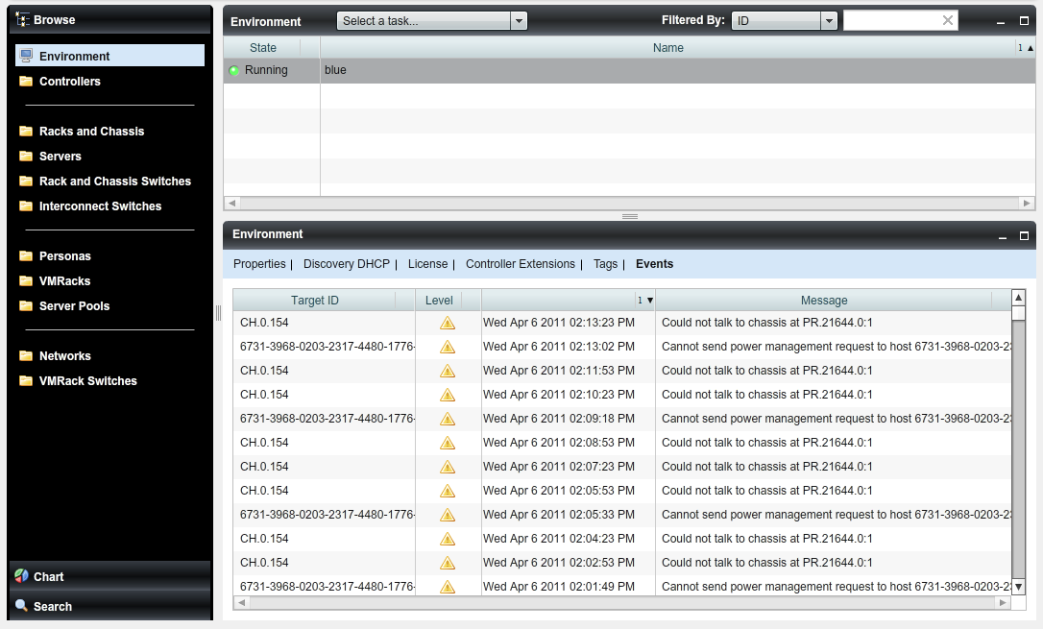
AIM 3.4 Console – Environment Events
This screenshot depicts the Current Events of Chassis CH.0.154. The number of events displayed is the last hundred events recorded in the Controller’s event log.
Navigation pane > Environment > Events tab

Slide 45
AIM 3.4 Console – Persona Properties
This screenshot depicts the list of Personas assigned to a ESX VM (Chassis) and the properties of Persona PI_Webstore_Apache.1.0 on Server BS_1-1_CH.0.11. Also included is the physical location and Operation System information.
Navigation Panel > Personas > Properties tab

Slide 46
Changes to CLI Commands - New Commands
ADD | ASSIGN | CABLE | LIST | REMOVE | UNASSIGN
add admin role | assign ip address to network connection | cable network to external network | list networks | remove network from role | unassign ip address from network connection
add license activation code | assign network to role | cable switch to external network | list roles | remove role | unassign network from role
add network | assign server pool to role | cable switch to switch | list system info | remove server pool from role | unassign server pool from role
add operator role | assign role to user |  | list users | remove user
add user |  |  | list vmrack switch bond bridges | remove user from role | UPDATE
 |  |  | list vmrack switch port groups |  | update network
Enable | Disable |  | list vmrack switches |  | update role
enable user | disable user |  | list vswitches |  | update user

Slide 47
Changes to CLI Commands - Deprecated Commands
Commands relating to Layout View in the Administrator Console (used in releases prior to this one) are being deprecated. These include:
layout [cable | external network | persona | rack | switch | vmrack | vswitch ]
list all layout
list external network layout
list icons
list layout
list [persona | rack | switch | vmrack | vswitch ] layout
Commands relating to virtual NICs (vNICs) that have been deprecated include:
add vnic to [persona | vmrack]
Review the list of changed commands listed in the Dell AIM 3.4 Release notes.

Slide 48
Support Changes
Support has been added for:
Juniper Networks Switches
Edge Network Devices
Virtual World-Wide Port Name Support for Brocade HBAs and CNAs
Additional Hardware and Software
  see the Dell AIM 3. 4 Hardware/Software Compatibility Matrix for current list of hardware, software and firmware supported by Dell AIM.

Slide 49
Dell AIM Logs Tags
Dell AIM processes use tools from the Apache log4j project to manage how log files are created. Logged events are tagged with labels of severity in descending order:
FATAL
ERROR
WARN
INFO
DEBUG
TRACE – used for debugging

Slide 50
Log file sizing
On Controllers, the /opt/dell/aim/var/etc/log4j.controller.xml file controls how Dell AIM processes write information to logs, how large to permit logs to grow before rolling them over, and so on.
On Linux personas and Xen VMRacks, this file is: /opt/dell/aim/var/etc/log4j.xml.
On Windows personas, this file is
C:\Program Files\Dell\AIM\persona\etc\log4j.xml.

Slide 51
Example: Changing the Maximum File Size
To change the maximum file size or maximum number of retained files for the events.log file, change the values of MaxFileSize or MaxBackupIndex in the following section:
  <appender name="MESSAGES" class="org.apache.log4j.RollingFileAppender">
  <param name="Threshold" value="info"/>
  <param name="File" value="/opt/dell/aim/var/log/messages.log"/>
  <param name="MaxFileSize" value="1MB"/>
  <param name="MaxBackupIndex" value="3"/>
  <layout class="org.apache.log4j.PatternLayout">
  <param name="ConversionPattern" value="%d [%t] %-5p %c %x - %m%n"
/>
  </layout>
  </appender>

Slide 52
Files in /opt/dell/aim/var/log
This directory contains a number of diagnostic and event log files.
Error.log - records events of ERROR and FATAL level.
Events.log - records events intended for Dell operators
Messages.log - records Dell AIM process events of INFO severity and higher
Verbose.log - records Dell AIM process events of DEBUG severity and higher
Note: It is recommended to monitor the log and related files in /opt/dell/aim/var/log to ensure that they do not consume too much space on the server’s hard disk

Slide 53
Windows Persona Logs
The persona logs on the Windows personas and VMRacks are stored in the following folder:
%USERPROFILE%\Documents\Dell\AIM\Persona\log\ where the %USERPROFILE% is the data folder of the user who performed the agent installation and is C:\Users\userName\ on Windows 2008
or C:\Documents and Settings\userName\ on Windows 2003.

Slide 54
AIM File Path Changes from 3.3.x to 3.4
The file path and naming convention of the AIM directories has changed in AIM 3.4
DELL AIM 3.3.x | DELL AIM 3.4
/var/opt/scalent | /opt/dell/aim
/var/opt/scalent/license | /opt/dell/aim/license
/var/opt/scalent/shared | /opt/dell/aim/shared
/var/opt/scalent/tftpboot | /opt/dell/aim/var/tftpboot
/var/opt/scalent/etc | /opt/dell/aim/var/etc/

Slide 55
Additional File paths
Installation Log
#/var/log/dell/aim-install/dell_im_installController.log
INFO-level in the verbose log
#/opt/dell/aim/var/log/verbose.log
Dell AIM installation shell
# /opt/dell/aim/bin/setupController.sh
Diagnostic data collection script
# /opt/dell/aim/bin/collect.sh
LDAP configuration
# /opt/dell/aim/smc/conf/jetty-jaas.conf
Secure Sockets Layer configuration
# /opt/dell/aim/var/etc/controller.properties

Slide 56
Thank you
Continue to the next module

Slide 57
Dell AIM Training
AIM Essentials Overview

Slide 58
Objective
The primary objective of creating an AIM Essentials edition is to lower the barriers of adoption of AIM. One of the biggest barriers has been the large consulting services cost involved in deploying AIM. By creating the Essentials edition, the goal is to reduce the amount of consulting services required for initial deployment as well as lower the entry price point and make it attractive for customers across segments to adopt AIM.
The purpose for this training presentation is to better prepare your understanding of the AIM Essentials product program and your ability to discuss and work with this product offering.

Slide 59
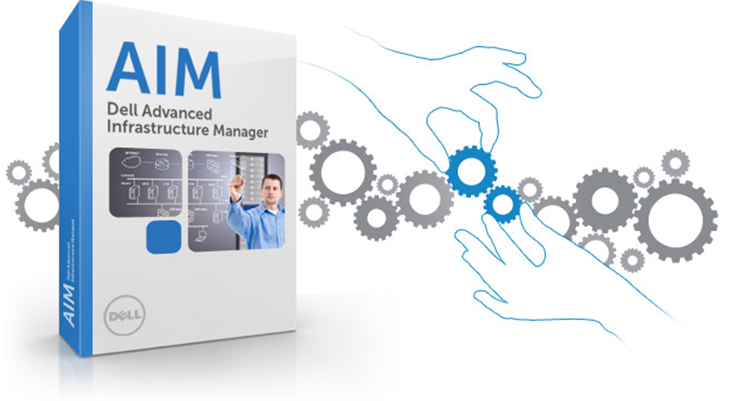
Topics
What’s New with AIM
Marketing AIM Essentials
AIM Essentials Support Matric
A Closer look at the AIM Essentials 3.4.2 Platform
Upgrading AIM Essentials
How do Services and Support work with AIM Essentials?
Self-paced Labs for AIM Essentials

Slide 60
What’s New with AIM
What is AIM Essentials?
How is the AIM Environment different?
AIM Essentials Features
Basic Functionality
AIM Essentials vs. AIM Enterprise - At a Glance
No Mixed AIM Environments

Slide 61
What is AIM Essentials?
AIM Essentials is being rolled as part of the ‘AIM Expansion’ initiative targeted at accelerating the sales and deployment of AIM.
The key objective of this program is to market a starter edition of AIM called ‘AIM Essentials’. This release features a subset of the current AIM product’s capabilities offered at a lower price point.
The primary use case for AIM Essentials is server failover or HA.
AIM Essentials provides a rapid server repurposing solution for development and test environments.
AIM Essentials customers are given a seamless upgrade path to AIM Enterprise which will support heterogeneous infrastructure, support for heterogeneity is the core competitive differentiator for AIM.
Notes:
The primary use case for AIM Essentials is server failover or HA.
The failover process will not be fully automated meaning that the workload will get retargeted to another server. However, if there is a need to carry out any network reconfiguration, it needs to be done manually.
Side note:
We are currently seriously challenged during our AIM sales campaigns. Sales cycles are very long (6 to 9 months) and the resulting sale is almost always a starter configuration. ‘AIM Essentials’ is targeted at lowering the barriers for sale and hence shorten the sales cycle for the initial sale. The primary buyer of Dell AIM is the server administrator This prompts the need to provide training/certification to the Customer.

Slide 62
How is the AIM Environment different?
AIM Essentials will only be integrated into Dell only Greenfield deployments
  Only Dell equipment can be used in these implementations of AIM
No Managed Switches
  Requiring manual configuration with some persona migrations
iSCSI and Local Disc ONLY
  Fiber Channel SAN is not supported in AIM Essentials
No AIM CLI
  All configurations need to take place on the AIM Console UI
  No command line level configurations
  Troubleshooting needs to be performed at the UI and Log file level
No redundant Controller integrations
  AIM Controller .ovf VM are not supported as redundant DR Controller pairs
  AIM Essential Controllers are limited to the AIM-Controller-OVF.x86-64-3.4.2.ovf only
Limited Function set
  Discussed within User Experience segment of this training

Slide 63
AIM Essentials Feature Set
‘AIM Essentials’ features are a subset of functions that is currently available in the AIM standalone product. The these features are:
Server Discovery – this is limited to Dell Servers only
Network Switch Discovery – limited to Dell PowerConnect only AIM Essentials’, switches can be discovered in a ‘Read-Only’ mode.
Personas - AIM Essentials’ allows the users to create ‘iSCSI booted’ and ‘local disk booted’ personas ONLY. VMDK and VHD images are also supported.
NIC Operation modes - NICs on the discovered servers operate in Access mode only. The Dell AIM Virtual NICs functionality is disabled, and the VLAN driver is not installed on the persona images.
AIM CLI – Is disabled in ‘AIM Essentials’
Web Service APIs – Limited to the AIM Console and any other Dell published programs that are bundled with the product distribution.
Extensions - Both Persona and Controller Extensions are disabled in ‘AIM Essentials’.
Notes:
‘AIM Essentials’ features are a subset of functions that is currently available in the AIM standalone product. The these features are:
Server Discovery – The discovery programs (including Standalone Discovery) has been enhanced to allow only the discovery of Dell servers only. As and when a discovery of a non-Dell server is attempted, an appropriate error message is displayed and logged. The servers to be discovered can be physically cabled to network switches that are not managed by ‘AIM Essentials’ or that have been discovered as ‘Read Only’ switches. The Dell servers are discovered and managed are governed by the AIM support Matrix.
Network Switch Discovery – ‘AIM Essentials’ does not have the ability to configure network switch ports. However, the switches can be discovered in a ‘Read-Only’ mode.
Note: ‘AIM Essentials 1.0’ supports Dell PowerConnect switches ONLY.
Persona Boot Type -
‘AIM Essentials’ allows the users to create ‘iSCSI booted’ and ‘local disk booted’ personas ONLY.
As part of the support of ‘local disk booted’ personas, VMDK and VHD images are supported in ‘AIM Essentials’. All other boot types should be disabled.
iSCSI booting includes software and hardware iSCSI booting options.
NIC Operating Modes - The NICs on the discovered servers operate in Access mode only. Consequently, the Dell AIM Virtual NICs functionality is disabled. The VLAN driver is not installed in the persona images.
AIM CLI - The CLI (Command Line Interface) is disabled in ‘AIM Essentials’. All the functions that users perform in the ‘AIM Essentials’ edition are available in the AIM GUI console.
Web Services APIs – Access to Web Services APIs should be disabled with the exception of the AIM Console and any other Dell published programs that are bundled with the product distribution.
Extensions – Both Persona and Controller Extensions are disabled in ‘AIM Essentials’.
There will be no restriction on the supported OS and Hypervisors with the exception of RHEL Xen.

Slide 64
AIM Essentials - Basic Functionality
Dell AIM Essentials has a subset of functions that is inherits from the AIM Enterprise code that it shares. Essentials functionality is simplified by the AIM Essentials license that changes the UI and functions by modifying the license controlled schema.
AIM Essentials
Functions | Persona Operations:
Logging in and verifying the license | Add/ Update a Persona
Entitlement | Start and Stop the Persona
Adding a Dell M1000 Chassis to AIM | Delete the persona
Adding a Network Switch to AIM | VMRack Operations:
Physical Server Discovery | Discover a disk booted VMRack
Virtual Machine Discovery | Add/Update a VMRack
Adding and Managing Server Pool | Stop a Vmrack
 | Delete a VMrack

Slide 65
AIM Essentials vs. AIM Enterprise - At a Glance
 | AIM Essentials | AIM Enterprise
Server Support | Dell Blade and Rack servers ONLY | Dell and non-Dell Blade and rack servers
Network Switch Configuration Modes | Unmanaged, Read-Only | Unmanaged, Read-only, Read-Write
Switch support | Dell and non-Dell switches for unmanaged mode; Dell Switches for Read-Only mode | Dell and non-Dell switches
NIC Configuration Modes | Access Mode only | Access and Trunk Mode
Boot Method support | iSCSI, local disk (including VHD and VMDK) | NFS, iSCSI, FC-SAN, FCoE, local disk
Scalability | Limited to 32 servers (or 64 sockets) | No imposed limits
Controller Deployment | Only as OVF Virtual Appliance | Choice of Virtual Appliance or Physical servers
Controller Resiliency | Not Available. Other HA options like VMware HA or FT may be used. | Available using the built-in support. Controllers need to be deployed on physical servers
CLI | Not available | Full Access
Web Services APIs | Not Available | Full access
Workload specific configuration | Not Available | Available thru Persona Extensions

Slide 66
No Mixed AIM Environments
In a given environment, there cannot be a combination of ‘AIM Essentials’ and ‘AIM Enterprise’. There are a number of inflection points that will force customers of ‘AIM Essentials’ to upgrade to ‘AIM Enterprise’.
These are :
  The customer’s desire to have ability to fully manage all the network switches in the AIM environment.
  Need to include non-Dell servers in the AIM environment
  Need to integrate with the 3rd party tools. To include CMDB, monitoring, run book automation .. etc.
  Ability to create automated scripts and hence the need for ‘AIM CLI’
  Need to support booting methods other than iSCSI or local disk viz FC-SAN, FCoE and NFS
  Ability to integrate workflows associated with applications (persona extensions) or other devices like firewall, load balancer, storage controller ..etc. (controller extension)

Slide 67
Marketing AIM Essentials
Who will buy AIM Essentials?
How does AIM Essentials compare?
AIM Essentials vs. Virtual Connect Manager

Slide 68
Who will buy AIM Essentials?
The target market for AIM has been Large Enterprises and Public business segments primarily focused on large datacenters. Owing to the seemingly large entry price point, we have been shut –out of many smaller opportunities which could eventually grow bigger
AIM Essentials will target homogeneous greenfield (Dell only) environments. The primary use case that will be addressed by AIM Essentials is “Automated Server Failover” or HA. Additionally, it will also be positioned as a rapid server repurposing solution for development/test environments where there is a need to frequently change the workload that is booted up on a server or VM.

Slide 69
How does AIM Essentials compare?
There is no one single product which is exactly comparable to AIM or AIM Essentials. However, there are a few products that we have analyzed. These include HP Virtual Connect Manager, PlateSpin Protect and DoubleTake Availability.
HP VCM is the closest in terms of feature set, this can be viewed on the next slide.
The PlateSpin and DoubleTake products were compared in terms of Server failover.

Slide 70
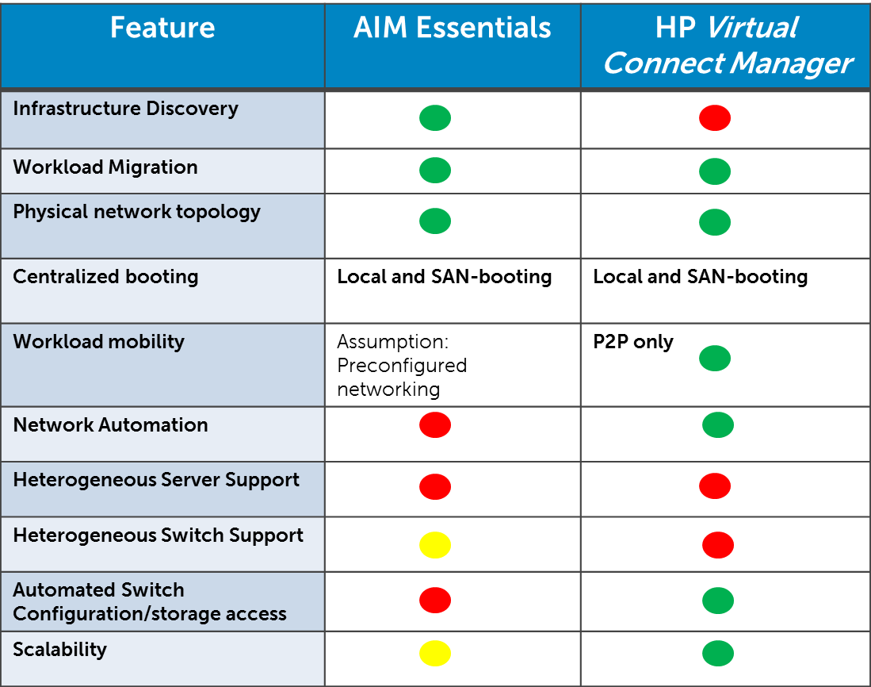
AIM Essentials vs. Virtual Connect Manager

Slide 71
AIM Essentials Support Matric
Which Hardware Platforms are supported?
Which Operating Systems Platforms are supported?
  Supported Windows Operating Systems
  Supported Red Hat Operating Systems
  Supported Novel Operating Systems
Which Hypervisors are supported?
Supported VMware Hypervisors
Supported Microsoft Hyper-V Hypervisors
What types of Activation will there be?
45 Day Customer Evaluation
The AIM Launcher Kit

Slide 72
Which Hardware Platforms are Supported?
Hardware Platforms Supported by AIM Essentials
Dell Rack Mount Servers | PowerEdge R610, R710, R715, R810, R815, R910 PowerEdge C1100, C2100, C6100
Dell Blade Servers | PowerEdge M610, M610x, M710, M710HD, M805, M905, M910
Dell PowerConnect Switches (for Read-only mode) | PowerConnect 6224, 6248, 8024/8024F, M6220, M6348, M8024
Add-on Interface Cards | Broadcom NetXtreme II 57711 Dual Port SFP+/Direct Attach 10Gb Card Broadcom NetXtreme II 57711 Dual Port 10Gb Ethernet Mezzanine Card Broadcom 57712-K (for HW iSCSI only)

Slide 73
Supported Windows Operating Systems
Microsoft Windows
Versions | AIM Boot Types | Server/VM Boot BIOS | iSCSI Offload
2003 Server Standard and Enterprise SP1 R2 – 32/64 Bit SP2 R2 – 32/64 Bit 2008 Server Standard, Enterprise and Data Center SP2 - 32/64 bit, R2 | Disk-Booted | Disk | N/A
 | iSCSI-Booted | PXE | N/A
 | Hardware iSCSI-Booted | iSCSI | No
 | Hardware iSCSI-Booted | iSCSI | Yes

Slide 74
Supported Red Hat Operating Systems
Red Hat Linux
Versions | AIM Boot Types | Server/VM Boot BIOS | iSCSI Offload
AS/EL 4 Update 4 - 32/64 bit AS/EL 4 Update 5 – 32/64 bit AS/EL 4 Update 6 – 32/64 bit AS/EL 4 Update 7 – 32/64 bit AS/EL 4 Update 8 – 32/64 bit EL 5 Update 1 – 32/64 bit EL 5 Update 2 – 32/64 bit EL 5 Update 3 – 32/64 bit EL 5 Update 4 – 32/64 bit EL 5 Update 5 – 32/64 bit | Disk-Booted | Disk | N/A
 | iSCSI-Booted | PXE | N/A
 | Hardware iSCSI-Booted | iSCSI | No
 | Hardware iSCSI-Booted | iSCSI | Yes

Slide 75
Supported Novell Operating Systems
Novell (SUSE) Linux
Versions | AIM Boot Types | Server/VM Boot BIOS | iSCSI Offload
SLES 10 Update 1 – 32/64 bit SLES 10 Update 2 – 32/64 bit SLES 10 Update 3 – 32/64 bit SLES 11 – 32/64 bit SLES 11 SP1 – 32/64 bit | Disk-Booted | Disk | N/A
 | iSCSI-Booted | PXE | N/A
 | Hardware iSCSI-Booted | iSCSI | No
 | Hardware iSCSI-Booted | iSCSI | Yes

Slide 76
Supported Hypervisor: ESX and ESXi
VMware ESX
Versions | AIM Boot Types | Server Boot BIOS | Guest OS
3.5 Update 5 4.0 Update 1 4.1 Update 1 | Disk-Booted | Disk | Windows 2003/2008 Red Hat Linux 4/5/6.1 SUSE Linux 10/11
VMware ESXi
Versions | AIM Boot Types | Server Boot BIOS | iSCSI Offload | Guest OS
4.0 Update 1 | Disk-Booted | Disk | N/A | Windows 2003/2008 Red Hat Linux 4/5/6.1 SUSE Linux 10/11
4.1 Update 1 | Disk-Booted | Disk | N/A
 | Hardware iSCSI-Booted | iSCSI | NO

Slide 77
Supported Hypervisor: Hyper-V
Microsoft Hyper-V
Versions | AIM Boot Types | Server Boot BIOS | iSCSI Offload | Guest OS
2008 R2 Enterprise and Data Center | Disk-Booted | Disk | N/A | Windows 2003/2008 Red Hat Linux 4/5/6.1 SUSE Linux 10/11
 | iSCSI Booted³Booted | PXE | N/A
 | Hardware iSCSI-Booted³Booted | iSCSI | NO
 | Hardware iSCSI-Booted²Booted | iSCSI | YES

Slide 78
What types of Activation will there be?
Additional License information:
  The ‘License Validator’ (encode and decode functions) has been enhanced to support the licenses needed for ‘AIM Essentials’.
  Maximum number of managed sockets should not exceed 64
  (max of 32 hosts assuming that most deployment will be 2 socket servers which also equates to 2 fully populated Dell Blade Chassis)
  The ‘Activation Code Generator has been updated to generate new types of Activation Codes for ‘AIM Essentials’. These combinations are:
AIM Essentials Activation Code Combinations
AIM Essentials - | 4 Socket | 1 year Support
AIM Essentials - | 4 Socket | 3 year Support
AIM Essentials - | 16 Socket | 1 year Support
AIM Essentials - | 16 Socket | 3 year Support
AIM Essentials - | 30 Socket | 1 year Support
AIM Essentials - | 30 Socket | 3 year Support
AIM Essentials - | 32 Socket | 1 year Support
AIM Essentials - | 32 Socket | 3 year Support

Slide 79
45 Day Customer Evaluation
Dell customers will be able to evaluate AIM within their environment. The Evaluation period is intended to:
Promote and ensure sales for ‘AIM Enterprise’ or ‘AIM Essentials’.
Ease of implementation of AIM by using the recommended ‘Launcher Kit’.
Involve the Software Sales team (SEs) as the customer’s primary contact for the tasks related to the deployment of the AIM software and subsequent support.
Notes:
As part of this initiative, customers will have an ability to evaluate AIM in their environment. The goal is to ensure that the 45 day evaluation s get converted into real sales for ‘AIM’ or ‘AIM Essentials’. In order to make it easy for running the evaluation s, the GSE team is putting together a ‘Launcher Kit’, the details of which are provided in the next section. The ‘launcher kit’ will enable to run all the evaluation s using a consistent configuration. However, it is the decision of the sales team to determine if an alternate configuration is better suited for the opportunity. In either case, the goal is to minimize the dependency on Services. The Software Sales team (SEs) should be the customer’s primary contact for the tasks related to deployment of the AIM software and subsequent support. The SEs can leverage other teams as required. Here are the highlights of the 45 day evaluation.
To provide a good customer experience, it is recommended that we include the normal ProSupport for AIM as part of the free trial license. To do this, the trial license would have to be ordered like the regular AIM since we need to tie the support contract to a service tag. The license price would be $0, but for the customer to get a free trial license, the account team would have to pay for the support (estimated $1K-$2K for a 32-socket trial license) using the standard revenue adjustment process. This is a relatively small expense for the account team to pay in exchange for a valuable trial period.
The general consensus is to have the evaluation capped at 45 days. Because the support timeframe entitlement starts when the trial is actually ordered, there is likely a period where the customer is not actually using AIM as it is being implemented. So the actual usable period for the trial that would include support is likely closer to 30 days (lose some support days during the implementation period of the trial). To maximize the benefit of the inclusion of the Support Services, the account team should order the free trial as close as possible to the actual implementation date.
Implementation: the Services PG team is looking at pre-packaged, fixed implementation services that would specifically cover this trial implementation. This would likely not be available till later in Q4. In the meanwhile, sales would have to request the standard custom SOW to get GICS to implement the trial

Slide 80
The AIM Launcher Kit
The AIM Launcher Kit is a reference configuration that is being put together by the GSE team. This has been put together primarily as a sales enablement tool.
The Launcher Kit is not meant to be integrated into a customer’s datacenter environment.
Included with the Launcher Kit are:
Design Guide with detailed network configuration
Ordering guide with DellStar Configurations
Setup overview
Use Case Guide
For the first version, the Launcher Kit will be qualified with ‘AIM Enterprise’ only.
Notes:
The AIM Launcher Kit is a reference configuration that is being put together by the GSE team. For the first version, the Launcher Kit will be qualified with ‘AIM Enterprise’ only. This architecture and configuration will be conceived and tested by the GSE team to ensure the success of AIM evaluations in the field. This is being put together primarily as a sales enablement tool. The kit will also include a detailed design guide with an ordering template to ease the process of procurement and deployment. The Launcher Kit is not meant to be integrated into a customer’s datacenter environment, In order to do that GICS needs to be engaged. The deliverables include :
Design Guide with detailed network configuration
Ordering guide with DellStar Configurations
Setup overview
Use Case Guide

Slide 81
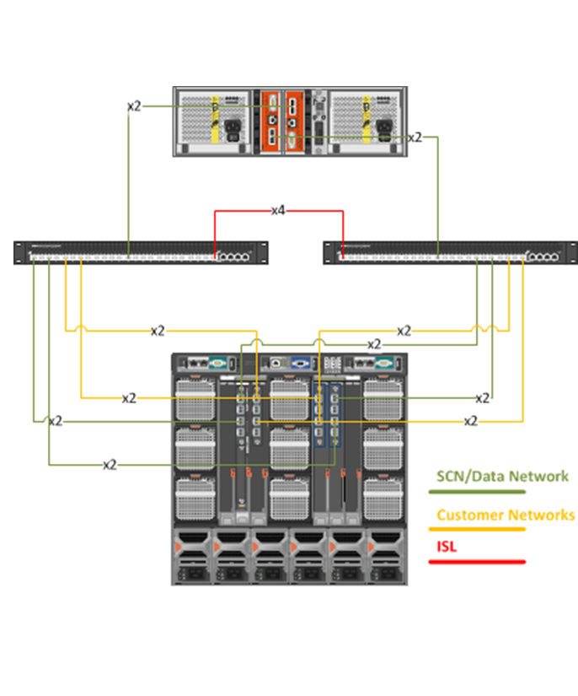
Launcher Kit Details
Required components
  At least 4 managed M710HD servers
  1 M710 HD ESXi Hypervisor with an AIM Controller appliance
  2 Dual Port 57711 Add-in mezzanine cards per server
  4 M8024F Top-of-Rack switches
  1 PS6010 Storage Array
Flexibility in architecture
  Up to 15 managed servers
  Up to 3 10GbE storage arrays
  CPU, memory and HDD configuration of managed servers
  Windows Server 2008 Licenses (at least 1 required to demo use cases)
Notes:
Required components
At least 4 managed M710HD servers
1 M710 HD ESXi Hypervisor with an AIM Controller appliance
2 Dual Port 57711 Add-in mezzanine cards per server
4 M8024F Top-of-Rack switches
1 PS6010 Storage Array
Flexibility in architecture
Up to 15 managed servers
Up to 3 10GbE storage arrays
CPU, memory and HDD configuration of managed servers
Windows Server 2008 Licenses (at least 1 required to demo use cases)

Slide 82
A Closer Look at AIM Essentials
A Guided Tour of AIM Essentials

Slide 83
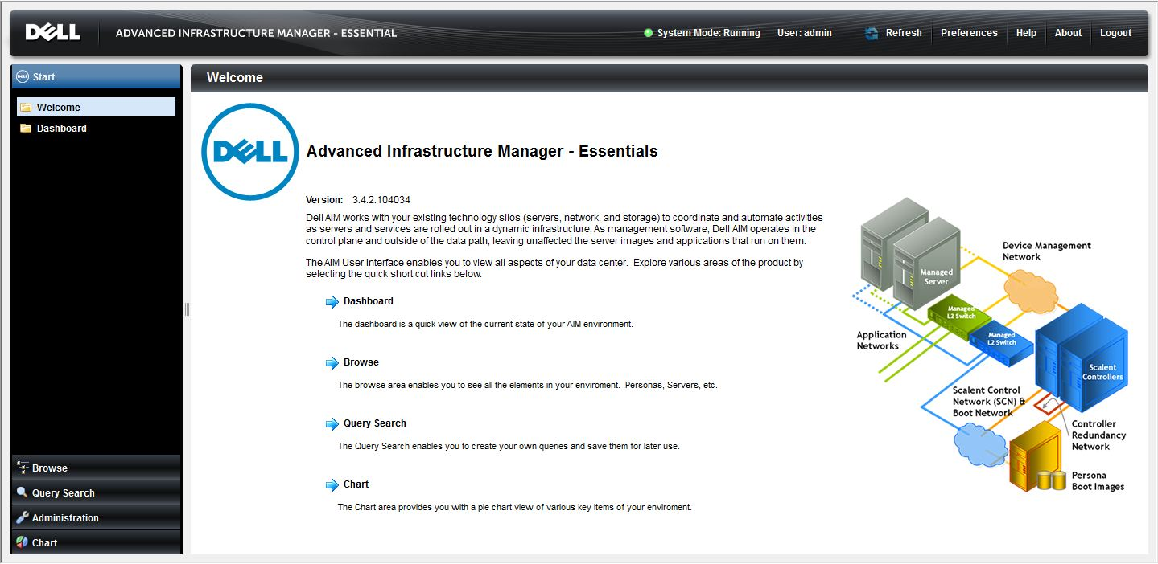
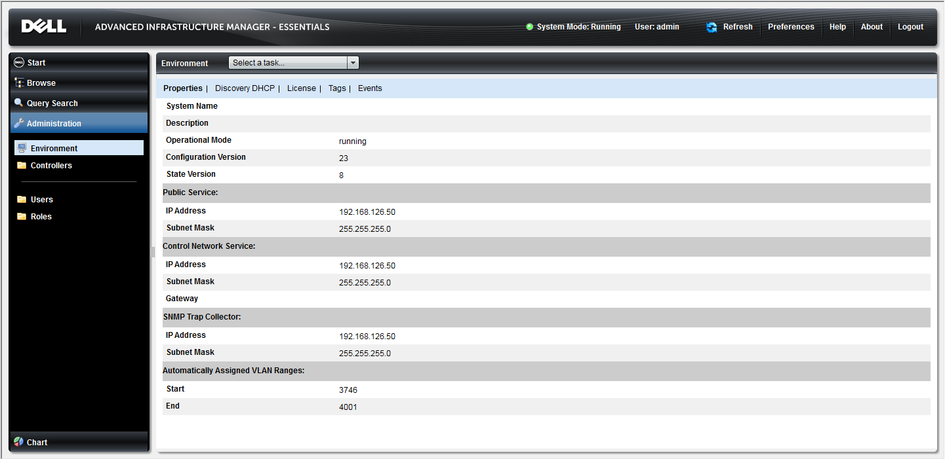
AIM Essential Console Branding
AIM Essentials and AIM Enterprise share the same software bits. The Console branding is determined by schema activation the license is applied to the bits, AIM Essentials will have its own Welcome and Header branding. The log in screen is shared by both Essentials and Enterprise as AIM.
Notes:
When the AIM Essentials license key is installed in the Controller the following changes to take place in the AIM Console.
After login the banner displays ‘Dell AIM Essentials’.
All features that are disabled in ‘AIM Essentials’ are grayed out or disabled in the UI Console. For example, the option to create persona extensions should not be able to be clicked from the UI
The following operations can be executed from the AIM Essentials Console UI:
Add /Delete Dell M1000e Blade chassis
Add /delete a vRack
Add /delete network switches (only in Read-only mode)
M1000e Blade Chassis switch modules in Read-only mode
Top of the rack switches
Interconnect Switches
Operations related to personas, VMracks and server pools will remain the same add, delete, start, stop .. etc

Slide 84
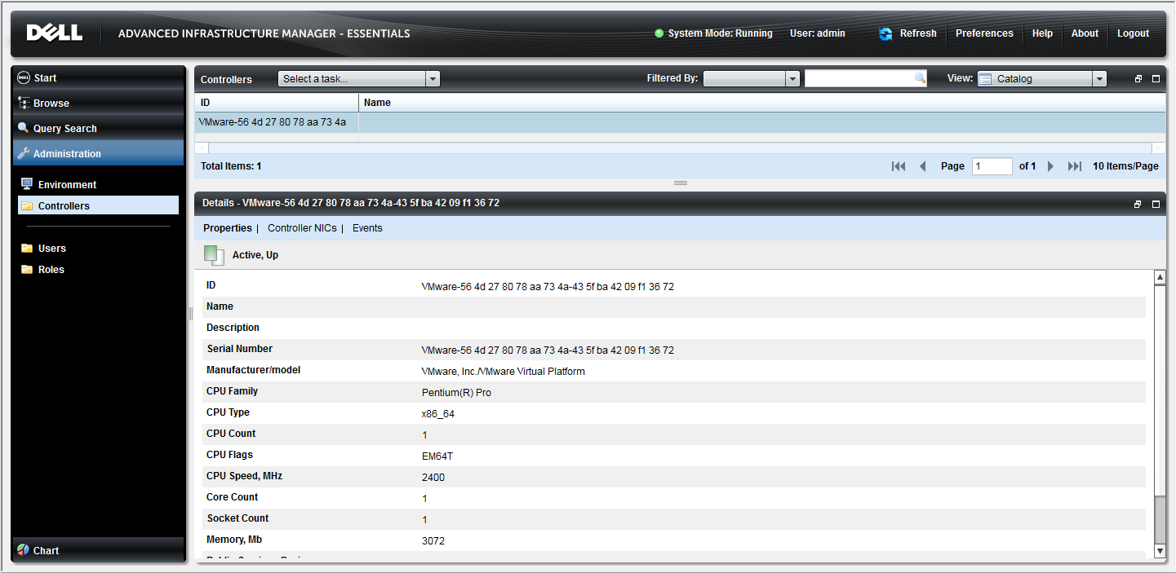
Essentials Console - at a Glance
Current User
Display Refresh
Auto-Refresh
Documentation
System Status
Tasks Menu
Element Types
Navigation Pane
Catalog
Element details
Workspace
Column Headings
Dropdown filter
Notes:
When the AIM Essentials license key is installed in the Controller the following changes to take place in the AIM Console.
After login the banner displays ‘Dell AIM Essentials’.
All features that are disabled in ‘AIM Essentials’ are grayed out or disabled in the UI Console. For example, the option to create persona extensions should not be able to be clicked from the UI
The following operations can be executed from the AIM Essentials Console UI:
Add /Delete Dell M1000e Blade chassis
Add /delete a vRack
Add /delete network switches (only in Read-only mode)
M1000e Blade Chassis switch modules in Read-only mode
Top of the rack switches
Interconnect Switches
Operations related to personas, VMracks and server pools will remain the same add, delete, start, stop .. etc

Slide 85

Essentials UI – Welcome Screen
The Welcome page is the products splash page with a high level graphic of typical AIM Environment, this screen also provides the links to the various work areas within AIM, these are the same as in the Navigation panel to the left side of the screen
Links to the individual work areas within Essentials
Console Login > Navigation Bar > Welcome

Slide 86
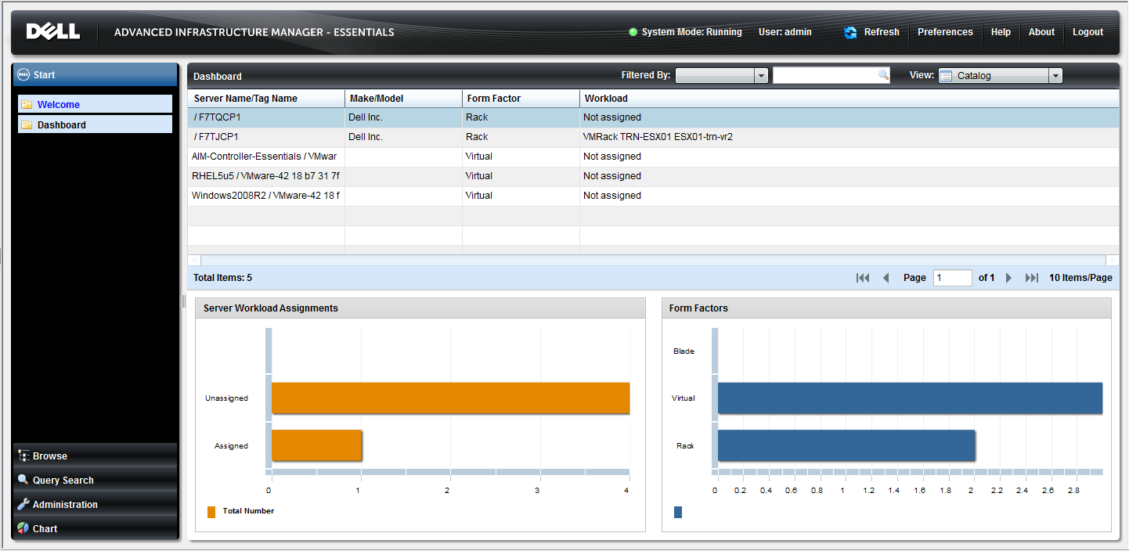
Essentials UI – Dashboard
The Dashboard offers an quick look at servers (physical and virtual) that have been discovered to host AIM Personas
Areas include:
Catalog quick glance of server information
Server Workload Assignments
Form Factors - Physical Rack or Blade and Virtual
Console Login > Navigation Bar > Dashboard

Slide 87
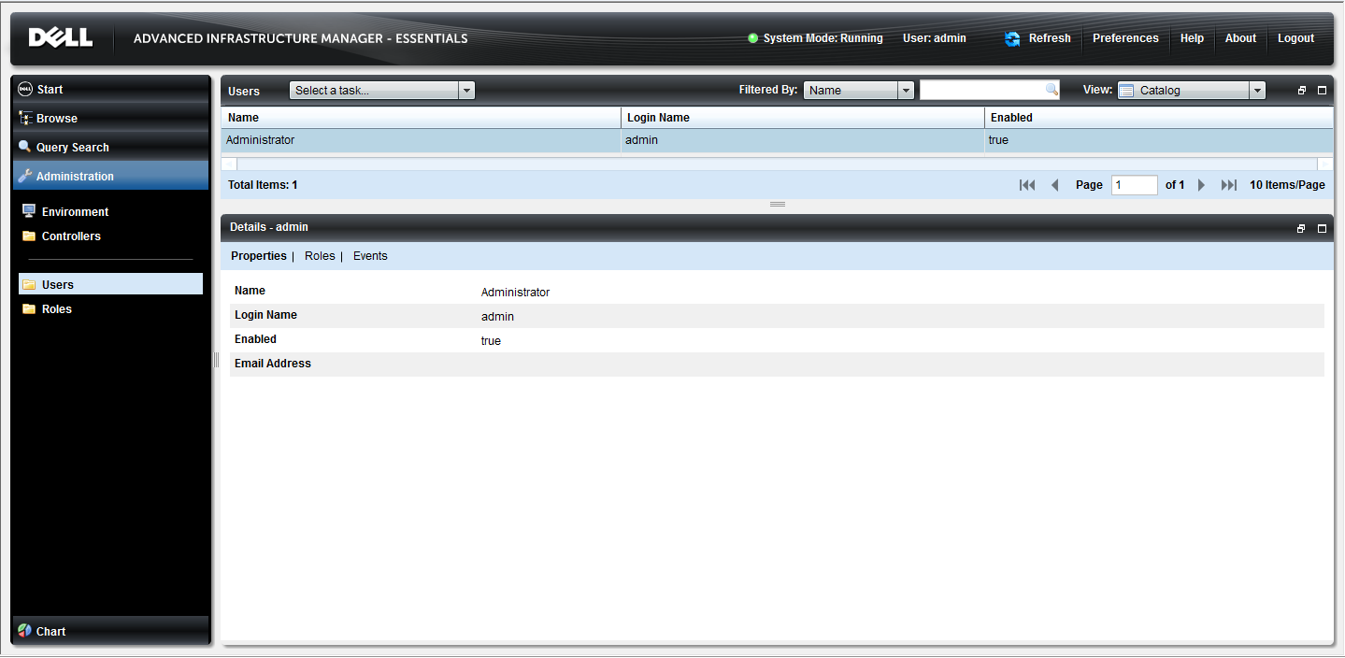
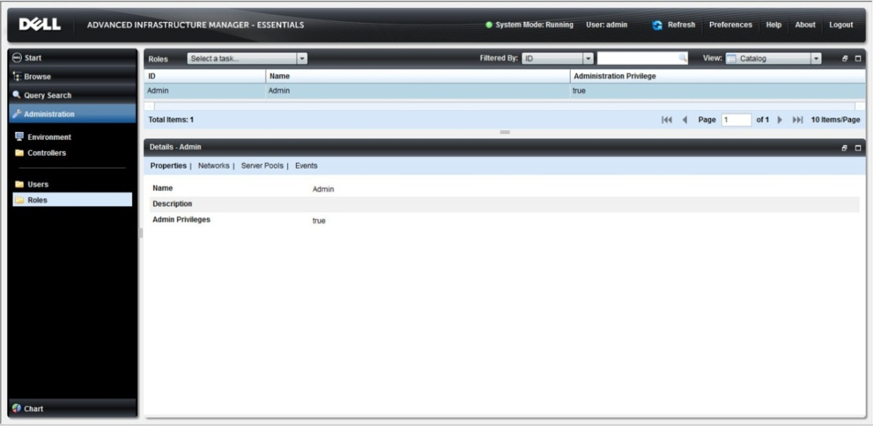
Essentials UI – Administration
The Administration page provides Users and Roles configuration tools that enable the administrator to create tasked based role and user creation for AIM administration tasks. In AIM 3.4.2 the Environment and Controllers screens have been incorporated into the Administration area of AIM.
Console Login > Navigation Bar > Administration

Slide 88
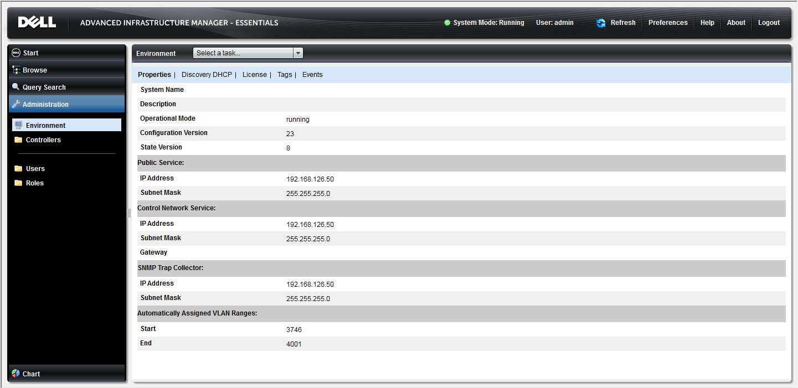
Essentials UI – Environment
The Environment page has been moved into the Administration area providing a quick glance to Environment Properties, DHCP, License data, Tags, and Events.
Console Login > Navigation Bar > Administration > Environment

Slide 89
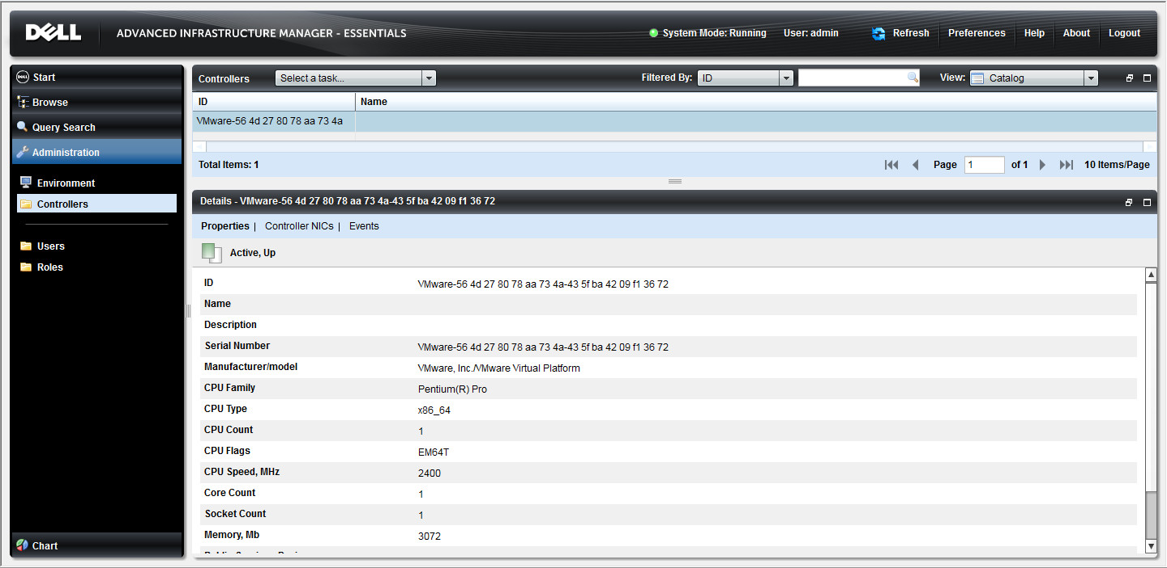
Essentials UI – Controllers
The Controllers page gives users with associated rights a quick view of the Controllers properties, NICs and associated events. Providing the Administrator with enhanced monitoring capabilities over previous release versions.
No graphical or Network views are available for this element
Console Login > Welcome > Browse > Controllers

Slide 90
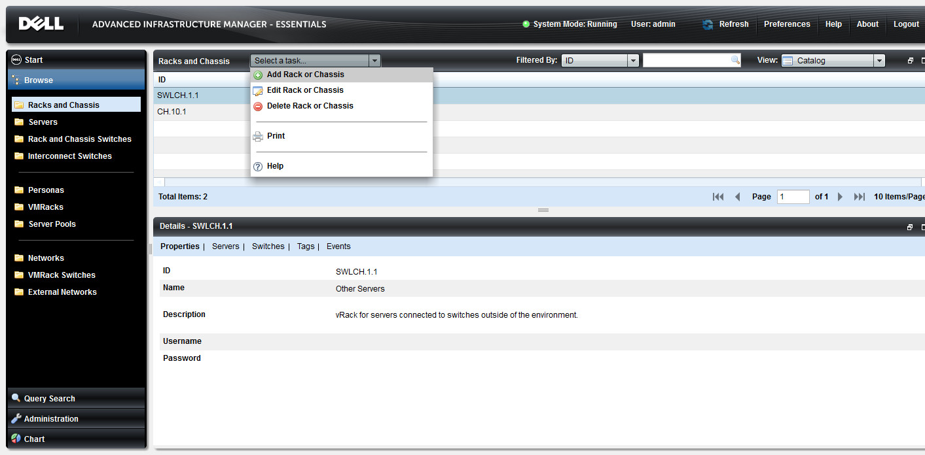
Essentials UI – Racks and Chassis
–Task dropdown menu
The Racks and Chassis page provides Catalog, Server and Network views of managed Racks ad Chassis within the AIM environment. Also available from the Select a Task menu are wizards added to AIM 3.4.2 providing for UI based adding and editing of Racks and Chassis into the AIM environment.
Console Login > Welcome > Browse > Racks and Chassis

Slide 91
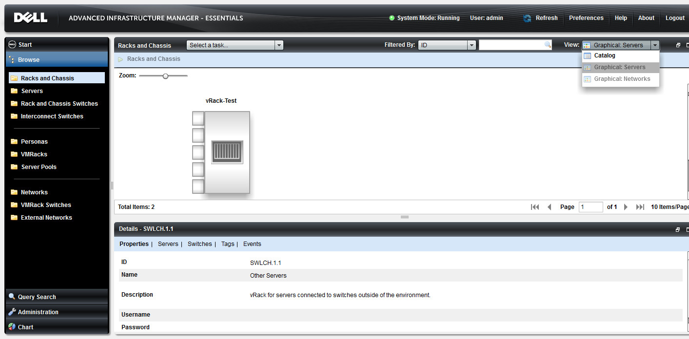
Essentials UI – Racks and Chassis
- Drop down selection of Graphic view
AIM Essentials 3.4.2 provides graphical representation of the managed vRacks along with its associated servers and switches. Clicking on the image changes the information in the Details area below reflecting information about the selected object.
Console Login > Welcome > Browse > Racks and Chassis

Slide 92
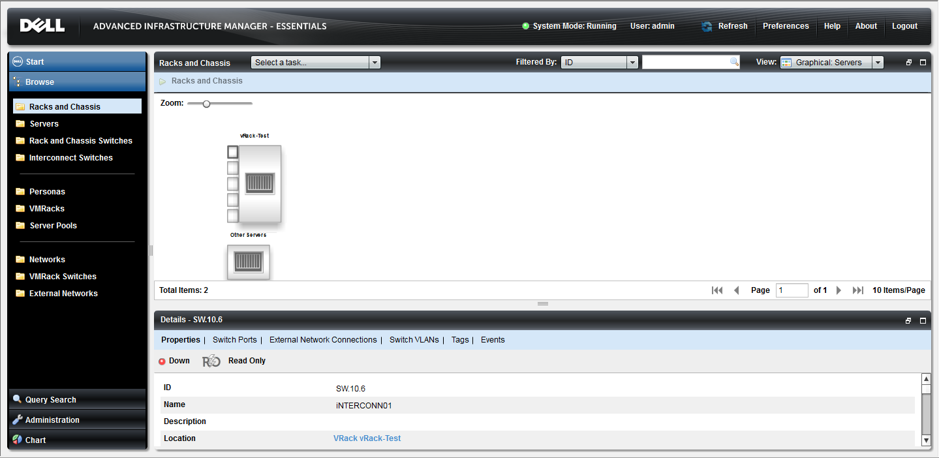
Essentials UI – Racks and Chassis
– Graphic view with Switch Data
This screenshot shows you that the top switch ID SW.10.6 is also an Interconnect switch named interconn01. Details for this switch also provide the location and a quick jump link to take you to the Switches details tab of the Associated vRack CH.10.1 for this example.
Console Login > Welcome > Browse > Racks and Chassis

Slide 93
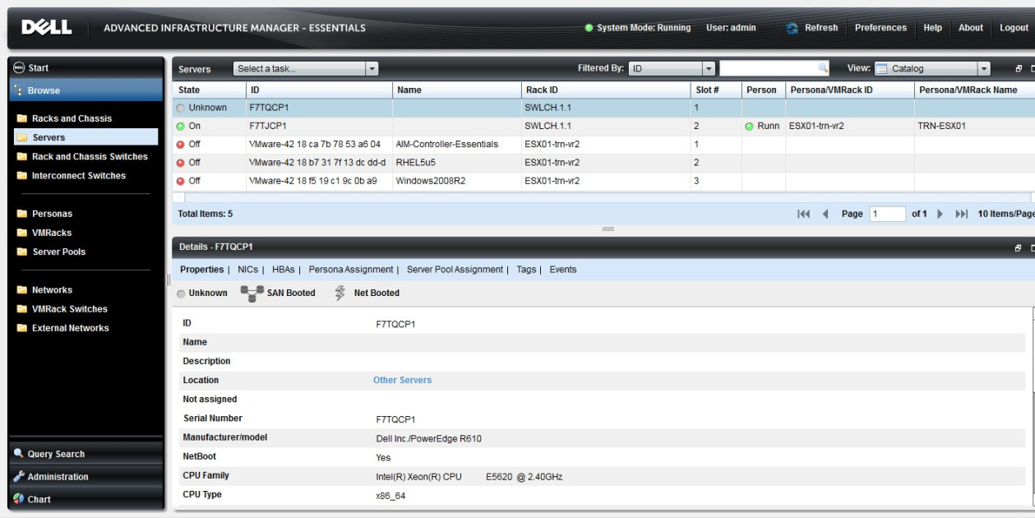
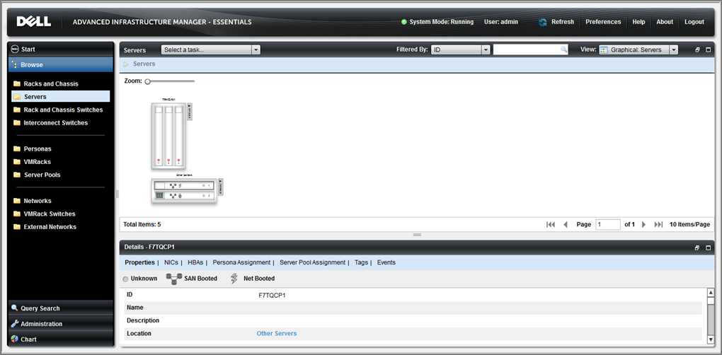
Essentials UI – Servers
The Servers page lists discovered servers within the associated rack. In this example there are two hardware servers, identified by their Service Tag ID and 3 virtual machine servers that are hosted on the ESX physical machine F7QCP1.
Also shown here is the graphical server view for this Controller.
Console Login > Welcome > Browse > Servers

Slide 94
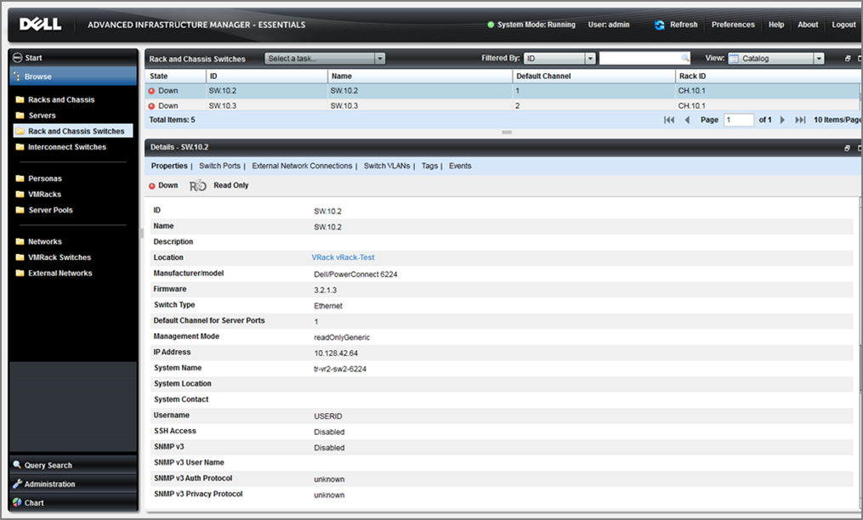
Essentials UI – Racks and Chassis Switches
The Racks and Chassis page also provides a Catalog and Graphical Server view listing the switches added as read only switches into the AIM Essentials environment. Details provides properties ID, Name, Location. Manufacturer, Firmware, management mode, IP address and other information about the selected switch.
Additional information in the Details area include:
Switch Port
External Network Connections
VLANS
Tags
and Events
Console Login > Welcome > Browse > Racks and Chassis Switches

Slide 95
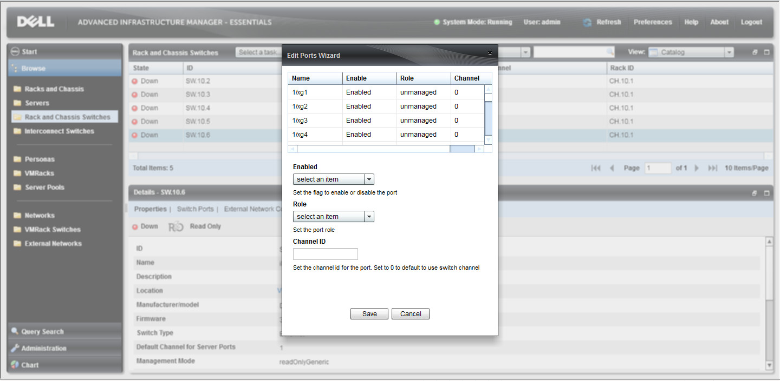
Essentials UI – Racks and Chassis Switches
- Edit Ports Wizard
Switch Ports can now be edited using the AIM 3.4.2 Essentials Console UI. Users with administrative rights to perform this task can Enable a port, select a role such as external, interconnect, host, unmanaged, or unknown for the switch port. Channel ID can also be set using the Edit Port Wizard.
Console Login > Welcome > Browse > Racks and Chassis Switches

Slide 96
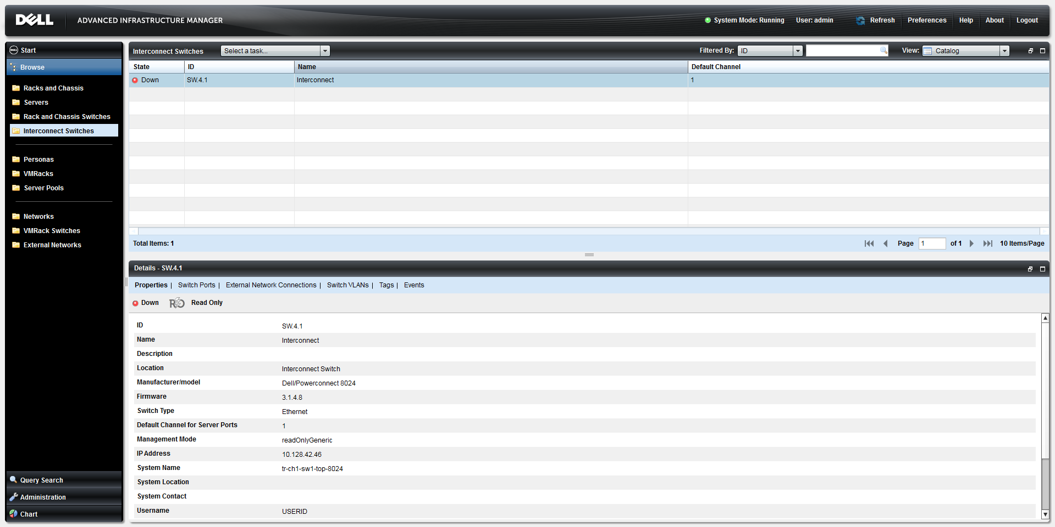
Essentials UI – Interconnect Switches
The Interconnect page is used list and to add Interconnect switches into the AIM Environment.
Console Login > Welcome > Browse > Interconnect Switches

Slide 97
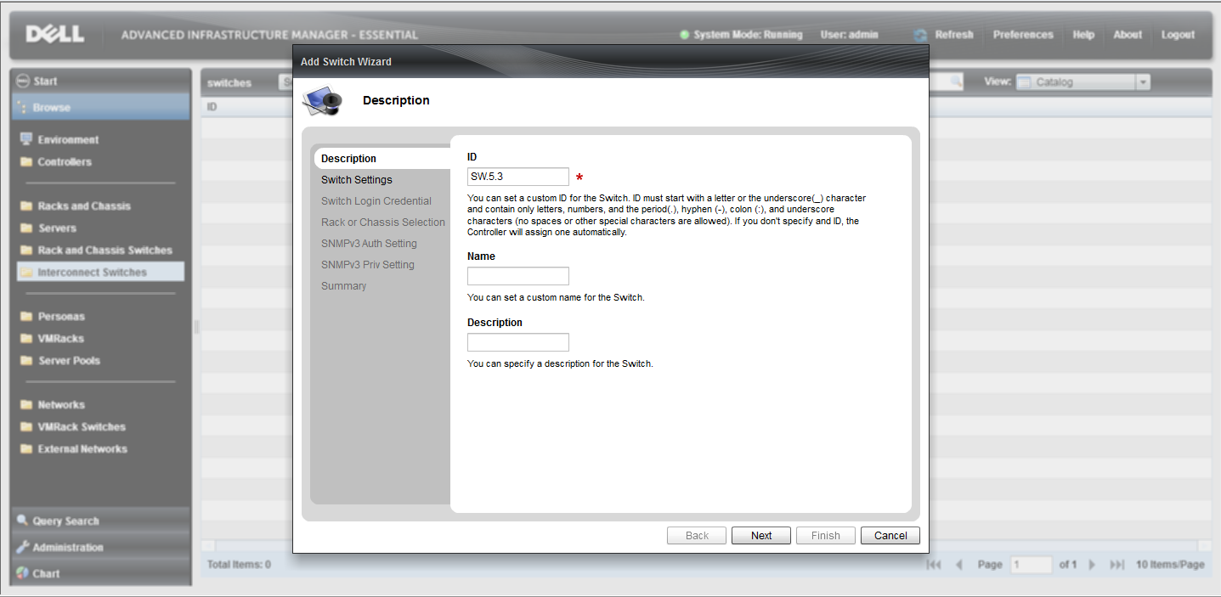
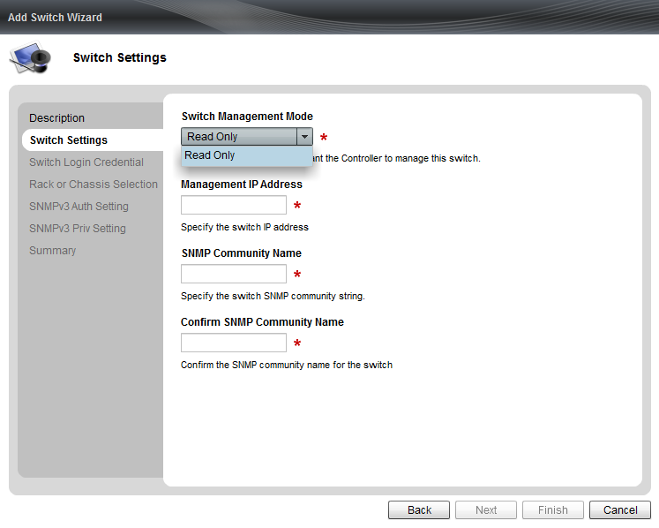
Essentials UI – Interconnect Switches
- Add Switch Wizard
Interconnect switches can now be added to the AIM environment through the AIM 3.4.2 Essentials Console UI.
Console Login > Welcome > Browse > Interconnect Switches

Slide 98
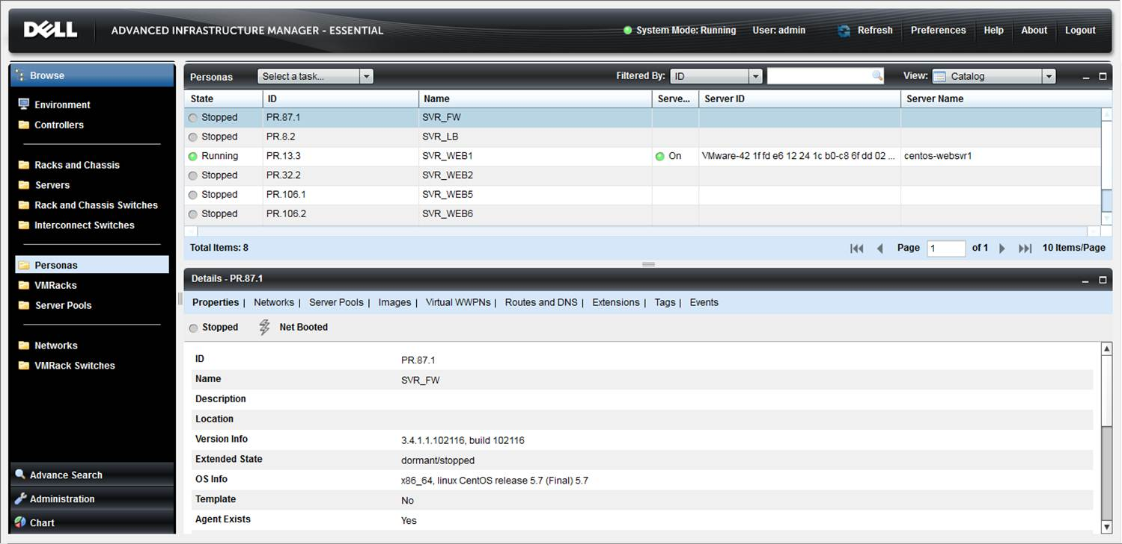
Essentials UI – Personas
The Personas page provides a catalog, graphical Server, and Networks view giving administrators information and monitoring capabilities regarding AIM Personas, and the servers and networks associated with those Persona.
Console Login > Welcome > Browse > Personas

Slide 99
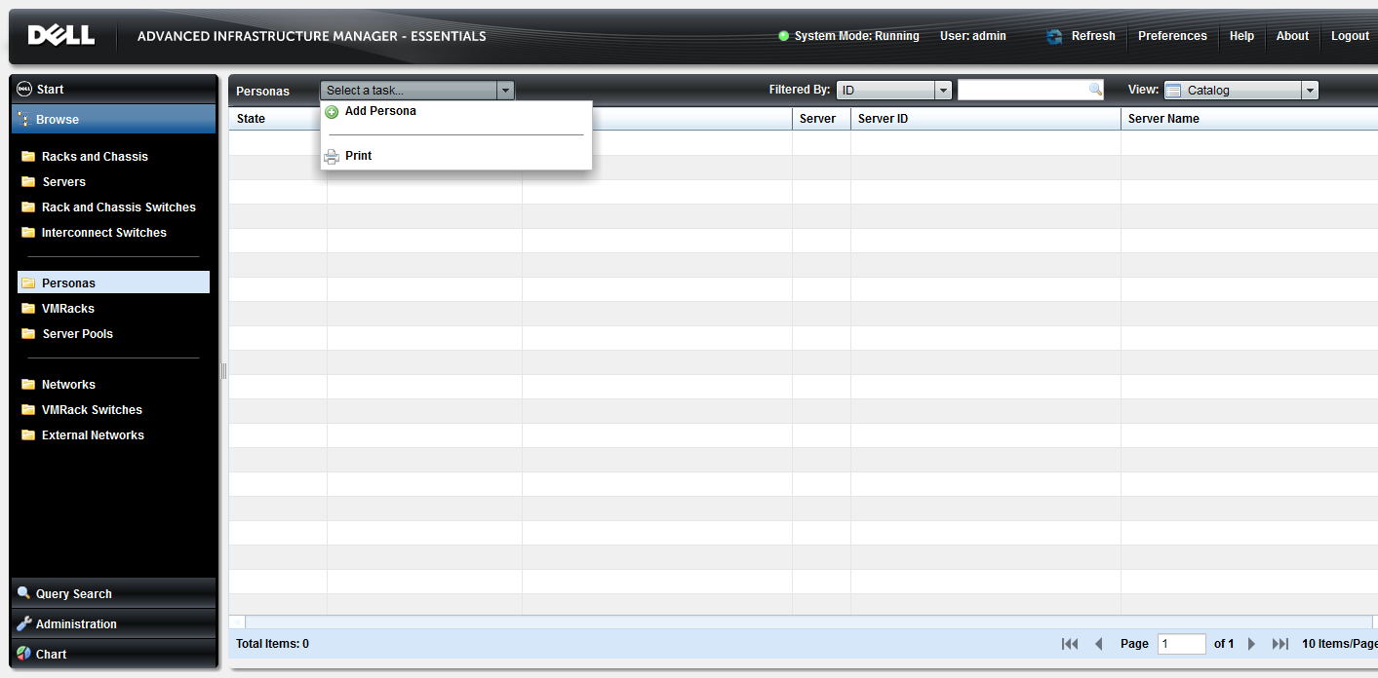
Essentials UI – Personas
- Adding a Persona
Adding a Persona into AIM begins at the Persona element Select a Task menu.
Console Login > Welcome > Browse > Personas > Task Menu

Slide 100
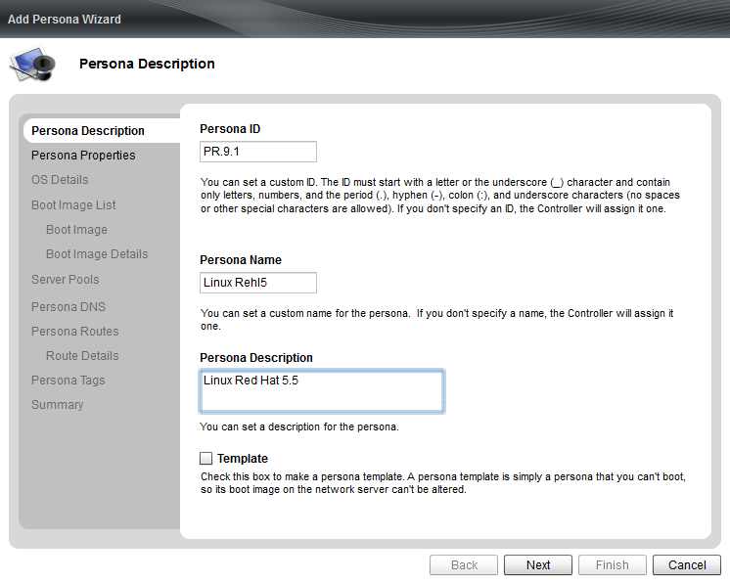
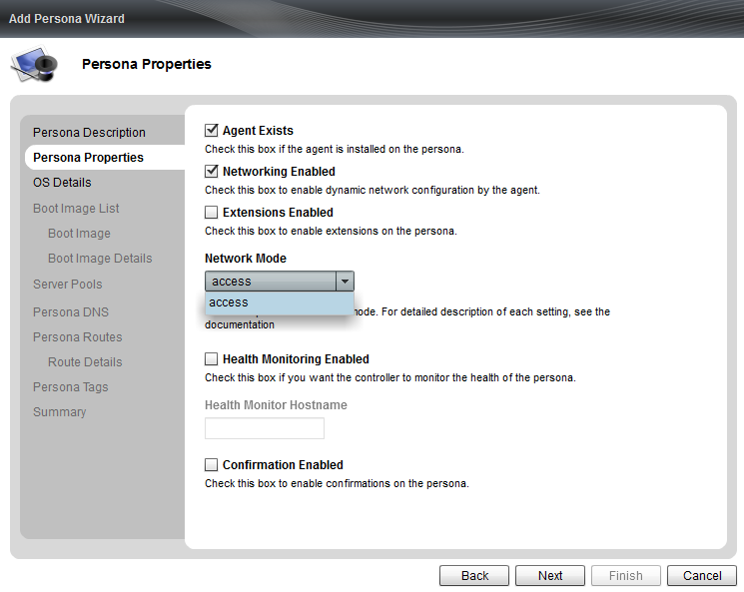
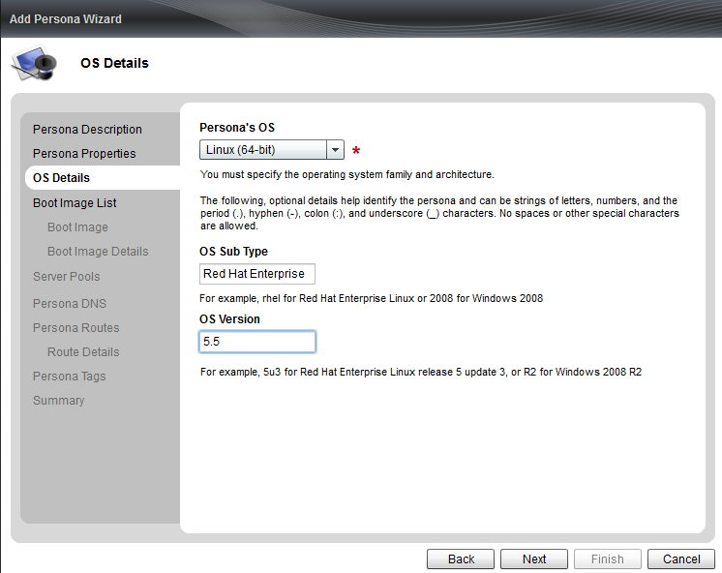
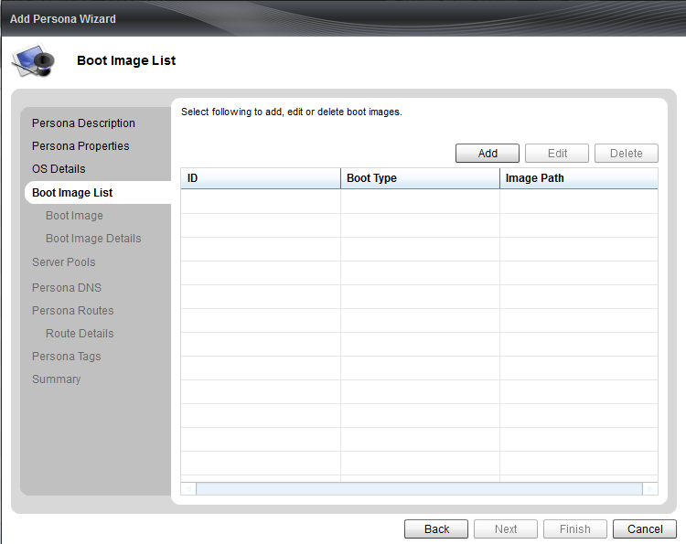
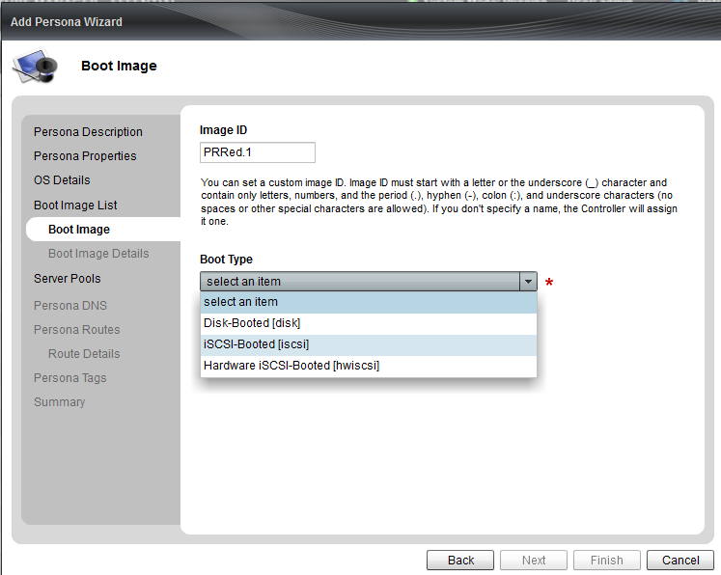
Essentials UI – Personas
- Adding a Persona (2)
The Add Persona Wizard provides an easy path to add a persona into AIM. Persona Description, Properties, OS Details, Boot Image List, Boot Image
Creating a Persona can be done in 12 steps or less.
Console Login > Welcome > Browse > Personas > Add Persona Wizard

Slide 101
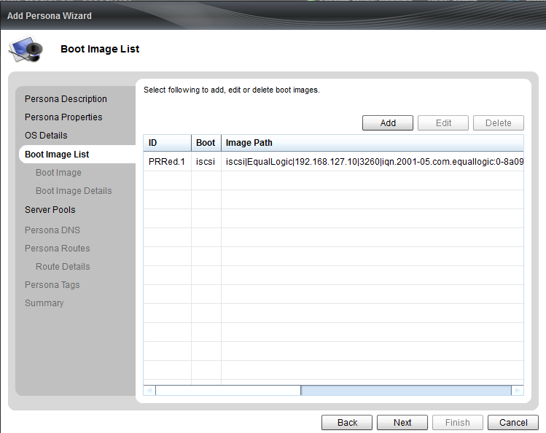
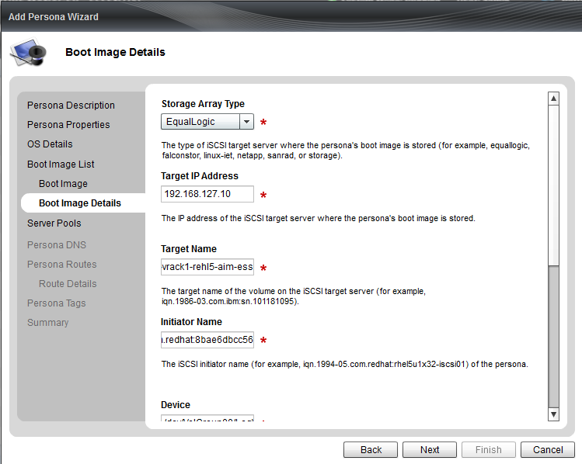
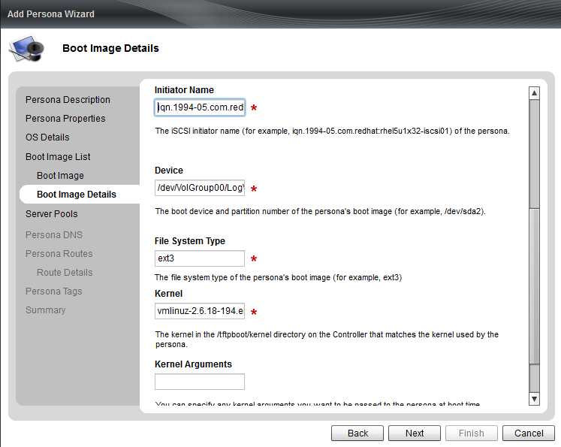
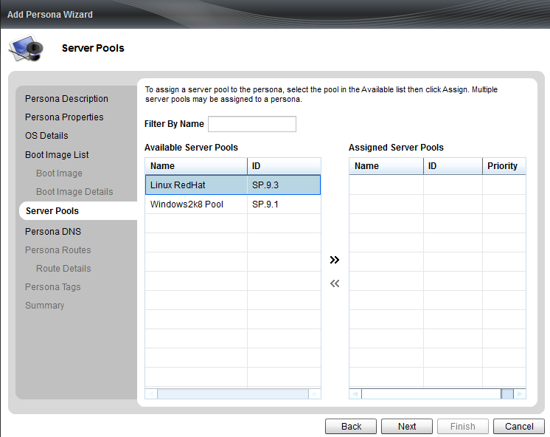
Essentials UI – Personas
- Adding a Persona (3)
Boot Image List, Boot Image, Boot Image Details , Server Pools
Console Login > Welcome > Browse > Personas > Add Persona Wizard

Slide 102
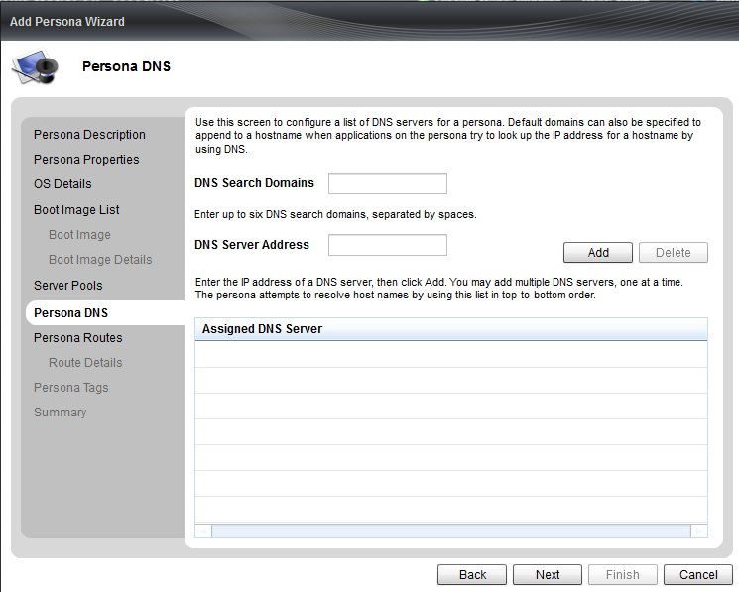
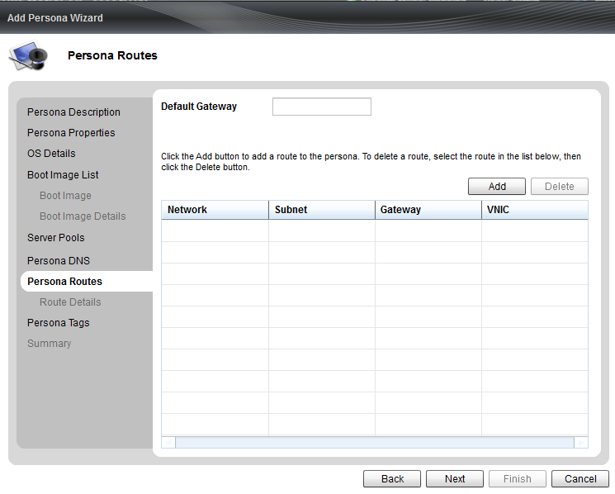
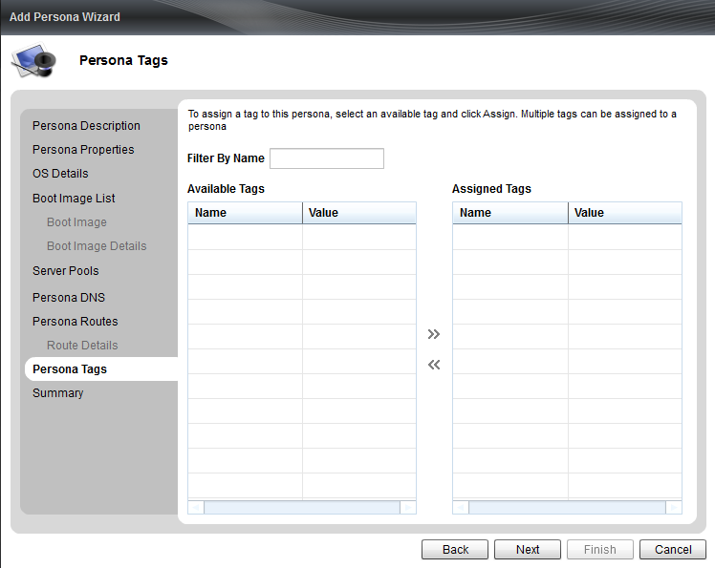
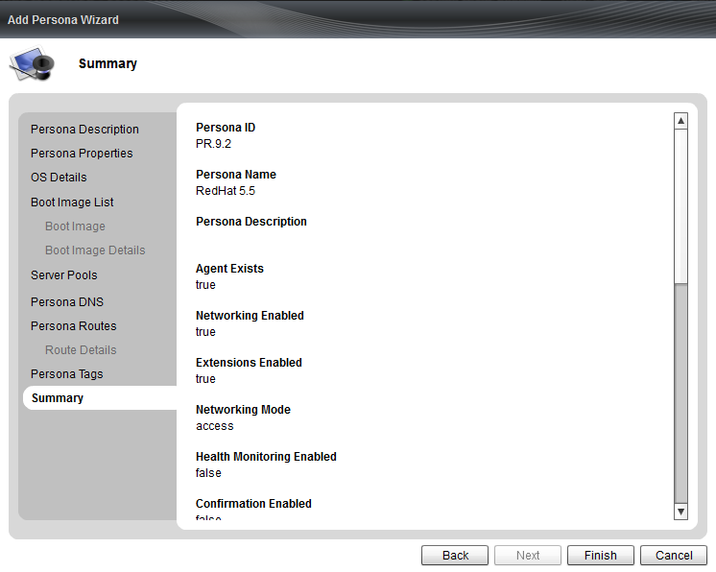
Essentials UI – Personas
- Adding a Persona (4)
Persona DNS, Persona Routes, Persona Tags, Persona Build Summary
Console Login > Welcome > Browse > Personas > Add Persona Wizard

Slide 103
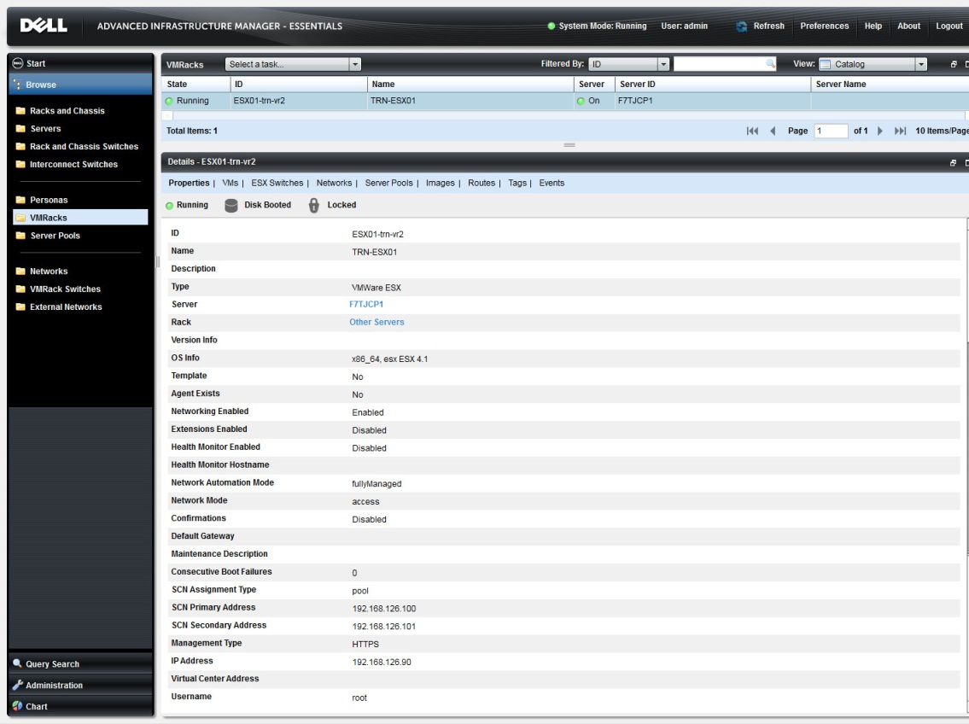
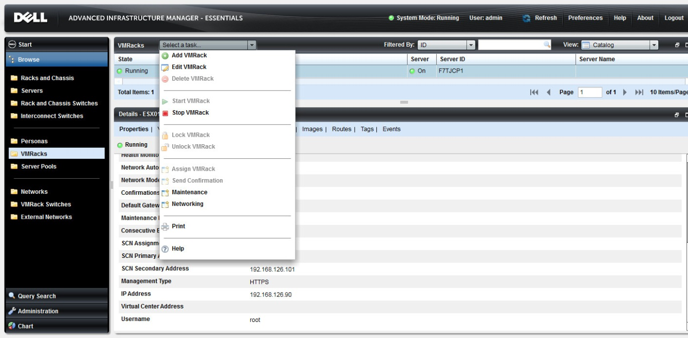
Essentials UI – VMracks
VMRacks can now be added to the AIM environment through the AIM 3.4.2 Essentials Console UI. These pages provide monitoring and task based wizards.
Console Login > Welcome > Browse > VMracks

Slide 104
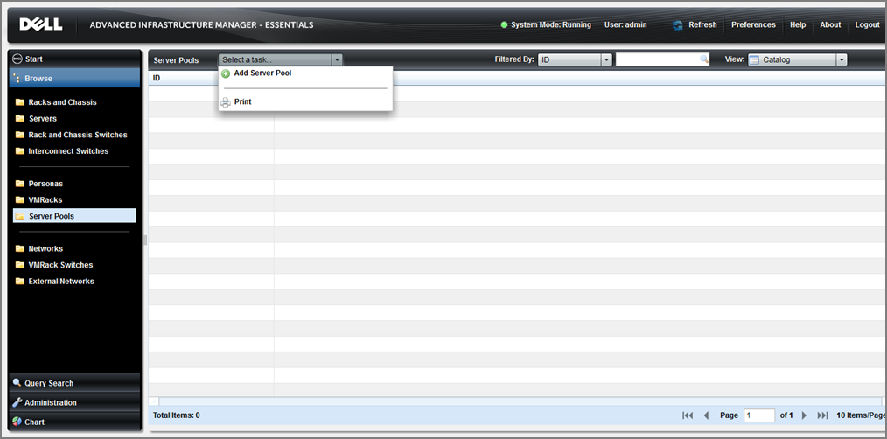
Essentials UI – Server Pools
-with Task bar
The Server Pool page is used to add and monitor Server Pools. Server Pools are also managed at the Persona and Server level.
Console Login > Welcome > Browse > Server Pools

Slide 105
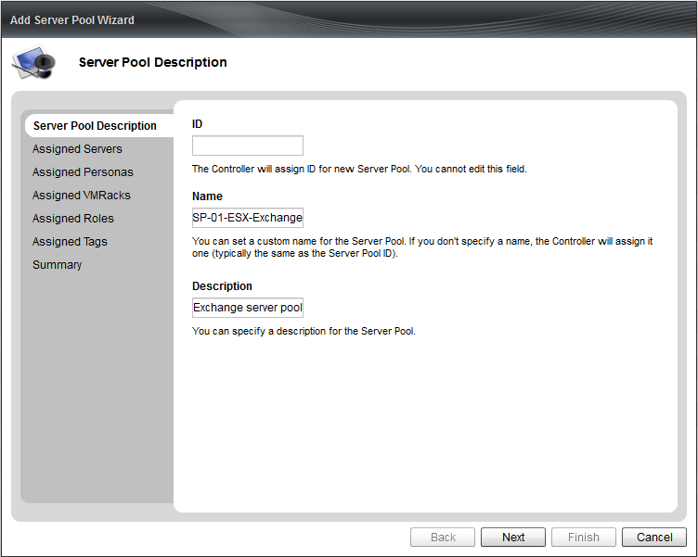
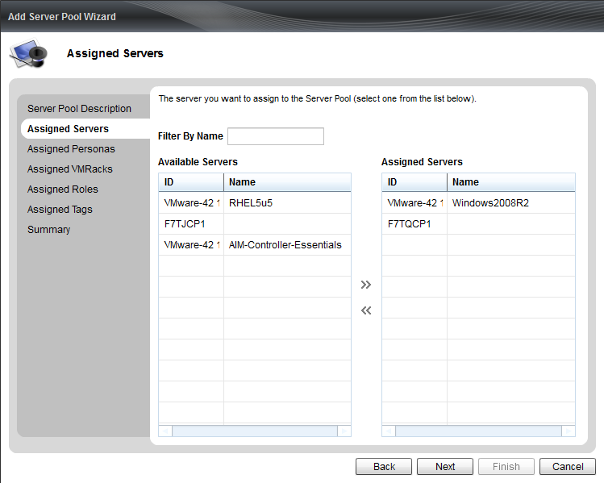
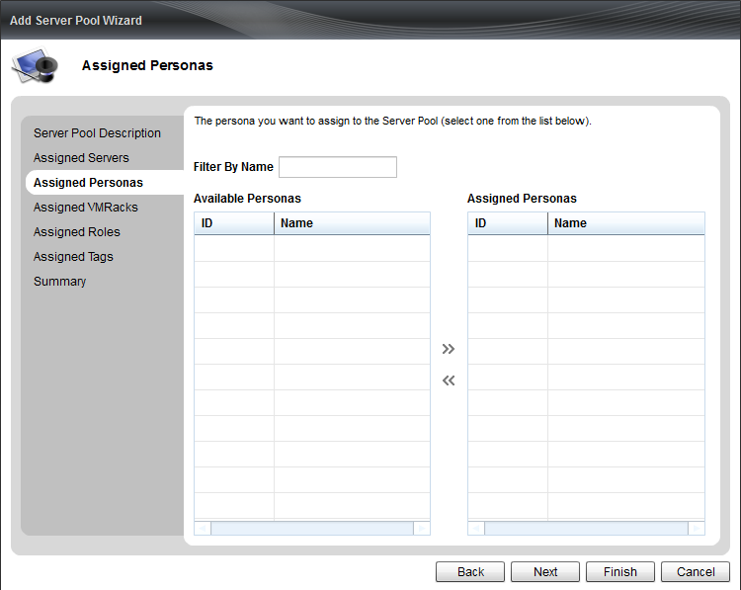
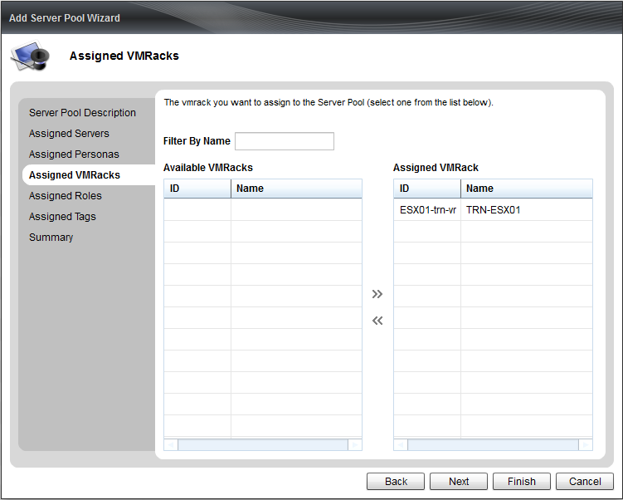



Essentials UI – Server Pools
-Server Pool Wizard
The seven screens of the Server Pool Wizard
Console Login > Welcome > Browse > Server Pools > Wizard

Slide 106

Essentials UI – Networks
The Networks page us used to list and edit existing network within AIM Essentials. Expanding the Select a Task drop down menu networks can be assigned to Personas, and VMRacks.
Console Login > Welcome > Browse > Server Pools

Slide 107
Upgrading AIM Essentials
Upgrade to AIM Enterprise
Upgrade Scenarios
Upgrading to AIM Enterprise Review

Slide 108
Upgrade to AIM Enterprise
Dell customers can expect an easy upgrade path from ‘AIM Essentials’ to ‘AIM Enterprise’, the upgrade process to upgrade to a single AIM Enterprise controller is as follows:
Customer obtains license for ‘AIM Enterprise’
Controller service is stopped. The old license key is replaced with the new license key.
Controller service is restarted
At this point in time, the
  Console should reflect the banner change to AIM Enterprise
  All the AIM functions/features should be enabled in the configurator as well as the UI console and CLI.
Notes:
If Essentials is an OVF-only deployment, and a customer wants to upgrade to Enterprise with resiliency, will that require a Consulting Services engagement?
Yes – consulting would be required for Essentials to “Enterprise” upgrade; the heavy lift of networking setup would be done in the upgrade.

Slide 109
Upgrade Scenarios
There are 5 upgrade scenarios , in addition to standard contract renewals:
AIM Essentials Older Version - > AIM Essentials Current Version
  Just a download, if valid subscription entitlement exists.
AIM Essentials Curent Version - > AIM Enterprise Curent Version
  New APOS order for upgrade + pro-rated ProSupport.
AIM Essentials Older Version - > AIM Enterprise Current Version
  Same as 1+2 above.
AIM Enterprise Trial -> AIM Enterprise
  New Sale (new Service Tag, new Contract).
License Add-ons (have 4 socket, needs 4 more)
  New Sale for additional sockets. (new Service Tag, new Contract)
  New License Key for total socket count.
  APOS will have to track separate renewals.

Slide 110
Upgrading to AIM Enterprise Review
Upgrading to a newer version of ‘AIM Essentials’ will be exactly what the process is today for ‘AIM’.
It is mandatory to include a Services engagement to upgrade from ‘AIM Essentials’ to ‘AIM Enterprise’.
The features of the upgrade process include:
  No downtime for running business applications
  The Controller and Agent software should be able to be upgraded independent of each other.
  A process may be in place, that will update the agent software across many nodes simultaneously. At this time this is a desirable and not a mandatory requirement.
Notes:
Upgrading to a newer version of ‘AIM Essentials’ will be exactly what the process is today for ‘AIM’.
It is mandatory to include a Services engagement to upgrade from ‘AIM Essentials’ to ‘AIM Enterprise’. The features of the upgrade process include:
No downtime for running business applications – The Dell AIM upgrade process should not involve rebooting the servers or mandate the stoppage of business applications
The Controller and Agent software should be able to be upgraded independent of each other. This implies that during the upgrade process, there is a high likelihood that there will be mismatch of the AIM versions across the nodes and this should not have any impact on the running applications as well as AIM functions. It is acceptable to upgrade the controller prior to the managed nodes.
Based on customer feedback, it is also requested to have a process in place, that will update the agent software across many nodes simultaneously. This is a desirable and not a mandatory requirement.

Slide 111
How do Services and Support work with AIM Essentials?
AIM Essentials Consulting Services
ProSupport for AIM Essentials

Slide 112
AIM Essentials Consulting Services
Notes:
Existing GICS IT Consulting Staff are capable of supporting the Sales Motion for AIM Essentials considering it is a simpler software product than AIM Enterprise
GICS IT Consulting will leverage existing training and resources
Consulting implementation effort estimated at a lesser percentage average effort to implement than AIM Enterprise (refer to Business Case section and tables)
‘AIM Essentials’ will be priced at $600 per socket
There will be 20% additional price for subscription and support
Limited room for discounting
Scenario #1:
Consulting implementation duration is currently estimated at:
60% to 70% level of effort to that of AIM Enterprise
An average of 3 weeks duration per implementation engagement
Scenario #2:
If the following improvements can be made, then the number of implementations per month and quarter will increase as illustrated in the table below.
50% level of effort of AIM Enterprise
An average of 2 weeks duration per implementation engagement.

Slide 113
ProSupport for AIM Essentials
•
Comprehensive support for Dell
-
branded and 3
party
What is it?
rd
software
•
Support based on license purchases from Dell
•
Basic to advanced troubleshooting of software
issues
•
Access to patches, updates, and upgrades
What is the
•
Remote deployment assistance with patches and
scope?
updates
•
Re
-
installation support (returning product to its
original state)
•
Application validation support (product key failures)
•
Support for configuration, how
-
to and best
practices recommendations on usage
What does
•
Annual support and subscription contracts are priced
it cost?
between 18
-
25% of license price
How is it
delivered?
•
24x7 phone support

Slide 114
Self–paced Labs for AIM Essentials
Quick Install with ESXi
Hardware iscsi refresher
Logging in and verifying the license Entitlement
Adding a Dell M1000 Chassis to the environment
Adding a Network Switch to the environment
Physical Server Discovery
Virtual Machine Discovery
Adding and Managing Server Pools
Persona Operations
  Add/ Update a Persona
  Start and Stop the Persona
  Delete the persona
VMRack Operations
  Discover a disk booted VMRack
  Add/Update a VMRack
  Stop a Vmrack
  Delete a VMrack

Slide 115
Thank you
Continue your AIM training by completing all of the self paced labs recommended with this training.

Slide 116
Dell AIM Training
Training Lab Architecture
Lab documents, configurations, cabling, accounts, and IP

Slide 117
Dell AIM Training
AIM Essentials Overview

Slide 118
Objective
The primary objective of creating an AIM Essentials edition is to lower the barriers of adoption of AIM. One of the biggest barriers has been the large consulting services cost involved in deploying AIM. By creating the Essentials edition, the goal is to reduce the amount of consulting services required for initial deployment as well as lower the entry price point and make it attractive for customers across segments to adopt AIM.
The purpose for this training presentation is to better prepare your understanding of the AIM Essentials product program and your ability to discuss and work with this product offering.

Slide 119
Topics
What’s New with AIM
Marketing AIM Essentials
AIM Essentials Support Matric
A Closer look at the AIM Essentials 3.4.2 Platform
Upgrading AIM Essentials
How do Services and Support work with AIM Essentials?
Self-paced Labs for AIM Essentials

Slide 120
What’s New with AIM
What is AIM Essentials?
How is the AIM Environment different?
AIM Essentials Features
Basic Functionality
AIM Essentials vs. AIM Enterprise - At a Glance
No Mixed AIM Environments

Slide 121
What is AIM Essentials?
AIM Essentials is being rolled as part of the ‘AIM Expansion’ initiative targeted at accelerating the sales and deployment of AIM.
The key objective of this program is to market a starter edition of AIM called ‘AIM Essentials’. This release features a subset of the current AIM product’s capabilities offered at a lower price point.
The primary use case for AIM Essentials is server failover or HA.
AIM Essentials provides a rapid server repurposing solution for development and test environments.
AIM Essentials customers are given a seamless upgrade path to AIM Enterprise which will support heterogeneous infrastructure, support for heterogeneity is the core competitive differentiator for AIM.
Notes:
The primary use case for AIM Essentials is server failover or HA.
The failover process will not be fully automated meaning that the workload will get retargeted to another server. However, if there is a need to carry out any network reconfiguration, it needs to be done manually.
Side note:
We are currently seriously challenged during our AIM sales campaigns. Sales cycles are very long (6 to 9 months) and the resulting sale is almost always a starter configuration. ‘AIM Essentials’ is targeted at lowering the barriers for sale and hence shorten the sales cycle for the initial sale. The primary buyer of Dell AIM is the server administrator This prompts the need to provide training/certification to the Customer.

Slide 122
How is the AIM Environment different?
AIM Essentials will only be integrated into Dell only Greenfield deployments
  Only Dell equipment can be used in these implementations of AIM
No Managed Switches
  Requiring manual configuration with some persona migrations
iSCSI and Local Disc ONLY
  Fiber Channel SAN is not supported in AIM Essentials
No AIM CLI
  All configurations need to take place on the AIM Console UI
  No command line level configurations
  Troubleshooting needs to be performed at the UI and Log file level
No redundant Controller integrations
  AIM Controller .ovf VM are not supported as redundant DR Controller pairs
  AIM Essential Controllers are limited to the AIM-Controller-OVF.x86-64-3.4.2.ovf only
Limited Function set
  Discussed within User Experience segment of this training

Slide 123
AIM Essentials Feature Set
‘AIM Essentials’ features are a subset of functions that is currently available in the AIM standalone product. The these features are:
Server Discovery – this is limited to Dell Servers only
Network Switch Discovery – limited to Dell PowerConnect only AIM Essentials’, switches can be discovered in a ‘Read-Only’ mode.
Personas - AIM Essentials’ allows the users to create ‘iSCSI booted’ and ‘local disk booted’ personas ONLY. VMDK and VHD images are also supported.
NIC Operation modes - NICs on the discovered servers operate in Access mode only. The Dell AIM Virtual NICs functionality is disabled, and the VLAN driver is not installed on the persona images.
AIM CLI – Is disabled in ‘AIM Essentials’
Web Service APIs – Limited to the AIM Console and any other Dell published programs that are bundled with the product distribution.
Extensions - Both Persona and Controller Extensions are disabled in ‘AIM Essentials’.
Notes:
‘AIM Essentials’ features are a subset of functions that is currently available in the AIM standalone product. The these features are:
Server Discovery – The discovery programs (including Standalone Discovery) has been enhanced to allow only the discovery of Dell servers only. As and when a discovery of a non-Dell server is attempted, an appropriate error message is displayed and logged. The servers to be discovered can be physically cabled to network switches that are not managed by ‘AIM Essentials’ or that have been discovered as ‘Read Only’ switches. The Dell servers are discovered and managed are governed by the AIM support Matrix.
Network Switch Discovery – ‘AIM Essentials’ does not have the ability to configure network switch ports. However, the switches can be discovered in a ‘Read-Only’ mode.
Note: ‘AIM Essentials 1.0’ supports Dell PowerConnect switches ONLY.
Persona Boot Type -
‘AIM Essentials’ allows the users to create ‘iSCSI booted’ and ‘local disk booted’ personas ONLY.
As part of the support of ‘local disk booted’ personas, VMDK and VHD images are supported in ‘AIM Essentials’. All other boot types should be disabled.
iSCSI booting includes software and hardware iSCSI booting options.
NIC Operating Modes - The NICs on the discovered servers operate in Access mode only. Consequently, the Dell AIM Virtual NICs functionality is disabled. The VLAN driver is not installed in the persona images.
AIM CLI - The CLI (Command Line Interface) is disabled in ‘AIM Essentials’. All the functions that users perform in the ‘AIM Essentials’ edition are available in the AIM GUI console.
Web Services APIs – Access to Web Services APIs should be disabled with the exception of the AIM Console and any other Dell published programs that are bundled with the product distribution.
Extensions – Both Persona and Controller Extensions are disabled in ‘AIM Essentials’.
There will be no restriction on the supported OS and Hypervisors with the exception of RHEL Xen.

Slide 124
AIM Essentials - Basic Functionality
Dell AIM Essentials has a subset of functions that is inherits from the AIM Enterprise code that it shares. Essentials functionality is simplified by the AIM Essentials license that changes the UI and functions by modifying the license controlled schema.
AIM Essentials
Functions | Persona Operations:
Logging in and verifying the license | Add/ Update a Persona
Entitlement | Start and Stop the Persona
Adding a Dell M1000 Chassis to AIM | Delete the persona
Adding a Network Switch to AIM | VMRack Operations:
Physical Server Discovery | Discover a disk booted VMRack
Virtual Machine Discovery | Add/Update a VMRack
Adding and Managing Server Pool | Stop a Vmrack
 | Delete a VMrack

Slide 125
AIM Essentials vs. AIM Enterprise - At a Glance
 | AIM Essentials | AIM Enterprise
Server Support | Dell Blade and Rack servers ONLY | Dell and non-Dell Blade and rack servers
Network Switch Configuration Modes | Unmanaged, Read-Only | Unmanaged, Read-only, Read-Write
Switch support | Dell and non-Dell switches for unmanaged mode; Dell Switches for Read-Only mode | Dell and non-Dell switches
NIC Configuration Modes | Access Mode only | Access and Trunk Mode
Boot Method support | iSCSI, local disk (including VHD and VMDK) | NFS, iSCSI, FC-SAN, FCoE, local disk
Scalability | Limited to 32 servers (or 64 sockets) | No imposed limits
Controller Deployment | Only as OVF Virtual Appliance | Choice of Virtual Appliance or Physical servers
Controller Resiliency | Not Available. Other HA options like VMware HA or FT may be used. | Available using the built-in support. Controllers need to be deployed on physical servers
CLI | Not available | Full Access
Web Services APIs | Not Available | Full access
Workload specific configuration | Not Available | Available thru Persona Extensions

Slide 126
No Mixed AIM Environments
In a given environment, there cannot be a combination of ‘AIM Essentials’ and ‘AIM Enterprise’. There are a number of inflection points that will force customers of ‘AIM Essentials’ to upgrade to ‘AIM Enterprise’.
These are :
  The customer’s desire to have ability to fully manage all the network switches in the AIM environment.
  Need to include non-Dell servers in the AIM environment
  Need to integrate with the 3rd party tools. To include CMDB, monitoring, run book automation .. etc.
  Ability to create automated scripts and hence the need for ‘AIM CLI’
  Need to support booting methods other than iSCSI or local disk viz FC-SAN, FCoE and NFS
  Ability to integrate workflows associated with applications (persona extensions) or other devices like firewall, load balancer, storage controller ..etc. (controller extension)

Slide 127
Marketing AIM Essentials
Who will buy AIM Essentials?
How does AIM Essentials compare?
AIM Essentials vs. Virtual Connect Manager

Slide 128
Who will buy AIM Essentials?
The target market for AIM has been Large Enterprises and Public business segments primarily focused on large datacenters. Owing to the seemingly large entry price point, we have been shut –out of many smaller opportunities which could eventually grow bigger
AIM Essentials will target homogeneous greenfield (Dell only) environments. The primary use case that will be addressed by AIM Essentials is “Automated Server Failover” or HA. Additionally, it will also be positioned as a rapid server repurposing solution for development/test environments where there is a need to frequently change the workload that is booted up on a server or VM.

Slide 129
How does AIM Essentials compare?
There is no one single product which is exactly comparable to AIM or AIM Essentials. However, there are a few products that we have analyzed. These include HP Virtual Connect Manager, PlateSpin Protect and DoubleTake Availability.
HP VCM is the closest in terms of feature set, this can be viewed on the next slide.
The PlateSpin and DoubleTake products were compared in terms of Server failover.

Slide 130
AIM Essentials vs. Virtual Connect Manager

Slide 131
AIM Essentials Support Matric
Which Hardware Platforms are supported?
Which Operating Systems Platforms are supported?
  Supported Windows Operating Systems
  Supported Red Hat Operating Systems
  Supported Novel Operating Systems
Which Hypervisors are supported?
Supported VMware Hypervisors
Supported Microsoft Hyper-V Hypervisors
What types of Activation will there be?
45 Day Customer Evaluation
The AIM Launcher Kit

Slide 132
Which Hardware Platforms are Supported?
Hardware Platforms Supported by AIM Essentials
Dell Rack Mount Servers | PowerEdge R610, R710, R715, R810, R815, R910 PowerEdge C1100, C2100, C6100
Dell Blade Servers | PowerEdge M610, M610x, M710, M710HD, M805, M905, M910
Dell PowerConnect Switches (for Read-only mode) | PowerConnect 6224, 6248, 8024/8024F, M6220, M6348, M8024
Add-on Interface Cards | Broadcom NetXtreme II 57711 Dual Port SFP+/Direct Attach 10Gb Card Broadcom NetXtreme II 57711 Dual Port 10Gb Ethernet Mezzanine Card Broadcom 57712-K (for HW iSCSI only)

Slide 133
Supported Windows Operating Systems
Microsoft Windows
Versions | AIM Boot Types | Server/VM Boot BIOS | iSCSI Offload
2003 Server Standard and Enterprise SP1 R2 – 32/64 Bit SP2 R2 – 32/64 Bit 2008 Server Standard, Enterprise and Data Center SP2 - 32/64 bit, R2 | Disk-Booted | Disk | N/A
 | iSCSI-Booted | PXE | N/A
 | Hardware iSCSI-Booted | iSCSI | No
 | Hardware iSCSI-Booted | iSCSI | Yes

Slide 134
Supported Red Hat Operating Systems
Red Hat Linux
Versions | AIM Boot Types | Server/VM Boot BIOS | iSCSI Offload
AS/EL 4 Update 4 - 32/64 bit AS/EL 4 Update 5 – 32/64 bit AS/EL 4 Update 6 – 32/64 bit AS/EL 4 Update 7 – 32/64 bit AS/EL 4 Update 8 – 32/64 bit EL 5 Update 1 – 32/64 bit EL 5 Update 2 – 32/64 bit EL 5 Update 3 – 32/64 bit EL 5 Update 4 – 32/64 bit EL 5 Update 5 – 32/64 bit | Disk-Booted | Disk | N/A
 | iSCSI-Booted | PXE | N/A
 | Hardware iSCSI-Booted | iSCSI | No
 | Hardware iSCSI-Booted | iSCSI | Yes

Slide 135
Supported Novell Operating Systems
Novell (SUSE) Linux
Versions | AIM Boot Types | Server/VM Boot BIOS | iSCSI Offload
SLES 10 Update 1 – 32/64 bit SLES 10 Update 2 – 32/64 bit SLES 10 Update 3 – 32/64 bit SLES 11 – 32/64 bit SLES 11 SP1 – 32/64 bit | Disk-Booted | Disk | N/A
 | iSCSI-Booted | PXE | N/A
 | Hardware iSCSI-Booted | iSCSI | No
 | Hardware iSCSI-Booted | iSCSI | Yes

Slide 136
Supported Hypervisor: ESX and ESXi
VMware ESX
Versions | AIM Boot Types | Server Boot BIOS | Guest OS
3.5 Update 5 4.0 Update 1 4.1 Update 1 | Disk-Booted | Disk | Windows 2003/2008 Red Hat Linux 4/5/6.1 SUSE Linux 10/11
VMware ESXi
Versions | AIM Boot Types | Server Boot BIOS | iSCSI Offload | Guest OS
4.0 Update 1 | Disk-Booted | Disk | N/A | Windows 2003/2008 Red Hat Linux 4/5/6.1 SUSE Linux 10/11
4.1 Update 1 | Disk-Booted | Disk | N/A
 | Hardware iSCSI-Booted | iSCSI | NO

Slide 137
Supported Hypervisor: Hyper-V
Microsoft Hyper-V
Versions | AIM Boot Types | Server Boot BIOS | iSCSI Offload | Guest OS
2008 R2 Enterprise and Data Center | Disk-Booted | Disk | N/A | Windows 2003/2008 Red Hat Linux 4/5/6.1 SUSE Linux 10/11
 | iSCSI Booted³Booted | PXE | N/A
 | Hardware iSCSI-Booted³Booted | iSCSI | NO
 | Hardware iSCSI-Booted²Booted | iSCSI | YES

Slide 138
What types of Activation will there be?
Additional License information:
  The ‘License Validator’ (encode and decode functions) has been enhanced to support the licenses needed for ‘AIM Essentials’.
  Maximum number of managed sockets should not exceed 64
  (max of 32 hosts assuming that most deployment will be 2 socket servers which also equates to 2 fully populated Dell Blade Chassis)
  The ‘Activation Code Generator has been updated to generate new types of Activation Codes for ‘AIM Essentials’. These combinations are:
AIM Essentials Activation Code Combinations
AIM Essentials - | 4 Socket | 1 year Support
AIM Essentials - | 4 Socket | 3 year Support
AIM Essentials - | 16 Socket | 1 year Support
AIM Essentials - | 16 Socket | 3 year Support
AIM Essentials - | 30 Socket | 1 year Support
AIM Essentials - | 30 Socket | 3 year Support
AIM Essentials - | 32 Socket | 1 year Support
AIM Essentials - | 32 Socket | 3 year Support

Slide 139
45 Day Customer Evaluation
Dell customers will be able to evaluate AIM within their environment. The Evaluation period is intended to:
Promote and ensure sales for ‘AIM Enterprise’ or ‘AIM Essentials’.
Ease of implementation of AIM by using the recommended ‘Launcher Kit’.
Involve the Software Sales team (SEs) as the customer’s primary contact for the tasks related to the deployment of the AIM software and subsequent support.
Notes:
As part of this initiative, customers will have an ability to evaluate AIM in their environment. The goal is to ensure that the 45 day evaluation s get converted into real sales for ‘AIM’ or ‘AIM Essentials’. In order to make it easy for running the evaluation s, the GSE team is putting together a ‘Launcher Kit’, the details of which are provided in the next section. The ‘launcher kit’ will enable to run all the evaluation s using a consistent configuration. However, it is the decision of the sales team to determine if an alternate configuration is better suited for the opportunity. In either case, the goal is to minimize the dependency on Services. The Software Sales team (SEs) should be the customer’s primary contact for the tasks related to deployment of the AIM software and subsequent support. The SEs can leverage other teams as required. Here are the highlights of the 45 day evaluation.
To provide a good customer experience, it is recommended that we include the normal ProSupport for AIM as part of the free trial license. To do this, the trial license would have to be ordered like the regular AIM since we need to tie the support contract to a service tag. The license price would be $0, but for the customer to get a free trial license, the account team would have to pay for the support (estimated $1K-$2K for a 32-socket trial license) using the standard revenue adjustment process. This is a relatively small expense for the account team to pay in exchange for a valuable trial period.
The general consensus is to have the evaluation capped at 45 days. Because the support timeframe entitlement starts when the trial is actually ordered, there is likely a period where the customer is not actually using AIM as it is being implemented. So the actual usable period for the trial that would include support is likely closer to 30 days (lose some support days during the implementation period of the trial). To maximize the benefit of the inclusion of the Support Services, the account team should order the free trial as close as possible to the actual implementation date.
Implementation: the Services PG team is looking at pre-packaged, fixed implementation services that would specifically cover this trial implementation. This would likely not be available till later in Q4. In the meanwhile, sales would have to request the standard custom SOW to get GICS to implement the trial

Slide 140
The AIM Launcher Kit
The AIM Launcher Kit is a reference configuration that is being put together by the GSE team. This has been put together primarily as a sales enablement tool.
The Launcher Kit is not meant to be integrated into a customer’s datacenter environment.
Included with the Launcher Kit are:
Design Guide with detailed network configuration
Ordering guide with DellStar Configurations
Setup overview
Use Case Guide
For the first version, the Launcher Kit will be qualified with ‘AIM Enterprise’ only.
Notes:
The AIM Launcher Kit is a reference configuration that is being put together by the GSE team. For the first version, the Launcher Kit will be qualified with ‘AIM Enterprise’ only. This architecture and configuration will be conceived and tested by the GSE team to ensure the success of AIM evaluations in the field. This is being put together primarily as a sales enablement tool. The kit will also include a detailed design guide with an ordering template to ease the process of procurement and deployment. The Launcher Kit is not meant to be integrated into a customer’s datacenter environment, In order to do that GICS needs to be engaged. The deliverables include :
Design Guide with detailed network configuration
Ordering guide with DellStar Configurations
Setup overview
Use Case Guide

Slide 141
Launcher Kit Details
Required components
  At least 4 managed M710HD servers
  1 M710 HD ESXi Hypervisor with an AIM Controller appliance
  2 Dual Port 57711 Add-in mezzanine cards per server
  4 M8024F Top-of-Rack switches
  1 PS6010 Storage Array
Flexibility in architecture
  Up to 15 managed servers
  Up to 3 10GbE storage arrays
  CPU, memory and HDD configuration of managed servers
  Windows Server 2008 Licenses (at least 1 required to demo use cases)
Notes:
Required components
At least 4 managed M710HD servers
1 M710 HD ESXi Hypervisor with an AIM Controller appliance
2 Dual Port 57711 Add-in mezzanine cards per server
4 M8024F Top-of-Rack switches
1 PS6010 Storage Array
Flexibility in architecture
Up to 15 managed servers
Up to 3 10GbE storage arrays
CPU, memory and HDD configuration of managed servers
Windows Server 2008 Licenses (at least 1 required to demo use cases)

Slide 142
A Closer Look at AIM Essentials
A Guided Tour of AIM Essentials

Slide 143
AIM Essential Console Branding
AIM Essentials and AIM Enterprise share the same software bits. The Console branding is determined by schema activation the license is applied to the bits, AIM Essentials will have its own Welcome and Header branding. The log in screen is shared by both Essentials and Enterprise as AIM.
Notes:
When the AIM Essentials license key is installed in the Controller the following changes to take place in the AIM Console.
After login the banner displays ‘Dell AIM Essentials’.
All features that are disabled in ‘AIM Essentials’ are grayed out or disabled in the UI Console. For example, the option to create persona extensions should not be able to be clicked from the UI
The following operations can be executed from the AIM Essentials Console UI:
Add /Delete Dell M1000e Blade chassis
Add /delete a vRack
Add /delete network switches (only in Read-only mode)
M1000e Blade Chassis switch modules in Read-only mode
Top of the rack switches
Interconnect Switches
Operations related to personas, VMracks and server pools will remain the same add, delete, start, stop .. etc

Slide 144
Essentials Console - at a Glance
Current User
Display Refresh
Auto-Refresh
Documentation
System Status
Tasks Menu
Element Types
Navigation Pane
Catalog
Element details
Workspace
Column Headings
Dropdown filter
Notes:
When the AIM Essentials license key is installed in the Controller the following changes to take place in the AIM Console.
After login the banner displays ‘Dell AIM Essentials’.
All features that are disabled in ‘AIM Essentials’ are grayed out or disabled in the UI Console. For example, the option to create persona extensions should not be able to be clicked from the UI
The following operations can be executed from the AIM Essentials Console UI:
Add /Delete Dell M1000e Blade chassis
Add /delete a vRack
Add /delete network switches (only in Read-only mode)
M1000e Blade Chassis switch modules in Read-only mode
Top of the rack switches
Interconnect Switches
Operations related to personas, VMracks and server pools will remain the same add, delete, start, stop .. etc

Slide 145
Essentials UI – Welcome Screen
The Welcome page is the products splash page with a high level graphic of typical AIM Environment, this screen also provides the links to the various work areas within AIM, these are the same as in the Navigation panel to the left side of the screen
Links to the individual work areas within Essentials
Console Login > Navigation Bar > Welcome

Slide 146
Essentials UI – Dashboard
The Dashboard offers an quick look at servers (physical and virtual) that have been discovered to host AIM Personas
Areas include:
Catalog quick glance of server information
Server Workload Assignments
Form Factors - Physical Rack or Blade and Virtual
Console Login > Navigation Bar > Dashboard

Slide 147
Essentials UI – Administration
The Administration page provides Users and Roles configuration tools that enable the administrator to create tasked based role and user creation for AIM administration tasks. In AIM 3.4.2 the Environment and Controllers screens have been incorporated into the Administration area of AIM.
Console Login > Navigation Bar > Administration

Slide 148
Essentials UI – Environment
The Environment page has been moved into the Administration area providing a quick glance to Environment Properties, DHCP, License data, Tags, and Events.
Console Login > Navigation Bar > Administration > Environment

Slide 149
Essentials UI – Controllers
The Controllers page gives users with associated rights a quick view of the Controllers properties, NICs and associated events. Providing the Administrator with enhanced monitoring capabilities over previous release versions.
No graphical or Network views are available for this element
Console Login > Welcome > Browse > Controllers

Slide 150
Essentials UI – Racks and Chassis
–Task dropdown menu
The Racks and Chassis page provides Catalog, Server and Network views of managed Racks ad Chassis within the AIM environment. Also available from the Select a Task menu are wizards added to AIM 3.4.2 providing for UI based adding and editing of Racks and Chassis into the AIM environment.
Console Login > Welcome > Browse > Racks and Chassis

Slide 151
Essentials UI – Racks and Chassis
- Drop down selection of Graphic view
AIM Essentials 3.4.2 provides graphical representation of the managed vRacks along with its associated servers and switches. Clicking on the image changes the information in the Details area below reflecting information about the selected object.
Console Login > Welcome > Browse > Racks and Chassis

Slide 152
Essentials UI – Racks and Chassis
– Graphic view with Switch Data
This screenshot shows you that the top switch ID SW.10.6 is also an Interconnect switch named interconn01. Details for this switch also provide the location and a quick jump link to take you to the Switches details tab of the Associated vRack CH.10.1 for this example.
Console Login > Welcome > Browse > Racks and Chassis

Slide 153
Essentials UI – Servers
The Servers page lists discovered servers within the associated rack. In this example there are two hardware servers, identified by their Service Tag ID and 3 virtual machine servers that are hosted on the ESX physical machine F7QCP1.
Also shown here is the graphical server view for this Controller.
Console Login > Welcome > Browse > Servers

Slide 154
Essentials UI – Racks and Chassis Switches
The Racks and Chassis page also provides a Catalog and Graphical Server view listing the switches added as read only switches into the AIM Essentials environment. Details provides properties ID, Name, Location. Manufacturer, Firmware, management mode, IP address and other information about the selected switch.
Additional information in the Details area include:
Switch Port
External Network Connections
VLANS
Tags
and Events
Console Login > Welcome > Browse > Racks and Chassis Switches

Slide 155
Essentials UI – Racks and Chassis Switches
- Edit Ports Wizard
Switch Ports can now be edited using the AIM 3.4.2 Essentials Console UI. Users with administrative rights to perform this task can Enable a port, select a role such as external, interconnect, host, unmanaged, or unknown for the switch port. Channel ID can also be set using the Edit Port Wizard.
Console Login > Welcome > Browse > Racks and Chassis Switches

Slide 156
Essentials UI – Interconnect Switches
The Interconnect page is used list and to add Interconnect switches into the AIM Environment.
Console Login > Welcome > Browse > Interconnect Switches

Slide 157
Essentials UI – Interconnect Switches
- Add Switch Wizard
Interconnect switches can now be added to the AIM environment through the AIM 3.4.2 Essentials Console UI.
Console Login > Welcome > Browse > Interconnect Switches

Slide 158
Essentials UI – Personas
The Personas page provides a catalog, graphical Server, and Networks view giving administrators information and monitoring capabilities regarding AIM Personas, and the servers and networks associated with those Persona.
Console Login > Welcome > Browse > Personas

Slide 159
Essentials UI – Personas
- Adding a Persona
Adding a Persona into AIM begins at the Persona element Select a Task menu.
Console Login > Welcome > Browse > Personas > Task Menu

Slide 160
Essentials UI – Personas
- Adding a Persona (2)
The Add Persona Wizard provides an easy path to add a persona into AIM. Persona Description, Properties, OS Details, Boot Image List, Boot Image
Creating a Persona can be done in 12 steps or less.
Console Login > Welcome > Browse > Personas > Add Persona Wizard

Slide 161
Essentials UI – Personas
- Adding a Persona (3)
Boot Image List, Boot Image, Boot Image Details , Server Pools
Console Login > Welcome > Browse > Personas > Add Persona Wizard

Slide 162
Essentials UI – Personas
- Adding a Persona (4)
Persona DNS, Persona Routes, Persona Tags, Persona Build Summary
Console Login > Welcome > Browse > Personas > Add Persona Wizard

Slide 163
Essentials UI – VMracks
VMRacks can now be added to the AIM environment through the AIM 3.4.2 Essentials Console UI. These pages provide monitoring and task based wizards.
Console Login > Welcome > Browse > VMracks

Slide 164
Essentials UI – Server Pools
-with Task bar
The Server Pool page is used to add and monitor Server Pools. Server Pools are also managed at the Persona and Server level.
Console Login > Welcome > Browse > Server Pools

Slide 165
Essentials UI – Server Pools
-Server Pool Wizard
The seven screens of the Server Pool Wizard
Console Login > Welcome > Browse > Server Pools > Wizard

Slide 166
Essentials UI – Networks
The Networks page us used to list and edit existing network within AIM Essentials. Expanding the Select a Task drop down menu networks can be assigned to Personas, and VMRacks.
Console Login > Welcome > Browse > Server Pools

Slide 167
Upgrading AIM Essentials
Upgrade to AIM Enterprise
Upgrade Scenarios
Upgrading to AIM Enterprise Review

Slide 168
Upgrade to AIM Enterprise
Dell customers can expect an easy upgrade path from ‘AIM Essentials’ to ‘AIM Enterprise’, the upgrade process to upgrade to a single AIM Enterprise controller is as follows:
Customer obtains license for ‘AIM Enterprise’
Controller service is stopped. The old license key is replaced with the new license key.
Controller service is restarted
At this point in time, the
  Console should reflect the banner change to AIM Enterprise
  All the AIM functions/features should be enabled in the configurator as well as the UI console and CLI.
Notes:
If Essentials is an OVF-only deployment, and a customer wants to upgrade to Enterprise with resiliency, will that require a Consulting Services engagement?
Yes – consulting would be required for Essentials to “Enterprise” upgrade; the heavy lift of networking setup would be done in the upgrade.

Slide 169
Upgrade Scenarios
There are 5 upgrade scenarios , in addition to standard contract renewals:
AIM Essentials Older Version - > AIM Essentials Current Version
  Just a download, if valid subscription entitlement exists.
AIM Essentials Curent Version - > AIM Enterprise Curent Version
  New APOS order for upgrade + pro-rated ProSupport.
AIM Essentials Older Version - > AIM Enterprise Current Version
  Same as 1+2 above.
AIM Enterprise Trial -> AIM Enterprise
  New Sale (new Service Tag, new Contract).
License Add-ons (have 4 socket, needs 4 more)
  New Sale for additional sockets. (new Service Tag, new Contract)
  New License Key for total socket count.
  APOS will have to track separate renewals.

Slide 170
Upgrading to AIM Enterprise Review
Upgrading to a newer version of ‘AIM Essentials’ will be exactly what the process is today for ‘AIM’.
It is mandatory to include a Services engagement to upgrade from ‘AIM Essentials’ to ‘AIM Enterprise’.
The features of the upgrade process include:
  No downtime for running business applications
  The Controller and Agent software should be able to be upgraded independent of each other.
  A process may be in place, that will update the agent software across many nodes simultaneously. At this time this is a desirable and not a mandatory requirement.
Notes:
Upgrading to a newer version of ‘AIM Essentials’ will be exactly what the process is today for ‘AIM’.
It is mandatory to include a Services engagement to upgrade from ‘AIM Essentials’ to ‘AIM Enterprise’. The features of the upgrade process include:
No downtime for running business applications – The Dell AIM upgrade process should not involve rebooting the servers or mandate the stoppage of business applications
The Controller and Agent software should be able to be upgraded independent of each other. This implies that during the upgrade process, there is a high likelihood that there will be mismatch of the AIM versions across the nodes and this should not have any impact on the running applications as well as AIM functions. It is acceptable to upgrade the controller prior to the managed nodes.
Based on customer feedback, it is also requested to have a process in place, that will update the agent software across many nodes simultaneously. This is a desirable and not a mandatory requirement.

Slide 171
How do Services and Support work with AIM Essentials?
AIM Essentials Consulting Services
ProSupport for AIM Essentials

Slide 172
AIM Essentials Consulting Services
Notes:
Existing GICS IT Consulting Staff are capable of supporting the Sales Motion for AIM Essentials considering it is a simpler software product than AIM Enterprise
GICS IT Consulting will leverage existing training and resources
Consulting implementation effort estimated at a lesser percentage average effort to implement than AIM Enterprise (refer to Business Case section and tables)
‘AIM Essentials’ will be priced at $600 per socket
There will be 20% additional price for subscription and support
Limited room for discounting
Scenario #1:
Consulting implementation duration is currently estimated at:
60% to 70% level of effort to that of AIM Enterprise
An average of 3 weeks duration per implementation engagement
Scenario #2:
If the following improvements can be made, then the number of implementations per month and quarter will increase as illustrated in the table below.
50% level of effort of AIM Enterprise
An average of 2 weeks duration per implementation engagement.

Slide 173
ProSupport for AIM Essentials
•
Comprehensive support for Dell
-
branded and 3
party
What is it?
rd
software
•
Support based on license purchases from Dell
•
Basic to advanced troubleshooting of software
issues
•
Access to patches, updates, and upgrades
What is the
•
Remote deployment assistance with patches and
scope?
updates
•
Re
-
installation support (returning product to its
original state)
•
Application validation support (product key failures)
•
Support for configuration, how
-
to and best
practices recommendations on usage
What does
•
Annual support and subscription contracts are priced
it cost?
between 18
-
25% of license price
How is it
delivered?
•
24x7 phone support

Slide 174
Self–paced Labs for AIM Essentials
Quick Install with ESXi
Hardware iscsi refresher
Logging in and verifying the license Entitlement
Adding a Dell M1000 Chassis to the environment
Adding a Network Switch to the environment
Physical Server Discovery
Virtual Machine Discovery
Adding and Managing Server Pools
Persona Operations
  Add/ Update a Persona
  Start and Stop the Persona
  Delete the persona
VMRack Operations
  Discover a disk booted VMRack
  Add/Update a VMRack
  Stop a Vmrack
  Delete a VMrack

Slide 175
Thank you
Continue your AIM training by completing all of the self paced labs recommended with this training.

Slide 176

Objective
The Dell AIM Lab has been built to provide DELL GICS Service Delivery candidates with an environment that allows the deployment of various SOW installations, this module will introduce you to the Dell AIM Support lab layout, wiring runs and stacking of the four provided environments consisting of racked and chassis style servers, switches- Ethernet and Fiber, as well as FC- and iSCSI-SAN storage.
Modified with current lab architecture

Slide 177

Topics
Training Configurations
Layer 3 and Physical wiring run diagrams
Training Lab Deployment sheets
Training Lab Switch Configurations

Slide 178

Training Lab Configuration
As part of the GICS AIM Bootcamp training materials you have received configuration files that provide the configuration specifications for the lab switches, storage, chassis, rack and blade servers. These configuration include:
IP schemes for all static IP Addressed components
Server port, vlan and IP address configurations
Wiring runs for Ethernet and Fiber networks
User accounts and passwords for all equipment

Slide 179


Layer 3 and Physical wiring run diagrams
The Layer 3 and physical network diagrams draw out the network and individual subnet cabling, IP addressing and port assignments for each component within the lab.

Slide 180

Training Lab Deployment sheets
The training lab deployment sheets provide equipment identification and model, role, name, and idrac (management) IP address and user account and password.

Slide 181

Training Lab Switch Configurations
The switch configuration sheets included within the lab configuration documents has been provided to help you understand how each switch has been configured.
These printouts are after the fact of the configuration and should not be used as a configuration guideline.
The example to the right is the running configuration for switch tr-ch1-sw2-6220.
This switch is the first switch connected to the top switch in the chassis 1 training environment.

Slide 182
Review
The AIM Lab documents are useful tools that provide
Network configuration layout and configuration data
Cable runs for the environment
IP scheme for all components
User account information for the lab equipment

Slide 183
Thank you
Continue to the next module

Slide 184
Dell AIM Training
Dell AIM v3. 4 Controller

Slide 185
Lesson Objectives
Understand the role and functions of the AIM Controller
Understand the Controller addressing scheme
Learn how to plan a Controller installation

Slide 186
Topics Covered
Controller description
Hardware requirements
Networking requirements
Controller location in the data center
Controller services
Planning the installation
Logging in to the Controller

Slide 187
The AIM Controller
Software that manages the physical and virtual hardware, software, and network configurations in the AIM environment
Runs on a dedicated server inside or outside the AIM environment, communicating with the environment via the existing network infrastructure
Hosts the interfaces to the AIM environment: the web-based AIM Console, the command-line interface (CLI), and APIs
Provides DHCP and TFTP services to PXE boot servers
Maintains a master database of the resources in the AIM environment, how they are configured and their status

Slide 188
Controller Hardware Requirements
For each Controller you must configure a dedicated physical server (or a VM, in case of a single Controller-OVF) with the following:
  A Xeon 3000-series dual core @1.8Ghz, or better CPU
  2 GB of RAM.
  40 GB hard disk.
  1 gigabit Ethernet NIC (2 if you want to team your NICs for resiliency)
  A keyboard, monitor, and mouse, or a KVM switch
  An optical drive
  If using Fibre Channel SAN, you will also need a Host Bus Adapter
Additional components required for resiliency:
  Gigabit Ethernet NICs
  Fiber Channel HBAs (for FC-SAN based storage)
  Redundant network switch (in implementing network resiliency)
Notes:
A Xeon 3000-series dual core @1.8Ghz, AMD Opteron AM2 @1.7Ghz, or better CPU for small-scale deployments; or a Xeon 55xx-series quad core @2.4Ghz, AMD Opteron AM3 quad core @2.3Ghz, or better CPU for large-scale deployments
These are marketing numbers: 1000/500 persona running at one time would be the limit per controller Blackboard only used 250 because of outages at the market numbers.

Slide 189
Networks in the AIM Environment
The System Control Network (SCN) is used to:
  Discover new servers and their capabilities
  Communicate status and configuration changes to personas and VMRacks
  Connect servers with the network storage devices from which personas and VMRacks boot
  Manage many other aspects of how personas are configured, including how they are connected to virtual networks
Management networks (iDRAC, iLO, Lights Out)
  The Controller must have access to servers, chassis and switches for management purposes
  These components normally have an address on a separate management network

Slide 190
Controller Services IP Addresses
Public Services
  Hosts the web-based AIM Console as well as the web-based interfaces you connect to with the AIM CLI and other APIs
SCN Services
  Used to communicate with the elements in the AIM environment.
SNMP trap collector
  Controller address to which switches and other managed devices send SNMP traps
Controller Services
  When the same IP address is used for all above services the Controller Services IP is used during installation
Notes:
Three services
Public Services-What is used for the AIM console and CL
SCN - What the machines PXE boot to
SNAP Trap -
Control Services – Only used when combining all 3 services on one network, this is the simplest using the same IP address for all services

Slide 191

Addressing Example 1
Controller on SCN Using Controller Services
Notes:
Controller has a single interface connected to the SCN communication with all other network resources through a router – not secure
PXE uses the Controller Services IP
Primary work case = Development environment

Slide 192

Addressing Example 2
Controller on External Network
Notes:
Similar concept – All three services using the same IP. The difference is the Controller is on an external network not the SCN
Because the Controller is not on the SCN IP Helper is needed to communicate through the switch with host servers
#ip helper-address <address >

Slide 193

Addressing Example 3
Controller on SCN and External Network
Notes:
This example shows the Controller sitting on 2 networks, the SCN and another network such the data network. looking at the IP addresses notice that the servers mentioned earlier are being sectioned by IP 172.68.0.X =SCN, Public Services& SNMP trap = 192.168.3.x

Slide 194

Addressing Example 4
SCN Services Gateway Required
Notes:
Rarely used – multiple gateway
Specific route is required to get to the controller.
It is common to see this set incorrectly – only needed in this scenario.

Slide 195

Addressing Example 5
Separate NICs for all Services
Notes:
Separate NICs for all services – secure
Note: If all switches are sitting on the management network there is no reason to split out the SNMP collector from the public services IP

Slide 196

Controller Outside the SCN - Typical Deployment
192.21.1.11
192.24.1.0
192.24.2.0
AIM
Controller
192.20.1.101
AIM
Console
APP
Network C
APP
Network D
NOC Network
Controller Network
Firewall
NAS
Storage Network
192.22.1.11
CORE
Router
NETWORK LAYERS
DISTRIBUTION
System Control Network 192.25.1.0
ACCESS
192.23.1.11
192.25.1.11
192.25.1.21
192.23.2.11
192.23.1.12
192.25.1.12
192.25.1.22
192.23.2.12
192.23.1.13
192.25.1.13
192.25.1.23
192.23.2.13
Lights Out Mgmt
Network B
192.23.1.0
Lights Out Mgmt
Network A
192.23.2.0
vRack #1
vRack #2
Notes:
Reason /work case: Depends upon the customers existing environment or security.

Slide 197
Controller Outside the SCN - Requirements
Layer 3 access to the SCN and management networks
DHCP packets and traffic on specific UDP ports must be forwarded to the Controller
Controller must be the only DHCP server on the SCN network

Slide 198
Controller on the SCN - Typical Deployment
192.21.1.11
192.24.1.0
192.24.2.0
AIM
Console
APP
Network C
APP
Network D
NOC Network
NAS
Storage Network
192.22.1.11
CORE
Router
AIM
Controller
NETWORK LAYERS
DISTRIBUTION
System Control Network 192.25.1.0
192.25.1.101
ACCESS
192.23.1.11
192.25.1.11
192.25.1.21
192.23.2.11
192.23.1.12
192.25.1.12
192.25.1.22
192.23.2.12
192.23.1.13
192.25.1.13
192.25.1.23
192.23.2.13
Lights Out Mgmt
Network B
192.23.1.0
Lights Out Mgmt
Network A
192.23.2.0
vRack #1
vRack #2

Slide 199
Controller on the SCN - Requirements
The Controller can be accessed via the SCN or from a separate interface connected to an external network
Access to the management networks must be provided through a router

Slide 200
SCN Sizing
The SCN should be large enough to accommodate:
  The DHCP range with IP addresses for twice the number of personas and VMRacks
  The discovery DHCP range with IP addresses for the largest number of servers the Controller might ever encounter at once
  Static IP addresses beyond the DHCP and discovery DHCP ranges for devices that are logically outside the AIM environment while at the same time connected to vRack switches
Notes:
When planning a deployment picking the right network size (IP) is important. (Class C 254 IP allotment– not large enough if estimated 140 + personas are going to run at once)
2 per persona and 2 per rack

Slide 201
Using an Existing DHCP Server in the AIM Environment
An existing DHCP server can be used to:
  Assign IP addresses to personas and VMRacks
  Assign temporary IP addresses used for server discovery
TFTP server must remain on the controller
The existing DHCP server must be configured with:
  Boot Server Host Name
  Bootstrap file location to be used for PXE booting servers
This option is selectable at installation time and is not reversible
Notes:
Some customers do not want to have a second DHCP server in their network, in these cases the following is true:
Instructor: read about DHCP ‘Next-server’ options for PXE, this is used if AIM dhcp is switched off. See: http://support.citrix.com/atricle/CTX115094 7
Option 66 enter the IP address of the AIM server
Option 67 enter pxelinux.0

Slide 202
Virtual Networks (VLANs)
Infrastructure VLANs
  System Control Network (SCN) VLAN
  SVS (Sync VLAN - used as default native VLAN on trunk ports)
Managed VLANs
  The range of VLANs available to the Controller to assign to virtual networks if a VLAN number is not specified
VLANs outside this range are not managed by the Controller
Notes:
These are the different types of vLANS we use
SVS- AIM can manage the port configuration on switches (portlink) this is configured as a truck and the native vlan is assigned to be the sync vlan
Managed vlans – during setup you are asked for a range of ip add, during the creation of a vlan if you do not specify a vlan number one will be assigned from the preliminary range. This range is a negotiated number of vlans established between the server (or other) and the network group eliminating the need to request vlans at the time of need.

Slide 203
Planning an Installation
Deployment worksheet containing:
  External networks and netmasks
  Controller real IP addresses
  SCN Network and netmask
  Default Gateway
  SCN Gateway
  DHCP ranges
  SCN and SVS VLANs
  Managed VLANs
Notes:
This document is in the deployment_plan_install.pdf within help>document onboard the AIM Controller

Slide 204
Logging In
ssh account
  Standard authentication methods
AIM Console
  Local account or through LDAP server
AIM CLI
  Local account or through LDAP server

Slide 205
Licenses
Dell AIM uses an Activation code in the 3.4. release
Licenses are binary files generated from an XML document
  The license file is named “license.dat”
The file is copied to /opt/dell/aim/var/license/ on the controller
A valid license must be installed on the controller for normal operation
License functionality can be changed by incrementing the license schema
The AIM installer automatically upgrades previous schema licenses when required
Notes:
AIM 3.4
Once the license is in place you will need to stop and restart the service
# service aim stop
# service aim start
If for some reason this fails to stop all the Dell AIM processes, you can use the kill -9 command to first stop the /opt/dell/aim/bin/scmonitor process, and then all processes from the /opt/dell/aim/bin directory, to ensure that all Dell AIM processes are stopped.
You can check your current licenses in one of two ways:
Using the ‘list licenses’ command in the CLI or select the Environment element, then select the Environment tab and then the License sub-tab to view license information.

Slide 206


License Information from the Controller
Can be obtained from the Environment menu of the UI
Can also be read from the CLI
Lists details information about the licenses and Activation Codes you have purchased for Dell AIM

Slide 207
License Enforcement
Enforcement can based on:
  Number of CPU sockets from discovered servers
  Number of days since installation
  Expiration date
By default, the enforcement is set to “notify”
  Warning are printed in the event logs
To prevent the controller from operating if a license capacity is exceeded, enforcement is set to “strict”

Slide 208
License Capacity Upgrade
Only one license is supported by system
  To increase capacity, the existing license must be replaced
Activation codes are supported
  The license file can be enhanced to include one or more activation codes and derive the socket count from the activation codes
  The overall capabilities allowed is a “sum” of the capabilities allowed in each activation code
  The UI will display the activation codes details
Production licenses are never set to expire

Slide 209
Thank you
Continue to the next module

Slide 210
Dell AIM Training
The AIM Command Line Interface (CLI)

Slide 211
Lesson Objectives
Learn to use the Windows and Linux CLI

Slide 212
Topics Covered
The Windows CLI
How to connect to the simulator and the Controller
How to run commands from a text file
The Linux CLI
Generating commands for a live system or a Simulator
Commonly used AIM CLI Commands

Slide 213
The AIM CLI
Set of tools for configuring, controlling, and monitoring the AIM environment
Distributed as part of the AIM SDK
Necessary to accomplish certain tasks
Can be used in a live environment in a real data center or for testing and practice in a simulated environment
Documented in the CLI Reference

Slide 214
Windows vs Linux CLI
The CLI is available in two versions:
  Windows
    Installed as part of the SDK
    Interfaces with the Simulator or the Controller
    Sometimes referred to as the “Dell AIM Editor”
  Linux
    Installed with the Controller or stand-alone
    Meant for interfacing with the Controller
    Sometimes referred to as the “sdk”
    Connects to the Public Services IP address of the Controller

Slide 215


Starting the Windows CLI
The CLI is started using the “Dell IM Editor” desktop shortcut or from the Windows start menu
Can also be started with
C:\Program Files \Dell\AIM\SDK\bin\editor.bat
Two windows open
  DOS CLI Editor
  Java CLI Editor

Slide 216

Connecting with the Windows CLI
Default connection parameters
  Account - admin Password – admin
  Host - local host Protocol - http
  Port - 80
Use the “login” command to specify alternate connection parameters:

Slide 217

Opening a Secure Connection with the Windows CLI
The port and protocol specified must match the Controller or Simulator configuration
By default, ports 80 and 443 are used for non-secure and secure connections respectively
To open a secure connection, specify the port and protocol:

Slide 218

Opening the Databases with the Windows CLI
Once connected, use the “open” command to access the databases:
  open – Access to the configuration and layout databases
  open layout – Access to the layout database only
  open icons – Access to the icon database only

Slide 219

Command Completion with the Windows CLI
The Tab key completes commands or provides choices:
Use “help” to list available commands

Slide 220


Finding Possible Values with the Windows CLI
The Tab key also provides a list of values for certain commands:

Slide 221
Windows CLI Navigation
Command history
  Up and down arrows
Beginning and end of the line
  Home and end keys
Output history
  Page up and page down keys
Capturing commands or output to the clipboard
  Highlight the text and use Ctrl-C

Slide 222

Saving Changes and Exiting
Changes are committed using the “save” command
  save – Save changes to the configuration and layout databases
  save config – Save changes to the configuration database only
  save layout – Save changes to the layout database only
  save icons – Save changes to the icon database only
Use the “quit” or “exit” commands to exit the CLI

Slide 223

Connecting to the Controller Using a Batch File
Use a Windows batch file to log in automatically
Host, account name, and password are placed in the batch file

Slide 224


Windows CLI - Creating and Using Batch Files
Windows batch files can be used to run CLI commands
Commands are listed in a text file and are run with the “ifile” parameter
The petstore scripts are examples of batched CLI commands:

Slide 225

Running Command Lists from Inside the CLI
Use "execute commands" to run a list of commands
The "file" parameter specifies the list of commands to run

Slide 226
Installing the Stand-alone Linux CLI
On the AIM Linux ISO in RPM format
Packages to install:
  dell_im_common-3.4.2-100073.i386
  dell_im_sdk-3.4.2-100073.i386

Slide 227
Starting the Linux CLI
Started with the “sdk” shell script
  /opt/dell/aim/bin/sdk
Uses the same login parameters as the Windows CLI
To get the same features as the Windows CLI, such as tab-completion of commands and a command history, start with “tty=true”:

Slide 228
Using the ofile command option to save the output of CLI Commands
The ofile command-line option allows you to save the output of CLI commands in a file, which is particularly useful for troubleshooting and when you need to examine a long list of objects. The following examples show the use of ofile in the context of batch files.
On a Windows system:
  cd C:\Program Files\Dell\AIM\SDK\bin> editor.bat ifile=C:\TEMP\cmds.txt ofile=C:\TEMP\out.txt
On a Linux system or the Controller:
  # cd /opt/dell/aim/bin# ./sdk tty=true ifile=/tmp/cmds.txt ofile=/tmp/out.txt
CLI Reference Guide: Ch 1: Getting Started with the Dell AIM CLI > Saving the Output of CLI Commands

Slide 229
Formatting the output of CLI Commands in CSV
You may want to format the output of your CLI commands as comma-separated values (CSV) so that it can be loaded directly into a spreadsheet. Do this by specifying the option csvFormatting=true on the command line, or by enabling CSV formatting from within a batch file.
Here’s an example in a batch file:
  // List all personas in CSV format
  login account=admin password=admin
  openset csvFormatting=true
  list personas
CLI Reference Guide: Ch 1: Getting Started with the Dell AIM CLI > Command-Line Options for Starting the CLI

Slide 230
Command-Line Options for Starting the CLI
You can specify various options on the command-line when starting the CLI. Except when otherwise indicated, the options apply to both Linux (and Controller) and Windows versions of the SDK. The syntax is identical in all versions, for example:
On the Controller and on a Linux system:
# cd /opt/dell/aim/bin# ./sdk shell=true csvFormatting=true
If you’re not running X-Window:
# ./sdk tty=true
On a Windows system:
> cd C:\Program Files\Dell\AIM\SDK\bin
> editor.bat timeout=300 csvFormatting=true
CLI Reference Guide: Ch 1: Getting Started with the Dell AIM CLI > Command-Line Options for Starting the CLI

Slide 231
Generating Commands for Live System
>> generate commands for live system newfile=/var/tmp/comands/txt
This creates a file or multiple files with a set of CLI commands you can use as a starting point for creating scripts of CLI commands to recreate all or part of the current environment. You can later execute such script files with the execute commands command.
Adjust the list as necessary and run with "execute commands"
Note: You must be logged in to the Dell AIM environment as a user with administrative privileges (admin role) to use this command.
CLI Reference Guide: Ch 1: Getting Started with the Dell AIM CLI > generate commands for live system

Slide 232
Generating Commands for Simulator
>> generate commands for simulator newfile=/var/tmp/comands/txt
Creates a file or multiple files with a set of CLI commands you can use as a starting point for creating scripts of CLI commands to recreate all or part of the current environment. You can later execute such script files with the execute commands command.
The CLI can also create a list of commands that can be used to build a Simulator database
As with the “live system” command, the files are executed with the “execute commands” command
This is a useful method to practice scripts on a production database without affecting service
CLI Reference Guide: Ch 1: Getting Started with the Dell AIM CLI > generate commands for simulator

Slide 233
multipleFiles=true (Live system and Simulator)
If the multipleFiles=true parameter is passed, the generated commands will be split into four files each responsible for a major stage in the system setup allowing you to make necessary system modifications in between running each file.
newfile=fileName | The path and name for the new file containing the generated commands. If absent, output is to the standard output.
multipleFiles=boolean | If the parameter is set to true, the commands are split into the following files:
 | fileName_1-physicalInfrastructureStart, contains the commands to set up the parts of the environment that cannot be autodisovered, such as switches, vRacks, Server Pools, vWWPNs, networks, and so on
 | fileName_2-physicalInfrastructureEnd, contains the commands to add VMRacks and controller extensions, assign server pools to hosts, and update vRack servers
 | fileName_3-virtualInfrastructure, contains the commands to start VMRacks and assign server pools to the VMs
 | fileName_4-personas, contains the commands to add all personas, their assignments, vWWPNs, and other persona elements to the environment

Slide 234
Generating Commands for Persona
generate commands for persona id=<persona_id> on ( live system | simulator ) [newfile=<fileName>]
Creates a file with a set of CLI commands you can use as a starting point for creating scripts of CLI commands to recreate a specific (single) persona. You can later execute such script files with the execute commands command.
The scripts generated are different depending on whether you want to use them to control a live data center or the Simulator, but you can generate scripts for either environment from either environment.
Parameters
id=persona_id | The ID of the persona for which the commands are to be generated. See id.
live system or simulator | Generate commands for recreating the persona configuration on a real data center (“live system”) or for the Simulator.
newfile=file | The path and name for the new file containing the generated commands. If absent, output is to the standard output.
CLI Reference Guide: Ch 1: Getting Started with the Dell AIM CLI > generate commands for persona

Slide 235
Commonly used CLI commands
Accessing the Controller via the Windows CLI
Accessing the Controller via the Linux CLI
Listing resources
Assigning personas
Starting and stopping personas
Deleting and adding personas
Other commands

Slide 236

Accessing the Controller via the Windows CLI
Start the Dell AIM Editor and connect to the Controller public services IP address:
  login host=<Controller Public Services IP Address>
Open the database and check the Controller version:

Slide 237

Accessing the Controller via the Linux CLI
Log in to the Controller and start the CLI:
  /opt/dell/aim/bin/sdk tty=true
Open the database and check the Controller version:

Slide 238
Listing Personas, VMRacks and Hosts
Using the CLI to list the Personas, VMRacks and Hosts on your Controller.
Use the following CLI Persona and VMRack commands
  list personas
  list vmracks
Host commands
  All hosts
    list hosts
  Individual host types
    list servers
    list blades
    list vms
* Using the list command provides a list of the objects within the database

Slide 239
Persona Assignment
These steps are used to assign a persona to a host and then lock the persona to that host.
Select an unassigned Persona from your Controller and start it using the CLI.
  start persona id=<persona ID>
  save
Assigning the persona to an unassigned host and start it
  start persona id=<persona ID>
  assign persona id=<persona ID> to host id=<host ID>
  save
Locking the persona to the host
  lock persona id=<persona ID>
  save

Slide 240
Stopping and Unlocking personas
The following steps are used the CLI to list, then unlock and stop a persona that has been locked to a host.
Get the list of assigned personas
  list assigned personas
Unlocking a persona
  unlock persona id=<persona ID>
Unlocking a host
  unlock persona from host id=<host ID>
Stopping a persona
  stop persona id=<persona ID>

Slide 241
Creating a Server Pool and Assigning Resources
Using the CLI to add a server pool, then assign a host to that pool, and then assign a persona to that pool.
Adding a server pool
  add server pool name=“Bare Metal Servers”
  save
    Quote marks are needed when values contain spaces
    ID and description are optional fields
    ID is automatically generated when not specified
Assigning a host to a server pool
  assign server pool id=<server pool ID> to host id=<host ID>
  save
Assigning a persona to a server pool
  assign server pool id=<server pool ID> to persona id=<persona ID>
  save

Slide 242
Deleting a Persona
Using the CLI to Delete a persona.
Generate commands for a persona and save to a file
  generate commands for persona id=<persona ID> on live system newfile=C:\commands.txt
Remove the persona
  List cables and remove persona specific cables if present
    list cables
    remove cable id=<cable ID>
    remove persona id=<persona ID>
    save
Confirm that the persona is no longer visible from the Virtual View of the UI

Slide 243

Adding a Persona
Using the CLI to re-add a deleted persona.
Edit the commands.txt file and make the necessary changes:
Add the persona by executing the commands in the file
  execute commands file=C:\commands.txt
Verify that the persona was added back in the same location of the Virtual View and that it has the same attributes as before
The commands can also be executed manually

Slide 244


Adding and Assigning an Icon
How to add icons to your selected Persona.
Copy an icon from the SDK to the Controller
  Icons are in C:\Dell\SDK\icons
Add the icon
  /opt/dell/aim/bin/sdk tty=true
  open icons
  add icon id=exchange file=/var/tmp/exchange.png description=Exchange
  save icons
Log back to the UI by hitting the refresh button
Assign the icon to a persona

Slide 245
Switch Commands –Listing and updating Switches
CLI commands used to list and update switch :
Listing switches and switch ports
  list switches
  list switchports
Updating a switch port role
  update switchport name=<port name> switch id=<switch ID> set role=<role>
  save
Updating a switch port channel
  update switchport name=<port name> switch id=<switch ID> set channelId=<channel number>
  Save

Slide 246
Switch Commands –Adding a Read-Only switch to AIM
The following steps describe how to add a managed switch to the AIM environment.
  Open the configuration
  Use the add switch command to add the switch.
  For example (all on one line):
      add switch newId=SW.DevGrpA.01 to vrackId=VR.5150.2address=10.20.30.101 snmpPassword=n3w5w1th telnetUser=admin telnetPassword=@dm1n name=DevGrp_A_01description="Dev Group vRack Switch 1" enableSSH=true managementMode=readOnlyGeneric
  Save your changes (but do not exit the CLI yet if connecting the switch ports to other devices )
Note: If you’re adding the first switch in a vRack or chassis, you add the switch by adding a vRack or chassis instead of a just the switch, as described in Adding a vRack and Adding a Chassis.

Slide 247
Switch Commands –Adding a Managed switch to AIM
Adding a switch as a read-only switch, by specifing fullymanaged in the in the CLI command:
  Open the configuration
  Use the add switch command to add the switch.
  For example (all on one line):
      add switch newId=SW.DevGrpA.01 to vrackId=VR.5150.2address=10.20.30.101 snmpPassword=n3w5w1th telnetUser=admin telnetPassword=@dm1n name=DevGrp_A_01description="Dev Group vRack Switch 1" enableSSH=true managementMode=fullyManaged
  Save your changes (but do not exit the CLI yet if connecting the switch ports to other devices ):

Slide 248

Switch Commands –Connecting switch ports to other devices
Using the CLI to connect switch ports to other devices.
list switchports show fields=name,id,role where=“ID=DevGrpA”
Output received should be similar to the following:
Use one of the cable switch commands to connect the switch to other devices. For example, this command (entered all on one line) connects a port on a to another switch:
cable switch id=SW.DevGrpA.01 name=GigabitEthernet1/0/24 to switch id=SW.11.2 name=GigabitEthernet1/0/24
Save your changes

Slide 249
Switch Commands –Connecting to an external network
To cable a switch port to an external network, use the command:
cable switch to external network

Slide 250
Switch Commands – Configuring an Interconnect switch
If you are configuring the switch for use as an interconnect switch, you can simply connect it to the chassis switches, vRack switches, or other elements of your environment, as described in your deployment plan. See the next slide for Add Chassis steps.

Slide 251
Adding a Chassis
These steps describe how to add a chassis to the AIM environment using the CLI.
The add chassis command adds a blade server chassis to your Dell AIM environment. If the blade server contains a management module and managed switches, you need to include information that the Controller needs to manage them when you add the chassis.
  add chassis [newId=<id>] [type=<chassis_type>] address=<ip> snmpPassword=<string> telnetUser=<string> telnetPassword=<string> [ ( managementType=<management_type> | name=<string> | description=<string> | contact=<string> | location=<string> | useSSH=<boolean> ) ]*
Additional information example:
  add chassis address=10.20.156.111 snmpPassword=scalent telnetUser=USERID telnetPassword=PASSW0RD name=FinanceChassis-02 description="Finance Group Chassis 2." contact="Josh pager 555-1234" location="Data Center 3, Rack 25" useSSH=true

Slide 252
Add Chassis – Command Parameters
newId=id | A unique ID for the chassis.
type=chassis_type | Set type=ibm for an IBM BladeCenter chassis; set type=dell for a Dell PowerEdge chassis.
address=ip | The external IP address of the chassis management module.
snmpPassword=string | The SNMP “community name” for administering the chassis.
telnetUser=string | The administrative user name you configured for the chassis’ management module and switches.
telnetPassword=string | The password for the telnetuser.
name=string | A name for the chassis.
description=string | An extended description of the chassis.
contact=string | The person responsible for administering the chassis.
location=string | The physical location of the chassis.
useSSH=boolean | Whether or not to use SSH when connecting to the chassis for administrative purposes. The default is value not set, which is equivalent to false. If useSSH is set to true, the value of telnetUser becomes the SSH login account and the value of telnetPassword becomes the SSH login password.

Slide 253
Listing Events
Events can be listed using different criteria
  For a period of time
    list events startTime=2009.09.10:00:00:00
  The last events (ex. the last 100 events)
    list events maxCount=100
  Event level (INFO, WARN or ERROR)
    list events level=WARN
  Object ID (like persona or host ID)
    list events targetId=<target ID>
Search parameters can be combined and can also be done on Transaction ID and Event ID
Most recent events can be displayed with the “reverseSearch=true” option

Slide 254

Listing the License Information
The "list licenses" command shows license information:
The enforcement level is only available from the CLI

Slide 255


Setting and Checking the Maintenance Mode
Check the maintenance mode setting with the "list maintenance mode" command:
Set the maintenance mode to "Disable All Configuration Changes":
  set maintenance mode value=nochanges
  save

Slide 256
Thank you
Continue to the next module

Slide 257
Dell AIM Training
AIM 3.4.2 Environment Switch and Network Management

Slide 258
Lesson Objectives
Understand how the Controller manages network switches
Understand how the managed switches are used with the network management objects

Slide 259
Topics Covered
Managed switches
Switch management levels
Switch types
Switch configuration
Network management
Cabling

Slide 260
Managed Switches
The Controller can manage servers whether or not they're connected to managed switches
However, managed switches have advantages:
  Dynamic configuration of switch ports and VLANs
  Persona and VMRack network resiliency
  Graphical representation of external an inter-switch connections
    Port role
    Link status
  Easy way to trace server connections
Supported switches
  Various rack and chassis mounted switches from Dell, Cisco, Brocade and Foundry

Slide 261
Switch Management Modes
FullyManaged
  Requires telnet or ssh access
  Requires RW SNMP community or SNMPv3 related settings
  Ports and managed VLANs configured by the Controller
  Configuration is applied dynamically
    When personas are booted or retargeted
    When connections are made to other switches or external networks
ReadOnlyGeneric
  Requires RO SNMP community or SNMPv3 related settings
  Switch configuration is read and displayed but no changes are made
  Note: All this can to be done from the command line.

Slide 262

Switch Types
Switches are visible from the Rack and Chassis Switches view
and Interconnect Switches
  vRack switches
    Rack mounted-switches associated with rack-mounted servers
  Chassis switches
    Embedded in blade chassis
  Interconnect switches
    Rack-mounted switches
    linking vRack and
    chassis switches
All switches can connect
to external networks
Important: In AIM 3.4 it is important to know that you must create a Chassis or vRack prior to adding switches, if you add a switch without providing a chassisID or rackID the switch will be added as an interconnect switch, this switch will need to be deleted and added to the chassis or vrack if this is created out of order.
Notes:
vRack switches are physical (top of the rack) switches managing physical machines that boot personas (Esx – houses virtual machines)
Chassis switches
AIM does not monitor the chassis, customers use 3rd party monitoring tools for this.
Interconnect switch are the next level switches that connect the chassis and vRack switches to the customer network

Slide 263

Switch Configuration – Management Settings
Minimal configuration is required to manage a switch
  User account
  IP address
  Login access
Connectivity must also be established
with the Controller
  Normally through a management VLAN
  The management IP address
  can also be on the SCN

Slide 264
Switch Configuration – SNMP Settings
SNMP Community for SNMP v2
  RW for Read-Write
  RO for Read-Only
Additional settings for SNMPv3
  V3 User Name
  V3 Auth Protocol
  V3 Auth Password
  V3 Privacy Protocol
  The example will enable SNMPV3 in the graphic
  add switch newId=vr1-8024 address=10.128.42.59 snmpPassword=scalent telnetUser=USERID telnetPassword=PASSW0RD sysName=vr1-8024 channelId=1 managementMode=fullyManaged validationFrequency=1 enableSNMPV3=true SNMPV3AuthProtocol=MD5 SNMPV3UserName=USERID SNMPV3PrivatePassphrase=scalent V3 Privacy Password
Notes:
SNMP Community for SNMP v2
RW for Read-Write
RO for Read-Only
Additional settings for SNMPv3
V3 User Name
V3 Auth Protocol
V3 Auth Password
V3 Privacy Protocol
The example will enable SNMPV3 in the graphic
add switch newId=vr1-8024 address=10.128.42.59 snmpPassword=scalent telnetUser=USERID telnetPassword=PASSW0RD sysName=vr1-8024 channelId=1 managementMode=fullyManaged validationFrequency=1 enableSNMPV3=true SNMPV3AuthProtocol=MD5 SNMPV3UserName=USERID SNMPV3PrivatePassphrase=scalent

Slide 265

Switch Port Roles
host
  For managed NICs on managed servers
  Normally in trunk mode but can also
  be in access mode
  Native VLAN is the SCN
External
  To connect to other switches or external networks
  Access or trunk mode depending on the number of VLANs configured
Interconnect
  When an external port is connected to another managed switch external port, it automatically becomes an interconnect port
  Carries all managed VLANs
Unmanaged
  For ports not to be managed by the Controller
update switchport name=1/xg24 switch id=vr1-6224-1 set role=host
Notes:
Switch Port Role can not be manually configured to ‘I’ this automatically occurs only when two external ports are cabled together

Slide 266

Switch Port VLAN Settings
With switches in read-only mode, personas are only assigned to servers with the required VLAN configuration
The UI provides the VLAN
membership for all switch ports

Slide 267

Switch Port Channels
Channels are assigned to switch ports
They control where VLANs are
configured on personas
Up to 8 channels can be assigned
to switch ports
Notes:
This comes into play after personas are online and vNIC “network connections” configuration takes place.

Slide 268

Adding a Vrack Or Chassis Switch From The Console
When adding a vRack or Chassis from the AIM Console you should provide at least one switch.
From the main console choose Racks and Chassis, then from the Select a Task.. Sub menu choose Add Rack or Chassis.
Provide ID , name and description.
If needed continue with the contact name and location.
Click the Add button to add your switches.

Slide 269

Adding a Vrack Or Chassis Switch From The Console (cont..,)
Provide the information for the switches including, Switch Management mode, IP address SNMP, login details and Management.
Note: When adding a vRack leave it empty.
For Chassis provide the CMC IP information, username and password.
You can add as many switches as you have in your environment.

Slide 270
Adding a vRack or Chassis Switch From the CLI
vRack and chassis switches one switch must be added when a vRack or a chassis is created except for the switchless vRack, additional switches can be added afterwards
  To add vrack switch for example :
  add switch newId=tr-vr4 to vrackId=VR.4.0 address=10.10.156.31 snmpPassword=scalent telnetUser=USERID telnetPassword=PASSW0RD name="Channel2Switch07" channelId=2
  To add a chassis switch for example:
  add switch to rackId=CH.5.0 address=10.20.30.101 snmpPassword=n3w5w1th telnetUser=admin telnetPassword=@dm1n name=DevGrp_A_01 description="Dev Group vRack Switch 1" enableSSH=true managementMode=fullyManaged
Note: Switches vRack
  Used in deployments where AIM manages servers and storage only, no knowledge of the network switch in allowed. The switchless vRack is a generic container housing servers connected to unmanaged switches.
Notes:
Switches vRack
Used in deployments where AIM manages servers and storage only, no knowledge of the network switch in allowed. The switchless vRack is a generic container housing servers connected to unmanaged switches.

Slide 271

Adding an Interconnect Switch From AIM Console
Select Interconnect switches from the navigation panel, then select add switch from the Select a Task sub menu.
Provide the switch ID, name and description; along with Switch IP settings, and login credentials
Leave SNMPv3 blank.

Slide 272

Adding an Interconnect Switch From CLI
The Interconnect switches can be added at any time from the CLI:
For example:
add switch address=10.10.156.31 snmpPassword=scalent telnetUser=USERID telnetPassword=PASSW0RD name="Channel2Switch07" channelId=2
Caution: If you don not specify a vrack or a chassis the switch will be added as an interconnect switch in the Dell Aim Environment.

Slide 273

Network Management Components
Besides switches, other objects needed to provide connectivity for personas include:
  Networks
  Network Connections
  External Networks

Slide 274

Networks
A Network is essentially a VLAN
  Can be configured on customer or
  Controller-assigned VLAN ranges
Networks are configured with:
  Optional network and net mask
  Optional Controller-assigned
  IP address range
  Primary and secondary channels
  VLAN number

Slide 275
Network Connections
Network connections are VLANs assigned to personas and VMRacks
The VLAN number is inherited from the network to which it is connected
Network connections get their IP address from:
  Fixed IP
  The vSwitch range
  DHCP
  You can list the network Connections by:
  list network connections personaId=PR.WIN*
  list network connections vmrackId=VR4.0
Network Connection use case:
The ability to add system in an isolated workgroup or network and being able to add it to a network that has internet or other access to perform updates without needing to physically add a NIC, cable, or port.
Notes:
The important thing to remember about vlans is the versatility in function they ad to a virtual machine by adding the ability to belong to a different network, a work case to consider is the ability to take a system in an isolated workgroup or network and being able to add it to a network that has internet or other access to perform updates without needing to physically add a NIC, cable, or port.

Slide 276
External Networks
External networks configuration switch ports connected to:
  Unmanaged switches
  Network components
Must be connected to a network:
  Add a virtual connection from the external network to a switch in the environment. For example:
  cable switch id=SW.Finance02.01 name=1/xg3 to external network id=ExternalNet
Uses network VLAN number:
  update network command, enter the VLAN you want for the virtual network

Slide 277
Cables
From the CLI
  Connections to external networks
    Configures the switch port with the external network VLAN or all VLANs
    VLAN packets can be tagged or untagged
  Connections to other switches
    Configures the switch ports with all managed VLANs
  Physical cables must be installed to match the virtual cables
Cable Commands
The following commands are for working with physical and virtual cables:
  cable switch to external network
  cable switch port to switch port
  list cables
  remove cable
Notes:
White Board session: Very important to define the actions taking place in detail
External port configuration - can cut communications

Slide 278
Thank you
Continue to the next module

Slide 279
Dell AIM Training
Centralized Booting

Slide 280
Lesson Objectives
Understand the various booting methods used by Dell AIM

Slide 281
Topics Covered
  Storage types
  PXE booting
  Linux ramdisk
  Windows iSCSI booting
  FC-SAN booting
  Virtualizing the Network and the Fiber Channel WWPN
  VMDKs, RDMs, VHDs and Passthroughs

Slide 282
Storage Types
Storage technologies for OS images and Hypervisors
  Local Disk
  Network File Systems (NFS)
  iSCSI
  Fiber Channel SAN
Storage for ESX VMs
  VMDKs
  RDMs
Storage for Microsoft Hyper-V
  VHDs
  Pass-throughs

Slide 283
PXE Booting
Stands for Preboot eXecution Environment
  Environment to boot computers using a network interface
  Independent of storage device or installed Operating System
Combination of DHCP and TFTP protocols
  DHCP is used to locate the appropriate boot server
  TFTP used to download the initial bootstrap program and additional files
Used to boot all personas except
  Disk booted
  Direct-SAN booted
  Hardware iSCSI Booting
Reference:
  http://en.wikipedia.org/wiki/Preboot_Execution_Environment

Slide 284
Linux Ramdisk (initrd)
Used during the boot process for preloading the block device modules needed to access the root file system
When booting personas running Linux kernels the ramdisk is supplied by the controller
The ramdisk contains drivers for:
  iSCSI
  QLogic HBAs
  Emulex HBAs
  VMWare
Enables retargeting on disparate hardware

Slide 285
Windows iSCSI Booting
Servers are PXE booted
Thin iSCSI initiator downloaded during the boot process from the Emboot server embedded in the controller
Once in protected mode the Windows iSCSI initiator is used to connect to the iSCSI target

Slide 286
FC-SAN Booting
Linux
  Driver method
  vWWN written to HBA driver during the boot process
Windows and ESX
  BIOS method
  vWWN written to HBA BIOS and server is rebooted
  Emulex
    vWWPN written to volatile RAM
    Alternatively, the vWWPN can be written the NVRAM (boot once method)
    Only applicable to series 11000 and 12000 HBAs
  QLogic:
    vWWPN written to NVRAM (boot once method)
    Only applicable to series 2400 and greater (4GB and 8GB)

Slide 287
Virtualizing the Network
When personas are retargeted, the network switch ports VLAN configuration can be configured dynamically by the controller
No physical cabling changes are required when booting various personas on the same server
Virtual NICs created on personas preserve their MAC address when retargeted between physical servers

Slide 288
Virtualizing the Fiber Channel WWPN
The WWPNs mapped to LUNs are associated with personas instead of physical server HBAs
Virtual WWPNs are assigned to HBAs at boot time and removed when the server is powered down
Safeguards are in place to prevent multiple servers from accessing the same LUNs
Fiber channel fabric zoning is done once and no changes are required when retargeting personas
Zoning options:
  Hard zoning based on HBA ports
  Soft zoning based on virtual WWPN

Slide 289
VMDKs and RDMs on VMware ESX
Personas can be installed on a VMDK and can be retargeted if the VMDK is on shared storage
Bare metal iSCSI personas:
  Windows:
    Can be netbooted on a VM as on bare metal (requires preparation)
    Can be booted on a VM configured with a Raw Device Mapping (RDM) pointing to the iSCSI LUN
  Linux:
    Can be net-booted on a VM as on bare metal
Bare metal FC-SAN personas:
  Can be booted on a VM configured with a Raw Device Mapping (RDM) pointing to the FC-SAN LUN

Slide 290
VHDs and Pass-Throughs on Microsoft Hyper-V
Personas can be installed on a VHD and can be retargeted if the VHD is on shared storage
Bare metal iSCSI personas:
  Windows:
    Can be net-booted on a VM as on bare metal (requires preparation)
    Can be booted on a VM configured with a pass-through pointing to the iSCSI LUN
  Linux:
    Can be net-booted on a VM as on bare metal
Bare metal FC-SAN personas:
  Can be booted on a VM configured with a pass-through pointing to the FC-SAN LUN

Slide 291
Thank you
Continue to the next module

Slide 292
Dell AIM Training
Migration Tools
  SMU 3.4
  copy_persona.sh
Notes:
Dell AIM GICS Bootcamp
Migration Tools
SMU 3.4
copy_persona.sh

Slide 293
Lesson Objectives
Understand how to migrate Linux and Windows personas for centralized booting
Learn how the migration tools work
Notes:
Lesson Objectives
Understand how to migrate Linux and Windows personas for centralized booting
Learn how the migration tools work

Slide 294
Topics Covered
Windows migration using Server Migration Utility (SMU)
Linux migration using copy_persona.sh
Ramdisk generator (mkscalentrd)
Notes:
Topics Covered
Windows migration using Server Migration Utility (SMU)
Linux migration using copy_persona.sh
Ramdisk generator (mkscalentrd)

Slide 295
Windows Migration
Disk booted Windows image can be copied to centralized storage for iSCSI and FC-SAN booting
Migrated images can also be booted on VMs
Images must be equipped with proper drivers to boot from the FC-SAN or on VMs
iSCSI booting on bare metal is limited to identical hardware
Migrations are performed by Server Migration Utility (SMU)
Notes:
Windows Migration
Disk booted Windows image can be copied to centralized storage for iSCSI and FC-SAN booting
Migrated images can also be booted on VMs
Images must be equipped with proper drivers to boot from the FC-SAN or on VMs
iSCSI booting on bare metal is limited to identical hardware
Migrations are performed by Server Migration Utility (SMU)

Slide 296
Server Migration Utility (SMU)
Server Migration Utility, Windows Edition (SMU) is an application for copying a Windows image from a server’s local disk to a LUN on a Fiber-Channel or iSCSI SAN storage array.
You can also use the application to view detailed volume information, partition and format destination volumes, or install Emulex, QLogic, VMware, and Hyper-V drivers on an existing image.
SMU is delivered as a bootable disk image (ISO), with a customized distribution of the Windows Pre-installation Environment (WinPE).
Supports Windows Server 2003 and 2008
  Image migrations and modifications are done offline
  Source image is not altered
  Delivered as an ISO image, bootable from a CD or a USB drive
Notes:
Server Migration Utility
Server Migration Utility, Windows Edition (SMU) is an application for copying a Windows image from a server’s local disk to a LUN on a Fiber-Channel or iSCSI SAN storage array, such as for centralized network-booting, or from the SAN storage array to the server’s local disk, such as for provisioning Windows images from the SAN to multiple servers’ local disks. You can also use the application to view detailed volume information, partition and format destination volumes, or install Emulex, QLogic, VMware, and Hyper-V drivers on an existing image.
SMU is delivered as a bootable disk image (ISO), with a customized distribution of the Windows Pre-installation Environment (WinPE). You can use the image to create a bootable CD-ROM or USB drive.

Slide 297
Additional SMU Features
Prepares images for FC-SAN booting on servers with different storage controllers:
  Emulex and QLogic HBAs
  Emulex CNAs
  VMware ESX or Microsoft Hyper-V virtual machines
Migrates data volumes
Configures images to use local swap disks
Has customizable settings for partition creation and boot image copying
Adds drivers to the SMU Disk Image
Provides logs and audit trail
Notes:
Additional SMU Features
Prepares images for FC-SAN booting on servers with different storage controllers:
Emulex and QLogic HBAs
Emulex CNAs
VMware ESX or Microsoft Hyper-V virtual machines
Migrates data volumes
Configures images to use local swap disks
Has customizable settings for partition creation and boot image copying
Adds drivers to the SMU Disk Image
Provides logs and audit trail

Slide 298
New SMU 3.4 Features
Unattended Migration
Support for 10Gb Network Interface Cards (NICs)
Support for Additional HBAs and CNAs
Automated Preparation of Windows 2008 Images for iSCSI-booting on ESX and Hyper-V VMs
Notes:
Support for 10Gb Network Interface Cards (NICs)
This release of Server Migration Utility, Windows Edition provides support for additional network interface cards, specifically the following 10Gb NICs:
Broadcom 5709 Dual Port GbE I/O Card for the Dell M-Series Blades
Broadcom 57711 Dual Port 10GbE I/O Card for the Dell M-series Blades
Intel 10Gb E-x/k, Dual Port I/O Card for the Dell M-series blades
Broadcom 57710 10GbE NICs
Intel PRO 10GbE SR-XFP PCIe-8 NICs
For full list of support hardware, see the Dell support web site (http://support.dell.com).
Support for Additional HBAs and CNAs
In addition to the Emulex and QLogic adapters driver injection, this release of Server Migration Utility, Windows Edition now provides support for the Brocade family of HBAs and CNAs.
For full list of support hardware, see the Dell support web site (http://support.dell.com).
Automated Preparation of Windows 2008 Images for iSCSI-booting on ESX and Hyper-V VMs
Previous versions of Server Migration Utility, Windows Edition required the images to be manually booted using RDM and Passthru mechanisms to install the required Microsoft iSCSI Initiator and select the appropriate NICs before the images could be natively iSCSI-booted on the VMs. This process has been automated and the migrated images can now natively iSCSI-booted immediately after migration.

Slide 299
SMU Multi-Pathing Support
SMU can migrate images to LUNs accessible via multi-paths
If the destination LUN is configured with multiple paths to the server, the selection screen will present an entry for each path to the LUN
Selecting any of the identical entries for the destination volume will work
Notes:
SMU Multi-Pathing Support
SMU can migrate images to LUNs accessible via multi-paths
If the destination LUN is configured with multiple paths to the server, the selection screen will present an entry for each path to the LUN
Selecting any of the identical entries for the destination volume will work

Slide 300
SMU Requirements
To use Server Migration Utility, Windows Edition, you need:
The Server Migration Utility, Windows Edition disk image
A server with at least 1 GB of RAM and an optical drive or a USB slot where you will run Server Migration Utility, Windows Edition.
A 32-bit or 64-bit Windows 2003 or Windows 2008 boot image.
A Fiber-Channel or iSCSI connection from the server that contains the boot image you want to copy to the storage device with the LUN where you want to copy it.
If you are using an iSCSI connection to the SAN storage array, you will also need a DHCP server that SMU can connect to and obtain an IP address.
Notes:
To use Server Migration Utility, Windows Edition, you need:
• The Server Migration Utility, Windows Edition disk image with the customized distribution of the Windows Preinstallation Environment (WinPE).
Some new servers may contain hard disk controllers and network interface cards (NICs) that are not supported by the standard set of drivers included with Windows PE. In that case you may need to first add appropriate drivers to your Server Migration Utility, Windows Edition disk image, as described in Adding Drivers to the SMU Disk Image before you can copy disk images to and from local disks or iSCSI storage arrays using those servers.
• A server with at least 1 GB of RAM and an optical drive or a USB slot where you will run Server Migration Utility, Windows Edition.
• A 32-bit or 64-bit Windows 2003 or Windows 2008 boot image. The boot image can be installed on the server's local disk and copied to a SAN (Fibre-Channel or iSCSI) LUN, or configured on the SAN and then provisioned to the server's local disk.
IMPORTANT: If the Windows boot image you will copy is configured with any disk encryption utility (for example, BitLocker Drive Encryption), you must temporarily disable the disk encryption before you copy the image.
• A Fibre-Channel or iSCSI connection from the server that contains the boot image you want to copy to the storage device with the LUN where you want to copy it.
• If you use SMU to copy a Windows boot image from your local disk to an iSCSI target but plan to boot the migrated image using Fibre-Channel, you must copy the image from the iSCSI target to a LUN on a Fibre-Channel SAN before booting it. Copying a Windows Image from an iSCSI LUN to an FC LUN describes how to use SMU to perform this step.
• If you are using an iSCSI connection to the SAN storage array, you will also need a DHCP server in the environment that SMU can connect to and obtain an IP address when you boot it on the server with the source Windows boot image.
• If you are planning to migrate a Windows 2003 boot image using an iSCSI connection to the SAN storage array and you want to boot the migrated image using the iSCSI protocol, you must prepare the image as described in Prepare a Windows 2003 Image for iSCSI Booting.
You must also ensure that you only boot the copied image on physical servers with hardware that is identical to the server the image was copied from. If you want to boot the migrated image on different servers, you must copy the image to a LUN on a Fibre-Channel SAN and then SAN-boot it.
• If you are planning to migrate a Windows 2003 boot image, you must install the following updates before migrating the image or installing the HBA drivers on it:
For QLogic drivers, KB932755 and KB939315. For additional information on where to obtain the files and how to install them, see http://support.microsoft.com/kb/932755 and http://support.microsoft.com/kb/939315.
For Emulex drivers, KB932755 and KB945119. For additional information on where to obtain the files and how to install them, see http://support.microsoft.com/kb/932755 and http://support.microsoft.com/kb/945119.

Slide 301
Preparing to Use Server Migration Utility
Before you can use SMU, you must prepare the server where you will boot the application and a LUN on your SAN storage array where you will copy the Windows boot image or data volumes. If you plan to copy the Windows image or data volumes via an iSCSI connection, you must also mount the iSCSI LUN.
Preparation to use the DELL SMU are:
Add Static Routes for the iSCSI Storage Array to the Windows Image
Prepare a Windows 2003 Image for iSCSI Booting
Configuring the Server’s Boot Order
Notes:
Preparing to Use Server Migration Utility
Before you can use SMU, you must prepare the server where you will boot the application and a LUN on your SAN storage array where you will copy the Windows boot image or data volumes. If you plan to copy the Windows image or data volumes via an iSCSI connection, you must also mount the iSCSI LUN.
Preparation to use the DELL SMU are:
Add Static Routes for the iSCSI Storage Array to the Windows Image
Prepare a Windows 2003 Image for iSCSI Booting
Configuring the Server’s Boot Order

Slide 302
Adding a Static Route
Before the local boot image is transferred to the iSCSI array, permanent static routes should be added to the image for each IP address used by the iSCSI storage array (including the Group IP for EqualLogic arrays).
Add the required routes by opening Command Prompt (Start > Run > cmd) and running the following commands: (example)
  route add -p 192.168.0.60 mask 255.255.255.0 172.16.0.1
  route add -p 192.168.0.61 mask 255.255.255.0 172.16.0.1
  route add -p 192.168.0.62 mask 255.255.255.0 172.16.0.1
Alternatively, you can add a single route to cover the whole network where the iSCSI storage array is located:
  route add -p 192.168.0.0 mask 255.255.255.0 172.16.0.1
Notes:
Adding a Static Route
Before the local boot image is transferred to the iSCSI array, permanent static routes should be added to the image for each IP address used by the iSCSI storage array (including the Group IP for EqualLogic arrays).
Add the required routes by opening Command Prompt (Start > Run > cmd) and running the following commands:
(example)
route add -p 192.168.0.60 mask 255.255.255.0 172.16.0.1
route add -p 192.168.0.61 mask 255.255.255.0 172.16.0.1
route add -p 192.168.0.62 mask 255.255.255.0 172.16.0.1
Alternatively, you can add a single route to cover the whole network where the iSCSI storage array is located:
route add -p 192.168.0.0 mask 255.255.255.0 172.16.0.1

Slide 303
Installing the Microsoft iSCSI Boot Initiator
You can download the Microsoft iSCSI Boot Initiator from:
http://www.microsoft.com/downloads/details.aspx?familyid=12cb3c1a-15d6-4585-b385-befd1319f825
Once you have downloaded the iscsi boot initiator the general steps are:
Start the Microsoft iSCSI Boot Initiator.
Specify the initiator name crated for the persona.
Discover the storage array and add the Target Portal.
Log On to the target portal to verify the status change.
Shut down the server.
Notes:
Installing the Microsoft iSCSI Boot Initiator
You can download the Microsoft Iscsi Boot Initiator, from http://www.microsoft.com/downloads/details.aspx?familyid=12cb3c1a-15d6-4585-b385-befd1319f825
Start the Microsoft Iscsi Boot Initiator.
Select Start > All Programs > Microsoft iSCSI Initiator > Microsoft iSCSI Initiator.
If prompted to start the iSCSI service, choose Yes.
If prompted to add iSCSI service to firewall exceptions, choose Yes.
Specify the initiator name.
From the General tab of the iSCSI Initiator window, choose Change and specify the initiator name you have prepared for your iSCSI booted persona.
Discover the storage array.
From the Discovery tab of the iSCSI Initiator window, choose Add to add a Target Portal. Then specify the IP address and port number for your iSCSI target portal.
Log On to the target portal.
From the Targets tab of the iSCSI Initiator window, select the target portal you specified in the previous step and click “Log On...” Then click OK. You should see the status change to Connected.
Shut down the server.

Slide 304
Configuring the Server’s Boot Order
Remember that you must configure the server to boot from the device that contains the SMU disk image (for example, a bootable CD-ROM or USB drive) before any other device using the server Boot Manager utility by pressing the F-11 key.
Notes:
Configuring the Server’s Boot Order
Remember that you must configure the server to boot from the device that contains the SMU disk image (for example, a bootable CD-ROM or USB drive) before any other device using the server Boot Manager utility by pressing the F-11 key.

Slide 305

Using the SMU - First Steps
Begin using the SMU by connecting the SMU media, either CD-ROM or USB, and rebooting the server. The SMU boots the system and automatically loads the SMU application.
Once running accept the ‘licensing agreement’ and click Next.

Slide 306

Preparing an iSCSI LUN on a Storage Array
SMU 3.4 supports provisioning an iSCSI volume (LUN) only for Dell EqualLogic storage arrays. If you are using another type of SAN (such as NetApp), you must manually create and map the LUN using the storage array’s tools, as described in the documentation that came with the storage array
From the SMU “Main Menu”:
Select “Go to Advanced Operations”.
Select “Provision iSCSI LUN”
Enter the volume information
IP Address
Username
Password
Volumn Name
Size
Allowed Initiators
Target Name
-Next, mount the LUN
Notes:
Preparing a LUN on a Storage Array
Before copying an image to storage you need to create a logical drive (or LUN) on the SAN storage array with sufficient disk space for a copy of your Windows image or data volume.
If you are using a Dell EqualLogic storage array, you can use SMU’s wizard-based interface to provision an iSCSI volume (LUN) on the storage array, as described in this section.
*If you are using another type of SAN (such as NetApp), see the documentation that came with the storage array for more information about creating and mapping LUNs.
If you plan to copy the Windows image or a data volume to the SAN using a Fibre-Channel connection, you need to map that LUN to the WWPN of the HBA in the server. Or in the specific case of an EMC CLARiiON SAN that uses a different format for mapping a LUN to a server’s HBA, you need to map the LUN to both the world-wide node name and world-wide port name in WWNN:WWPN format.
SMU 3.4 supports provisioning an iSCSI volume (LUN) only for Dell EqualLogic storage arrays. If you are using another type of SAN (such as NetApp), you must manually create and map the LUN using the storage array’s tools, as described in the documentation that came with the storage array

Slide 307

Mounting the iSCSI LUN
After using the SMU application to provisioning an iSCSI volume (LUN) you must configure SMU to connect to and mount the LUN.
Return to the SMU “Main Menu”:
Select “Go to Advanced Operations”.
Select ‘’Mount a LUN via an iSCSI Connection’’
Enter the initiator name assigned to the LUN you want to mount
Enter the IP address
Enter the port number of the LUN’s iSCSI target portal.
Then, click Next.
The default iSCSI port is 3260
Notes:
Mounting the LUN
After using the SMU application to provisioning an iSCSI volume (LUN) you must configure SMU to connect to and mount the LUN.
Return to the SMU “Main Menu”:
Select “Go to Advanced Operations”.
Select ‘’Mount a LUN via an iSCSI Connection’’
Enter the initiator name assigned to the LUN you want to mount
Enter the IP address
Enter the port number of the LUN’s iSCSI target portal.
Then click Next.
You must specify:
The correct initiator node name that the LUN on your iSCSI storage array is mapped to. For example, iqn.1991-05.com.microsoft:win2003x64-01.
The IP address of the iSCSI target portal where you have created the LUN. For example, 10.10.100.50.
The port number of the iSCSI target portal where you have created the LUN.
The default iSCSI port is 3260, if this has been changed within the network it must be matched here.

Slide 308

Mounting the iSCSI LUN (pg2)
Once you have configured the application with the correct initiator node name and the iSCSI target portal IP address, you can mount the LUN by selecting the correct target portal that contains the LUN you want to mount.
Select the name of the target portal that contains the LUN you want to mount
Then, click Next.
Note: Only a single iSCSI portal can be mounted at any given time. If you repeat the procedure to mount an additional iSCSI portal, it will unmount all other portals.
Notes:
Mounting the LUN (pg2)
Once you have configured the application with the correct initiator node name and the iSCSI target portal IP address, you can mount the LUN by selecting the correct target portal that contains the LUN you want to mount.
Select the name of the target portal that contains the LUN you want to mount
Then click Next.
Note: Only a single iSCSI portal can be mounted at any given time. If you repeat the procedure to mount an additional iSCSI portal, it will unmount all other portals.

Slide 309

Confirming the iSCSI LUN
To view detailed information about disks and LUNs visible to the SMU, including all iSCSI LUNs that are mounted on the server review the Disk or LUN Details screen.
From the SMU’s Main Menu:
Select “Go to Advanced Operations”
Select “Disk and Volume Operations”
Select “Detailed Disk Info”
Note: If the newly added LUN does not become available as soon as it is created rescan for newly added LUNs.
Notes:
Confirming the LUN
To view detailed information about disks and LUNs visible to the SMU, including all iSCSI LUNs that are mounted on the server review the Disk or LUN Details screen.
From the SMU’s Main Menu:
Select “Go to Advanced Operations”
Select “Disk and Volume Operations”
Select “Detailed Disk Info”
Note:
Typically, the newly-added LUNs become available as soon as they are mounted. However, certain factors, such as a slow connection to the storage array, may cause the LUNs to not become visible in the volume copy or disk operations menus until you explicitly rescan for all devices available on the system. If that’s the case, you must rescan for newly added disks or LUNs.

Slide 310

Copying a Windows Image to a SAN LUN
After you have prepared a LUN on the SAN storage array and mapped it to the correct WWPN or initiator node name on the server with the Windows image you want to copy, you are ready to copy the Windows image to the SAN.
From the SMU Main Menu, select “Copy Windows Boot Image”.
Select the source and destination volumes
Then, click Next.
Source
Important: The application will completely erase the destination LUN, so you must ensure you have sufficient backups of any data you want to save from the destination LUN.
Destination
Notes:
Copying a Windows Image to a SAN LUN
After you have prepared a LUN on the SAN storage array and mapped it to the correct WWPN or initiator node name on the server with the Windows image you want to copy, you are ready to copy the Windows image to the SAN.
If not done already, connect the media containing the SMU disk image to your server and restart it.
From the SMU Main Menu, select “Copy Windows Boot Image”.
Select the source and destination volumes, then click Next.
Important: The application will completely erase the destination LUN, so you must ensure you have sufficient backups of any data you want to save from the destination LUN.

Slide 311

Injecting Drivers into the Copied Image
Next, install additional drivers on the migrated image that will allow the image to be booted via Fiber-Channel connection using the server’s HBA or inside a virtual machine such as VMware or Microsoft Hyper-V.
Select the Drivers that you want to inject into the copied image
Select the “Disable automatic reboot on Windows failure”
Then, click next.
Note: You should also disable automatic reboot on Windows failure, this allows for easier troubleshooting should the image fail to boot and present with a blue screen
Notes:
Injecting Drivers into the Copied Image
Next, install additional drivers on the migrated image that will allow the image to be booted via Fiber-Channel connection using the server’s HBA or inside a virtual machine such as VMware or Microsoft Hyper-V.
You can choose to install additional drivers on the migrated image that will allow the image to be booted via Fibre-Channel connection using the server’s HBA or inside virtual machines:
Emulex Fibre-Channel HBA Driver—allows the image to boot on servers with Emulex HBAs.
Emulex CNA Driver—allows the image to boot on servers with Emulex CNAs.
QLogic Fibre-Channel HBA Driver—allows the image to boot on servers with QLogic HBAs.
VMware Virtual Disk Driver—allows the image to boot in ESX virtual machines. For Windows 2003 images, SMU supports the LSI Logic Parallel SCSI Controller. For Windows 2008 images, SMU supports the LSI Logic Parallel and LSI Logic SAS SCSI Controllers.
Microsoft Hyper-V Virtual Disk Driver—allows the image to boot in Hyper-V virtual machines.
Note: You should also disable automatic reboot on Windows failure, this allows for easier troubleshooting should the image fail to boot and present with a blue screen.
The application cleans, partitions, and formats the LUN you selected creating a single volume. It copies the local Windows boot image you selected to the LUN. It also installs the drivers you have selected in previous step.
After SMU is done copying the Windows boot image to the SAN, it creates a C:\DellSMU directory on the destination volume and copies the migration log file to it. Then, the application returns to the main menu screen.
Keep in mind that if your source Windows image had additional volumes (such as Data volumes) associated with it, you must copy them separately using the Volume Copy option of SMU.
If you plan to boot the copied Windows boot image on the same server where the source image was installed, the best practice is to remove the local disk with the original Windows boot image installation from the server.

Slide 312

Review the Summary before Copying
Review the summary and confirm that you want to copy the Windows image.
The application cleans, partitions, and formats the LUN you selected creating a single volume.
It copies the local Windows boot image you selected to the LUN.
It also installs the drivers you have selected in previous step.
Notes:
Review the Summary before Copying
Review the summary and confirm that you want to copy the Windows image.
The application cleans, partitions, and formats the LUN you selected creating a single volume.
It copies the local Windows boot image you selected to the LUN.
It also installs the drivers you have selected in previous step.

Slide 313

SMU Installation Audit Trail
After SMU is done copying the Windows boot image to the SAN, it creates a C:\DellSMU directory on the destination volume and copies the migration log file to it.
Notes:
SMU Installation Audit Trail
After SMU is done copying the Windows boot image to the SAN, it creates a C:\DellSMU directory on the destination volume and copies the migration log file to it.

Slide 314

Preparing the Windows 2008 Image for iSCSI Booting
After copying the image to the iSCSI LUN and injecting the FC-SAN drivers the next step is to prepare the NICs for iSCSI booting. It is important to note that if you plan to iSCSI-boot the image in a Hyper-V VM, you must choose the same number of NICs as you have configured in the VM.
From the SMU “Advanced Operation menu”:
Select “Prepare Image for iSCSI Boot”
Select the iSCSI boot types that you want to prepare the image for.
Select the boot image you want to prepare and the network adapters you want to use for iSCSI booting
  Note: It is recommended to “prepare” all NICs as the boot NIC may not be easy to identify. You can select multiple NICs by holding down Ctrl key and clicking on each adapter.
Notes:
Preparing the Windows 2008 Image for iSCSI Booting
After copying the image to the iSCSI LUN and injecting the FC-SAN drivers the next step is to prepare the NICs for iSCSI booting.
From the SMU “Advanced Operation menu”:
Select “Prepare Image for iSCSI Boot”
Select the iSCSI boot types that you want to prepare the image for.
Select the boot image you want to prepare and the network adapters you want to use for iSCSI booting
Note: You can select multiple NICs by holding down Ctrl key and clicking on each adapter.

Slide 315
Additional Information
If your source Windows image had additional volumes (such as Data volumes) associated with it, you must copy them separately using the Volume Copy option of SMU.
If you plan to boot the copied Windows boot image on the same server where the source image was installed, the best practice is to remove the local disk with the original Windows boot image installation from the server.
Notes:
Additional Information
If your source Windows image had additional volumes (such as Data volumes) associated with it, you must copy them separately using the Volume Copy option of SMU.
If you plan to boot the copied Windows boot image on the same server where the source image was installed, the best practice is to remove the local disk with the original Windows boot image installation from the server.

Slide 316

Configuring an Image to Use a Local Swap Drive with SMU
SMU can configure a Windows boot image on the SAN to use the server’s local disk as a swap drive (where the PAGEFILE.SYS swap file is stored). The choices for setting the swap file size are manual input of minimum and the maximum sizes or let the operating system manage the size of the file by checking the “Use system managed size” box.
From the Main Menu:
Select “Configure Swap Drive”
Select the Windows boot image you want to configure, the local disk where you want to store the swap file and its size, and the drive letter for the swap disk.
Tip: The application will completely erase the local disk you select to store the swap file, so ensure you have sufficient backups of any data from that disk.
Notes:
Configuring an Image to Use a Local Swap Drive with SMU
SMU can configure a Windows boot image on the SAN to use the server’s local disk as a swap drive (where the PAGEFILE.SYS swap file is stored). The choices for setting the swap file size are manual input of minimum and the maximum sizes or let the operating system manage the size of the file by checking the “Use system managed size” box.
From the Main Menu:
Select “Configure Swap Drive”
Select the Windows boot image you want to configure, the local disk where you want to store the swap file and its size, and the drive letter for the swap disk.
Tip: The application will completely erase the local disk you select to store the swap file, so ensure you have sufficient backups of any data from that disk.

Slide 317
Configuring Additional Swap Drives with SMU
To retarget a Windows boot image that uses a local disk to store the swap file to another server, you must configure the local disk in that server with the same disk signature.
You can do that in one of two ways:
  Replace the local disk in the server with the one from the server to which you want to be able to retarget the Windows image and use SMU to configure it
  Use a third party tool (for example, http://mbrwizard.com/) to configure the disk in the other server with the disk signature used by SMU for swap drives (55555555)
Notes:
Configuring Additional Swap Drives with SMU
To retarget a Windows boot image that uses a local disk to store the swap file to another server, you must configure the local disk in that server with the same disk signature.
You can do that in one of two ways:
Replace the local disk in the server with the one from the server to which you want to be able to retarget the Windows image and use SMU to configure it
Use a third party tool (for example, http://mbrwizard.com/) to configure the disk in the other server with the disk signature used by SMU for swap drives (55555555)

Slide 318
Assigning a Drive Letter with SMU
SMU can be used to assign a driver letter to a volume that is part of an offline Windows image.
From the Main Menu:
Select “Configure Swap Drive”
Select the Volume that you want to assign a drive letter to.
Select the drive letter
Then, click Next
Notes:
Assigning a Drive Letter with SMU
SMU can be used to assign a driver letter to a volume that is part of an offline Windows image.
From the Main Menu:
Select “Configure Swap Drive”
Select the Volume that you want to assign a drive letter to.
Select the drive letter
Then, click Next

Slide 319
Setting SMU Preferences
There are a number of preferences you can change in SMU to customize how it creates partitions and copies Windows boot images.
NTFS Allocation Unit - Default value is 4 KB
Larger allocation unit values may improve performance but lead to less efficient disk space usage
Partition Alignment - Default value is 1024 KB
Can be changed if the storage device requires a partition alignment value other than 1024 KB
Windows System Directory Name – Default is \WINDOWS
If the name of the WINDOWS directory was changed when the OS was installed
Verbose logging
Useful for troubleshooting
Notes:
Setting SMU Preferences
There are a number of preferences you can change in SMU to customize how it creates partitions and copies Windows boot images.
From the SMU Main Menu:
Select “Edit Preferences”.
If desired, change one or more preferences
Then, click Next.
Set NTFS allocation unit value (KB)—In most cases, the default allocation unit value of 4KB is sufficient. However, you can set a custom allocation unit value if necessary (larger allocation unit values may improve performance but lead to less efficient disk space usage).
Set partition alignment value (KB)—In most cases, the default partition alignment value of 1024KB is sufficient. However, if your storage device requires a partition alignment value other than 1024KB, you must specify it here before you copy a Windows boot image to a LUN or create partitions on it.
Set Windows system directory name—When copying the Windows image to a LUN, the application uses the default WINDOWS directory location on the source volume. If you have changed the name of your WINDOWS directory when you installed the OS, you must specify the correct directory name before you copy the image.
Note: You can set the fields to their default values by pressing the Set Defaults button and then clicking Next to apply the changes.

Slide 320


Viewing and Saving SMU logs
Diagnostic information about operations SMU performs is saved to log file stored in the main memory of the server where SMU is booted. The “Show Log” button is available from most menus
You can save the log file to the server’s local disk or removable media.
Notes:
Viewing and Saving SMU Logs
SMU writes informative and diagnostic information about operations it performs in your environment to a log file stored in the main memory of the server where SMU is booted. You can save the log file to the server’s local disk or removable media as described in this section.
At any time while using SMU, click the Show Log button in the bottom left corner of the screen to view the log file.
From the Show Log menu, click the Save Log button in the bottom left corner.

Slide 321
Adding Drivers to the SMU Disk Image
You can add device drivers to the Server Migration Utility disk image so you can boot it and use it on servers that require drivers not included in the disk image. A good example is a hard disk Controller driver
This requires a computer equipped with the Windows Automatic Installation Kit (AIK) and an ISO image editing software like PowerISO
Refer to the Server Migration Utility, Windows Edition User’s Guide to review the steps and commands needed to perform this task.
Note: Emulex, QLogic, VMware and Hyper-V drivers SMU installs on the Windows boot image and cannot be changed
Notes:
Adding Drivers to the SMU Disk Image
You can add device drivers to the Server Migration Utility disk image so you can boot it and use it on servers that require drivers not included in the disk image. A good example is a hard disk Controller driver
For instructions on how to download and install the Windows AIK, see http://www.microsoft.com/downloads/details.aspx?FamilyID=C7D4BC6D-15F3-4284-9123-679830D629F2.
This requires a computer equipped with the Windows Automatic Installation Kit (AIK) and an ISO image editing software like PowerISO
Refer to the Server Migration Utility, Windows Edition User’s Guide to review the steps and commands needed to perform this task.
Note: Emulex, QLogic, VMware and Hyper-V drivers SMU installs on the Windows boot image and cannot be changed
321

Slide 322
Linux Migration
Linux images can be migrated to NFS volumes as well as Fiber Channel and iSCSI LUNs
Red Hat Linux and SuSE are supported
Destination can be configured with Logical Volume Manager (LVM)
Migrations are performed with copy_persona.sh
Notes:
Linux Migration
Linux images can be migrated to NFS volumes as well as Fiber Channel and iSCSI LUNs
Red Hat Linux and SuSE are supported
Destination can be configured with Logical Volume Manager (LVM)
Migrations are performed with copy_persona.sh

Slide 323
copy_persona.sh
copy_persona.sh is a general-purpose tool for copying personas to and from local disks, SAN and iSCSI volumes, and NFS servers, as well as partitioning volumes using custom partition schemes.
The /opt/dell/aim/bin/copy_persona.sh utility is included on all Linux personas.
The copy_persona.sh utility can be used to copy a persona from one volume to another.
Notes:
copy_persona.sh
You can use copy_persona.sh as a general-purpose tool for copying personas to and from local disks, SAN and iSCSI volumes, and NFS servers, as well as partitioning volumes using custom partition schemes.
The /opt/dell/aim/bin/copy_persona.sh utility is included on all Linux personas.

Slide 324
copy_persona.sh Features
General-purpose tool for copying Linux images to and from local disks, SAN and iSCSI volumes, and NFS servers
Installed with the persona agent from the Linux AIM ISO
Partitions a volume on a SAN storage array and then copies a disk-booted image to the SAN LUN
Migrations can be done online or offline
Can also migrate Xen Hypervisors

Slide 325
copy_persona.sh Features
Source can be the running image or another mounted image
Destination customizations
  Device name
  Partition table
  Use of LVM
  Swap size
Directories can be excluded
Migration logs can be saved to a file

Slide 326

copy_persona.sh Help Menu
Running the utility without options prints the help menu
  /opt/scalent/bin/copy_persona.sh

Slide 327
Before using copy_persona.sh
Before you can use the copy_persona.sh utility to copy a persona from a source volume to a destination volume:
Log into a persona as the root user and have administrative privileges on the destination volume’s server.
Create a RAM disk.
Make sure that you have sufficient modules installed and loaded on your persona so it can connect to and mount the LUN.
Unmount the destination volume before you copy the persona to it.
Important: The copy_persona.sh utility erases the destination volume, before copying a persona onto it be sure to back up anything on that volume that you want to keep
Notes:
Before using copy_persona.sh
Before you can use the copy_persona.sh utility to copy a persona from a source volume to a destination volume:
You must be logged into a persona as the root user and have administrative privileges on the destination volume’s server.
If you are using copy_persona.sh to create a persona that you will run on a server that is different than the ones you’ve run the source persona on in the past, be sure to install the modules you need to support that other server’s hardware and create a new RAM disk.
Make sure that you have sufficient modules installed and loaded on your persona so it can connect to and mount the LUN.
The destination volume is unmounted before you can copy the persona to it. -The utility mounts the device before it performs the copy and will return an error if the device is already mounted.
Important: The copy_persona.sh utility erases the destination volume before copying a persona onto it, so be sure to back up anything on that volume that you want to keep.

Slide 328
Overview
When you copy a boot image using copy_persona.sh, the files ystem is flagged to be relabeled on first boot.
Takes about 10 minutes
Can cause the persona or VMRack to retarget -lock the persona or VMRack to a server the first time you start it.
As the root user prepare the source persona for use.
The syntax for copy_persona.sh is:
  # ./copy_persona.sh -d dst [-r fpath] [-s src] [-t swap-size] [-q] [-k]
  [-e exclude] [-n y/n] [-l logfile] [-x eths] [-b bond]
  [-p part-table-file] [-v y/n] [-a y/n] [-g lvm-vg]

Slide 329
Using copy_persona.sh to Copy Linux Images
Required parameters:
  Destination (-d)
    Local disk or SAN/iSCSI LUN – Ex. /dev/sdb
    NFS mount point – Ex. 10.10.10.100:/exports/RHEL5U2-2
Optional parameters:
  Destination device name (-r)
    Device to use when booting as a persona (normally /dev/sda)
  Source (-s) (if not copying the running image)
    Local disk or SAN/iSCSI LUN – Ex. /dev/sdb
    NFS mount point – Ex. 10.10.10.100:/exports/RHEL5U2-1
  Swap size (-t)
    Destination swap size. Defaults to 3GB if not specified
  Quiet mode (-q)
    Suppresses standard output

Slide 330
Using copy_persona.sh to Copy Linux Images
Optional parameters:
  Source device size calculation bypass (-k)
    Speeds up the copy process when the destination device is known to be large enough to contain the source image
  Directories to exclude (-e)
    Multiple –e options can be used to exclude directories
  Disabling networking on destination (-n)
    When the AIM persona agent is used, networking must be disabled
    Defaults to “y”
  Logging (-l)
    Sends standard output to a log file
  Ethernet devices (-x)
    List of Ethernet devices (for a Xen VMRack)
  Bonded interface (-b)
    Build the Xen bridge on this bonded device (for a Xen VMRack)

Slide 331

Using LVM with copy_persona.sh
If you want to copy the currently running persona to a destination LUN that uses Logical Volume Manager (LVM), you can use the following example:
  # /opt/dell/aim/bin/copy_persona.sh -d /dev/sda -t 3000
The utility prompts about using Logical Volume Manager (LVM) on the destination device, choose yes.
The default partition layout can be modified by following the instructions provided by the utility

Slide 332

Customizing the Partition Table Using copy_persona.sh
If modifying the default partition layout, copy_persona.sh provides the steps required to complete the process
For 1 to 4 partitions, all partitions are primary
  For example, /dev/sda1 through /dev/sda4.
For more than 4 partitions, one primary and a second extended partition are created
The second and following partitions are logical partitions and the naming scheme skips /dev/sda2-4 and instead creates /dev/sda1, /dev/sda5, /dev/sda6, and so on

Slide 333
Linux RAM Disk
When you assign an iSCSI-booted persona to a server and boot it, the server first PXE boots downloading a Linux kernel and a RAM disk from the Dell AIM Controller over the network.
The RAM disk includes all tools and drivers necessary to establish a connection to the persona’s storage from any server that the persona may be assigned to.
The RAM disk includes:
NIC drivers
The iSCSI stack
Note: After the initial connection has been established, the control is passed from the RAM disk to the central storage device (iSCSI LUN) and the operating system continues to boot.
Notes:
Linux RAM Disk
When you assign an iSCSI-booted persona to a server and boot it, the server first PXE boots downloading a Linux kernel and a RAM disk from the Dell AIM Controller over the network. The RAM disk includes all tools and drivers necessary to establish a connection to the persona’s storage from any server that the persona may be assigned to.
The RAM disk includes:
NIC drivers
The iSCSI stack
Note: After the initial connection has been established, the control is passed from the RAM disk to the central storage device (iSCSI LUN) and the operating system continues to boot.

Slide 334
Creating Linux Ramdisks
If a ramdisk has not been created for a given type of persona (combination of boot type and OS version), it must be generated while the source persona is running
Ramdisks are generated with the mkscalenrd utility
# /opt/dell/aim/bin/mkscalentrd
Once generated, the ramdisk must be copied to the ramdisk directory on the Controller.
# /opt/dell/aim/var/tftpboot/ramdisk
Copy the matching kernel to the kernel directory on the Controller.
#/opt/dell/aim/var/tftpboot/kernel

Slide 335

The mkscalentrd Ramdisk Generator
Build a Linux RAMdisk by running the Dell AIM mkscalentrd utility. The utility is installed with the persona agent from the Dell_IM_linux_xxxxx.iso
# /opt/dell/aim/bin/mkscalentrd
Next, Copy the RAM disk and kernel to the appropriate directory onto the Dell AIM Controller.
Note: The mkscalentrd utility is also available on the Dell_IM_linux media in the mkscalentrd/ directory
Notes:
The mkscalent RAMdisk Generator
User is prompted when the following are missing:
HBA drivers (QLogic or Emulex)
iSCSI package
In many cases, it is acceptable to omit drivers; otherwise drivers must be installed and the ramdisk generated again
Note: If you have a pair of resilient Controllers, installing the RAM disk and kernel on the active Controller installs them in a directory it shares with the passive Controller, so you don’t need to install them on the passive Controller as a separate step.

Slide 336
Thank you
Continue to the next module

Slide 337
Dell AIM Training
Windows Personas

Slide 338
Lesson Objectives
Understand the procedure to build Windows personas from Windows disk images

Slide 339
Topics Covered
Windows 2008 and 2003
Installation
Preparation
Migration
Networking
Booting and Retargeting

Slide 340
Windows 2008 - Installation
Normally installed on local disk
May be installed directly on iSCSI target or FC-SAN LUN
32-bit and 64-bit SP2 and R2 versions supported

Slide 341
Windows 2008 - Preparation
No changes or additions are required on the source image
If the servers target storage are separated by a router you will need to build static routes on the image before you migrate it, see KBA 439
Notes:
Ensure that iSCSI initiator is active and that the Microsoft service iSCSI initiator is started and set to automatic. This can prevent the image from booting from iSCSI and will require that the persona be recreated.

Slide 342
Windows 2008 - Migration
Performed with SMU
Images must be “prepared for iSCSI booting” with SMU
Emulex and QLogic Fiber Channel HBA drivers automatically installed
In most cases, the ESX and Hyper-V Virtual Disk Drivers should be installed to prevent having to do it when P2V is performed
Automatic reboot on BSOD should be disabled

Slide 343
Windows 2008 - Networking
The persona agent can configure the following:
  Static Routes
  Default Gateway
  DNS Servers
vNICs are used to provide VLAN access to existing NICs
  vNIC configuration includes
    NetBIOS Over TCP
    WINS Server Address
    Register With DNS
    IP Address

Slide 344
Windows 2008 – Networking Restrictions
Intel e1000 NICs
  A registry change must be performed to all tagged traffic through the physical interface
  Applies to ESX e1000 network adapter as well
    vmxnet2 adapter can be used to prevent having to modify the registry
On iSCSI, vNICs cannot be created on the boot NIC
  Windows restriction
On Non R2 Windows the AIM driver must be installed manually after the AIM agent as been installed. (See Release notes and KBA 424)

Slide 345
Windows 2008 – iSCSI Booting and Retargeting
Requires identical hardware
  Examples of what works:
    R610 to R710
    M610 to M710
  Example of what does not work:
    R610 to 2950
  Update the registry with the iSCSI initiator path if additional LUNs must be mounted – See SMU Administrator Guide

Slide 346
Windows 2008 - FC Booting and Multi-Pathing
Boots using the BIOS method
  vWWPN written to HBA BIOS at boot time
If installed directly on LUN, SMU can be used to inject HBA driver from other manufacturer
Only EMC PowerPath is supported

Slide 347
Building a Windows 2008 iSCSI persona from a Local Disk Image
Provision a LUN in the iSCSI target
  Can be performed from SMU for EqualLogic
Boot SMU on the server with the image on local disk
Mount the iSCSI LUN
  SMU requires a DHCP server to obtain an IP address
Copy the boot image to the iSCSI LUN
From SMU, prepare the image for iSCSI booting
From SMU, inject the ESX or Hyper-V Virtual Disk Drivers if P2V is planned
Shutdown the server and configure it for PXE booting
  Disabling the local disk and disk controller is recommended
Add the persona to the AIM controller
  If using EQL in a routed environment, use one of the physical IP addresses
Start the persona on the original or identical server

Slide 348
Building a Windows 2008 FC-SAN persona from a Local Disk Image
Provision a LUN in the FC-SAN array
Install an HBA in the server with the local disk image
Map the LUN to the server HBA factory WWPN
Boot SMU on the server
Copy the boot image to the LUN
From SMU, inject the ESX or Hyper-V Virtual Disk Drivers if P2V is planned
Shutdown the server and configure it for PXE booting
  Remove any local disks and disable the disk controller
  Configure the HBA to boot from the BIOS
Add the persona to the AIM controller
  Add a vWWPN to the persona
Map the LUN to the persona vWWPN
  The vWWPN needs to be registered on the FC-SAN
Start the persona on a server with an HBA with access to the LUN

Slide 349
Windows 2003 - Installation
Normally installed on local disk
May be installed directly on iSCSI target or FC-SAN LUN
32-bit and 64-bit R2 versions supported
SP1 and SP2 are supported – SP2 preferred

Slide 350

Windows 2003 - Preparation
iSCSI requires installation of MSFT iSCSI boot initiator
  http://www.microsoft.com/downloadS/details.aspx?FamilyID=12cb3c1a-15d6-4585-b385-befd1319f825&displaylang=en
Intel PRO2KXP or PROEM64T NIC driver should be copied to allow installation while booted on VMs via RDM or PT
Intel dc21x4vm.inf and dc21x4vm.sys driver files should be copied on 64-bit images for Hyper-V VM NICs

Slide 351
Windows 2003 - Networking
The persona agent can configure the following:
  Static Routes
  Default Gateway
  DNS Servers
vNICs are used to provide VLAN access to existing NICs
  vNIC configuration includes
    NetBIOS Over TCP
    WINS Server Address
    Register With DNS
    IP Address
vNICs are not supported with certain Intermediate Filter Drivers like Symantec Endpoint Protection (SEP)

Slide 352
Windows 2003 – iSCSI Booting and Retargeting
Requires identical hardware
  What works:
    R610 to R710
    M610 to M710
  What does not work:
    R610 to 2950

Slide 353
Windows 2003 – FC Booting and Multi-Pathing
Boots using the BIOS method
  vWWPN written to HBA BIOS at boot time
If installed directly on LUN, SMU can be used to inject HBA driver from other manufacturer
Only EMC PowerPath is supported
NetApp MPIO is known to cause BSOD on personas booting on ESX VMs

Slide 354
Building a Windows 2003 iSCSI persona from a Local Disk Image
Install the MSFT iSCSI Boot Initiator on the source image
Copy the ESX and Hyper-V VM NIC drivers to the source image
Provision a LUN in the iSCSI target
  Can be performed from SMU for EqualLogic
Boot SMU on the server with the image on local disk
Mount the iSCSI LUN
  SMU requires a DHCP server to obtain an IP address
Copy the boot image to the iSCSI LUN
From SMU, inject the ESX or Hyper-V Virtual Disk Drivers if P2V is planned
Shutdown the server and configure it for PXE booting
  Disabling the local disk and disk controller is recommended
Add the persona to the AIM controller
Start the persona on the original or identical server

Slide 355
Building a Windows 2003 FC-SAN persona from a Local Disk Image
Provision a LUN in the FC-SAN array
Install an HBA in the server with the local disk image
Map the LUN to the server HBA factory WWPN
Boot SMU on the server
Copy the boot image to the LUN
From SMU, inject the ESX or Hyper-V Virtual Disk Drivers if P2V is planned
Shutdown the server and configure it for PXE booting
  Remove any local disks and disable the disk controller
  Configure the HBA to boot from the BIOS
Add the persona to the AIM controller
  Add a vWWPN to the persona
Map the LUN to the persona vWWPN
  The vWWPN needs to be registered on the FC-SAN
Start the persona on a server with an HBA with access to the LUN

Slide 356
VMware Considerations
iSCSI personas can be booted natively (via PXE)
  Need to be booted once via RDM
    On Windows 2003, iSCSI Boot Initiator must be re-installed
  VM Guest OS must be Windows
    # of bits must match the persona
FC personas are booted via RDM
  Additional image must be added to the existing persona
On ESX 4.0, E1000 NICs can be used on all VMs
No local hard disk required on VMs

Slide 357
Thank you
Continue to the next module

Slide 358
Dell AIM Training
ESX VMRacks

Slide 359
Lesson Objectives
Understand how to configure ESX in the AIM environment
Understand how to discover running ESX VMRacks
Understand how ESX VMRacks are SAN booted

Slide 360
Topics Covered
Configuring ESX VMRack networking
Configuring VMs
Booting Windows and Linux personas
VMware tools
Virtual Center and VMotion
ESX installation for SAN booting
Supported HBAs and booting methods
Configuration changes and disparate hardware
Installing AIM software on the VMRack
Adding the VMRack to the Controller

Slide 361
Physical to Virtual (P2V)
Personas can be retargeted between bare metal servers and ESX Virtual Machines
Drivers may need to be injected on the bare metal personas to boot them on VMs
Some personas must be accessible to the ESX VMRack and configured as Raw Device Mapping (RDM) to achieve P2V
Dynamic network configuration and network resiliency are supported on ESX VMs
Notes:
Drivers are injected into the persona using the SMU
In order for the Controller to SAN-boot a persona in an ESX VM, you must create a raw device mapping (RDM) from the ESX VMRack to the SAN LUN where your persona’s image resides. An RDM is a virtual machine disk (.vmdk) file that contains a pointer to the SAN LUN where a bootable image is stored (in this case, your persona), rather than the bootable image itself.

Slide 362
ESX VMRacks
Supported ESX releases:
  3.0.1 and 3.0.2
  3.5 Update 4 and 5
  4.0 Update 1 and 2
  4.1
  ESXi 4 and 4.1 (disk booted only)
Supported booting methods for P2V:
  Windows
    FC-SAN via RDM
    iSCSI native or via RDM
  Linux
    NFS
    iSCSI
    FC-SAN via RDM

Slide 363

ESX VMRack Networking
A typical network configuration consists of one vSwitch connected to a team of two physical NICs connected to the SCN
A service console is assigned an
SCN IP address for management
from the controller
Network resiliency is provided by
the ESX NIC team for both the
VMRack and the VMs running on it
A service console can also be configured on an unmanaged NIC for management from outside the AIM environment

Slide 364
VMRack Networking – Recommended Modes
These are the recommended VMRack networking mode configuration settings.
Recommended VMrack Network Modes
VMRack Type | Settings
VMWare ESX | ne = false
 | nm = trunk
 | nam = fullyManaged
Microsoft HyperV | ne = false
 | nm = access
 | nam = readOnly
RedHat Xen | ne = true
 | nm = trunk
 | nam = readOnly
Network Settings
ne = networkingEnabled
nm = networkMode
nam = networkAutomationMode

Slide 365
VMRack Networking – Manual Mode
Switch ports will be in trunk mode. Allowed vlans will correspond to the assigned networks on the VMRack.
The VMRack must be manually assigned to the networks.
Untagged packets are sent to the virtual machine.
Manual VMRack Mode
Network Settings | Support Description | VM Persona Assignment
ne = false | ESX – Supported Xen – Not supported HyperV – Supported but not common | Persona must be in access or auto mode.
nm = trunk |  | Persona networking is met if the VMRack is assigned to the same networks as the persona.
nam = readOnly

Slide 366
VMRack Networking – Automated Mode
The new standard mode for ESX being implemented for HyperV in 3.5.
Switch ports are set in trunk mode and allowed vlans are all the vlans on the corresponding channel.
Untagged packets are sent to the virtual machine.
VMRacks are automatically added to networks based on the personas assigned to the VMRack.
Automated VMRack Mode
Network Settings | Support Description | VM Persona Assignment
ne = false | ESX – Supported Xen – Not supported HyperV – Supported but not common | Persona must be in access or auto mode.
nm = trunk |  | Persona networking is met if the VMRack has the same set of channels as the persona.
nam = fullyManaged

Slide 367


vSwitch NIC Teaming Configuration
In the vSwitch properties Network Adapters, a second vmnic is added
In the NIC Teaming tab, Network Failover Detection must be set to Beacon Probing

Slide 368


ESX VM Configuration
No special VM configuration required.
Single NIC connected to the virtual machine network.
A hard drive is not necessary and can be deleted before the VM is created.
VM created without a Disk will not have a .vmdk file within its folder.

Slide 369
Persona Networking Resiliency
Network resiliency is achieved at the VMRack level
VM
VM
Persona
P1
NIC
Team
Physical Server
NIC 1
NIC 2
vRack Switch
1
2
Channel Assignment

Slide 370


ESX VMRack VLAN configuration
There are two ways to configure networking on an ESX VMRack in the AIM environment
  Only the VLANs assigned the personas running on the VMRack VMs
    Standard VMware settings
  All VLANs defined in the environment to be accessible by the VMRack:
    Setting the vSwitch to
    accept promiscuous mode
    Setting the VM Networt
    VLAN ID to 4095 (all VLANs)

Slide 371
Booting Windows Personas
iSCSI booted personas can be booted natively
  A driver must be injected in the personas using SMU
  Personas must be booted once via RDM to allow NIC driver installation
  The Guest OS on the VM must correspond to the persona OS
iSCSI and FC-SAN booted personas can be booted on ESX VM via RDMs
  The RDM must be created on the VMRack
  An image must be added to the persona
  A driver must be injected in the personas using SMU
  For iSCSI
    The VMRack must be configured for iSCSI (VM Kernel)
    The persona LUNs must be mapped to the VMRack iSCSI initiator
  For FC-SAN
    The VMRack must be equipped with an HBA
    The persona LUNs must be mapped to the VMRack WWPN or vWWPN
Notes:
The Guest OS on the VM must correspond to the persona OS, VMware VM build of new machine HOST OS selection needs to correspond to Persona being mounted to it

Slide 372
Booting Linux personas
NFS and iSCSI booted personas can be booted on ESX VMs without any additional drivers installed
  The vmxnet driver is recommended for better performance for VMs equipped with a “flexible” adapter
    Must be included in the ramdisk
    Sources included with persona
FC-SAN booted personas (via RDMs) require adding the mptspi kernel module to the local ramdisk
Notes:
Have Ivan or Steve explain this further: mptspi kernel module to the local ramdisk

Slide 373
VMware Tools
VMware tools should be installed on Windows and Linux personas

Slide 374

vSphere vCenter
ESX VMRacks can also be managed through vSphere vCenter 4 and 4.1
The VMRack management settings point to vCenter instead of the VMRack itself

Slide 375

VMotion
AIM tracks the movement of VMs the personas running on them but does not initiate VMotion

Slide 376
Add ESX4 or 4.1 VMRack To AIM
To add an ESXi 4 or 4.1 VMRack to your environment, you:
Discover a server where you will boot the VMRack as a network-booted server and then clear the netboot flag from the server
Add the VMRack to the environment using the Dell AIM Console or CLI
Assign the VMRack to the server using the Dell AIM Console or CLI
Note…. Do not run installESX.sh on ESX
Notes:
See Personas_VMRacks.pdf for more information.

Slide 377
SAN Booting ESX VMRacks
ESX VMRacks can be retargeted between servers when SAN booted
  ESX must be installed directly on the SAN
  A customized ramdisk is used in the booting process
VMRack and VM configuration used for disk booted VMRacks apply for SAN booted

Slide 378
SAN Booting ESX VMRacks (cont’d)
Uses the same BIOS booting method as Windows personas
  vWWN written to the HBA BIOS during the boot process
  Customized local ramdisk allows seamless retargeting (prevents reboot after initial retargeting)
Supported HBAs
  Emulex
    Requires series 11000 or 12000 HBAs
  Qlogic
    Requires series 2400 and newer HBAs

Slide 379
Configuration Changes and Disparate Hardware
A local ramdisk must be regenerated when VMRack settings are modified for:
  Networking
  Storage
The ramdisk generator is:
  /opt/dell/aim/bin/mkscesxlocalrd
When retargeting a VMRack on disparate hardware, association between physical NICs and vSwitches may change
  A script can be used to keep the association constant

Slide 380
Installing AIM Software on the VMRack
Installed from the AIM Linux ISO
Main components are:
  vDHCP client – runs once at boot time to update the Controller
  Ramdisk generator
There is no AIM agent on an ESX VMRack
  Monitoring is done from the VMRack management API

Slide 381

Adding the VMRack to the Controller
SAN booted VMracks must be added to the database via
  the UI
  or the CLI
Only a few fields are required
  Done from the Console in the VMRack Wizard VMRack Description page

Slide 382
Setting the VMRack Virtual WWPN
Once the VMRack is added to the Controller database, one or more vWWPN must be associated; you should do this from the CLI
  add vwwpn newId=vwwpn.02 wwpn=50:00:ea:a1:01:00:00:10 name=vwwpn10 fabricId=A
Then you should assign the vWWPN to the Vmrack
  assign vwwpn id=VWWPN.02 to vmrack id=VMR.9.4 assignmentMode=group groupName=Engr

Slide 383
Thank you
Continue to the next module

